Slide 1
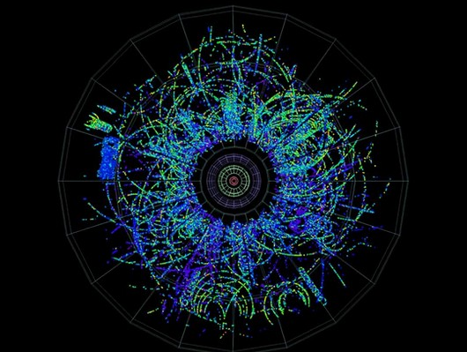
From small to LARGE systems
What can we learn from them
Collectivity in small systems !
Collectivity in small systems !
(depends on what you mean by 'collectivity')
A bit of History
State-of-the-Art
Why pp/pA interesting ?
3 Concrete Examples

Slide 2
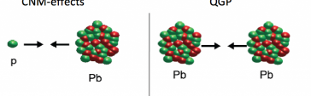
Why are small systems interesting ?
The pre- LHC answer
  pp = “Baseline”
    SEP*: Soft QCD is too difficult, hard QCD too imprecise
      lets measure what happens in ‘elementary’ collisions
  pA = “Cold Nuclear Matter” modifications Note: COMOVERS are not CNM
    IS: shadowing, energy loss of incoming partons, ↑ with √s (small x)
    FS: interaction inside nuclei (p,n) ↓ with √s (Lorentz γ)
  AA = “QGP” (hot/dense/macroscopic strongly interacting matter)
    modifications to baseline (pp) after correcting for CNM (pA) R_{AA}
The LHC “September Revolution” (21.9.2010)
p
* SEP = Somebody else's problem

Slide 3

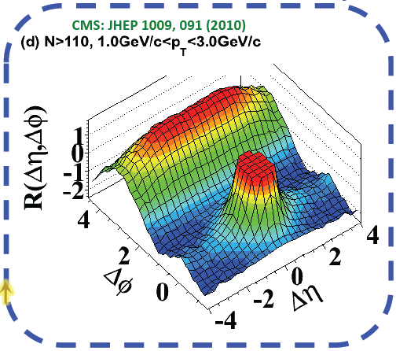
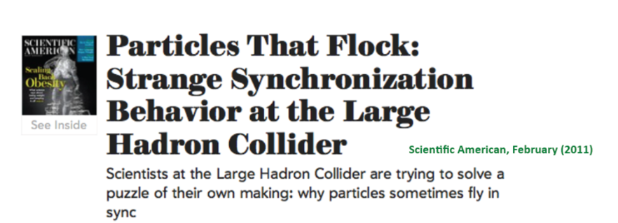
Surprise
The first LHC Discovery (pp 7 TeV, Sept 2010)
  long range rapidity ‘Ridge' in 2-particle correlations
    visible in the highest multiplicity pp collisions
    arguably still the most unexpected LHC discovery
?
'Near Side Ridge
'Away Side JET'
'Near Side JET'

Slide 4
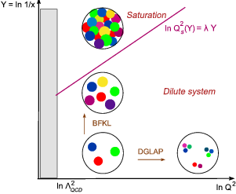
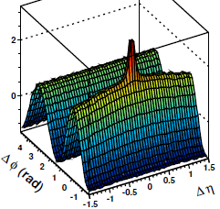
Origin of the pp 'Ridge'
Spawned a large number of different explanations
  mostly rather ad hoc, very speculative, or outright weird
IS: Color Glass Condensate CGC: 'first principles' theory
  'new state of cold & dense parton matter'
    classsical FT in high density limit (small x, small Q²)
    some success describing aspects of ep, pp, eA:
    geometric scaling, low-x, particle production, ..
FS: Collective flow (Hydro) ?
  vaguely similar correlations in nucleus-nucleus
PbPb 10-20%
Flow
pp 7 TeV

Slide 5
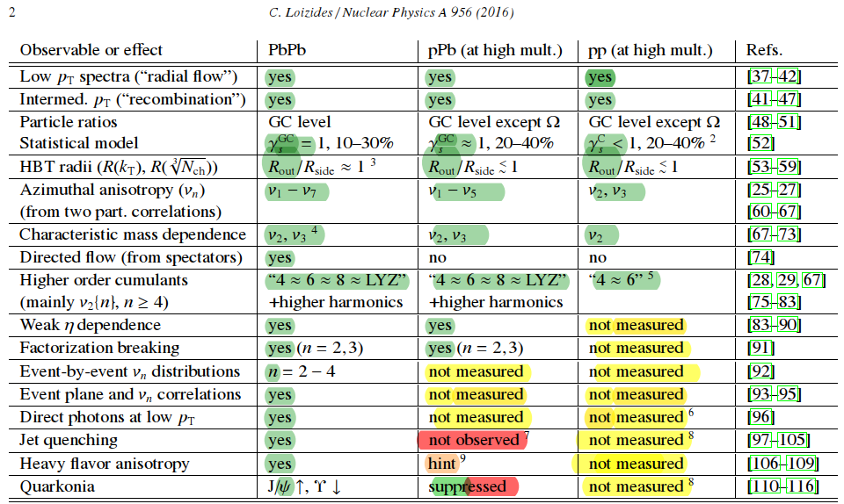
State-of-the-Art “QGP” signals
2018
?
measured
missing in this table
  low mass dileptons : seen PbPb, not seen pPb, pp
  CME, CMW: seen PbPb , pPb, not measured pp)
  column with low multiplicity pp !
Not measurable with
standard methods
BUT: eg
Y(2)/Y(1); h-jet correlation

Slide 6
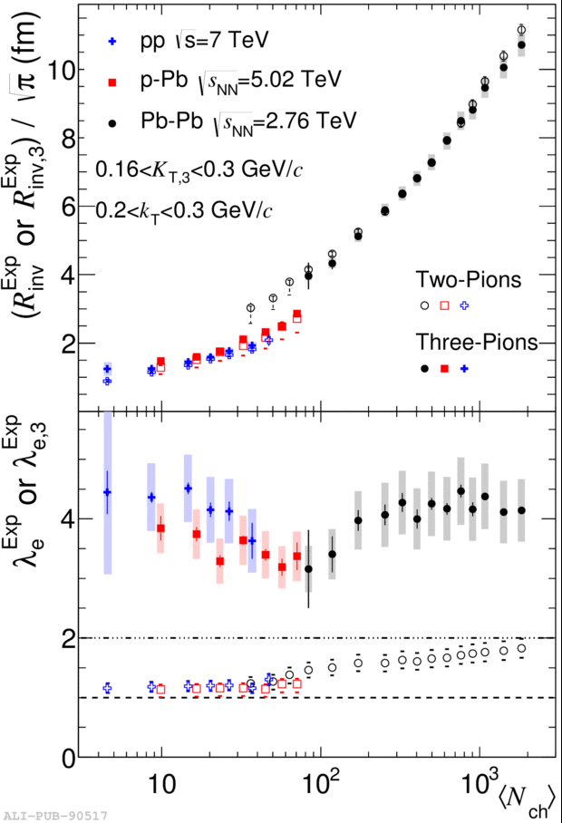

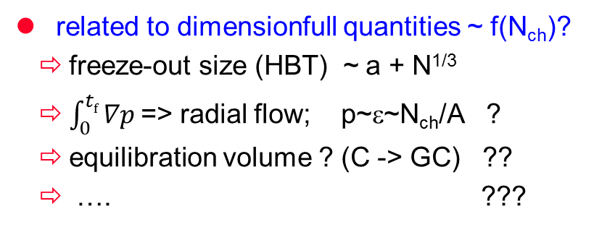
Smooth Evolution down to dN/dy ~ 0 !
HBT N_{ch} & k_{T} dependence
Charge Balance Function
space-time-momentum correlation!
PbPb
pp
ALICE EPJC 76 (2016) 86
PbPb
PbPb
pp pPb
pPb
pp, pPb
Alice 1606.07424
ALICE PRC 93 (2016) 054908
CMS 1605.06699
Strangeness Enhancement
related to dimensionfull quantities ~ f(N_{ch})?
  freeze-out size (HBT) ~ a + N^{1/3}
  $\int_{0}^{tf}{∇p }$=> radial flow; p~ε~N_{ch}/A ?
  equilibration volume ? (C -> GC) ??
  …. ???
pp
PbPb
pPb
‘Radial flow’

Slide 7
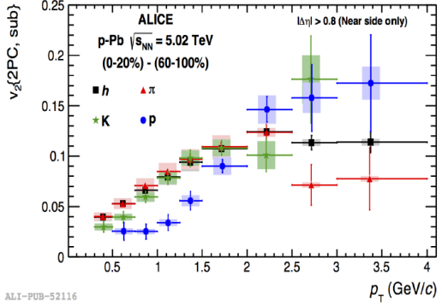
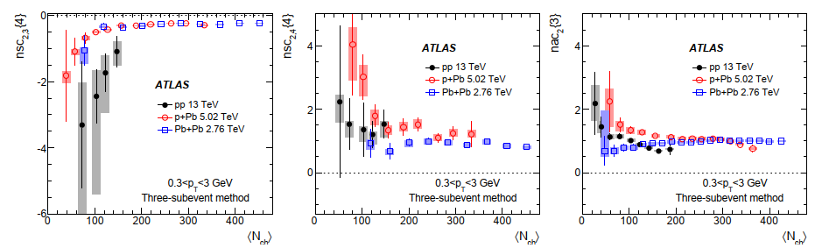
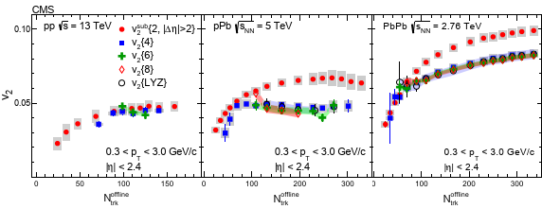
Azimuthal Flow in pp/pA
Hydro-Dynamics: pA almost as well measured as AA
  LO: radial (v₀) & directed (v₁) & elliptic (v₂) (< 2010)
  NLO: higher harmonics, cumulants, fluctuations
  NNLO: non-linear mode mixing, ..
    v_{n}≠ ε_{n}, mode coupling
    factorization violation v(p_{T1},p_{T2}) ≠ v(p_{T1})*v(p_{T2}
LO: PID v₂
NNLO: Factorization test
NNLO: mode mixing
NLO: cumulants

Slide 8
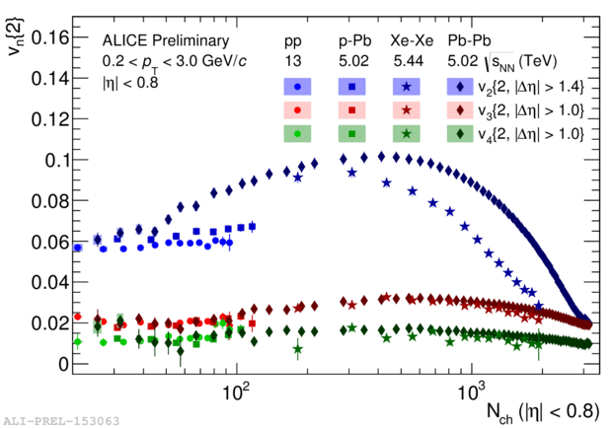
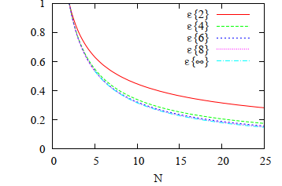
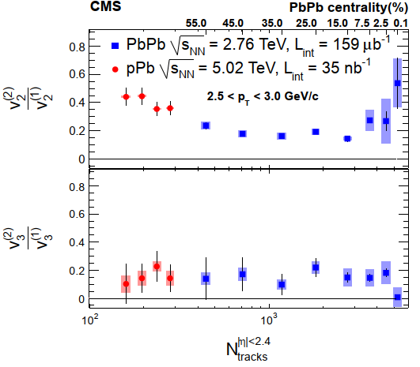
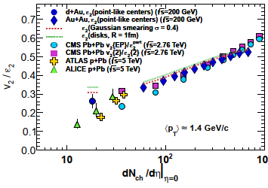
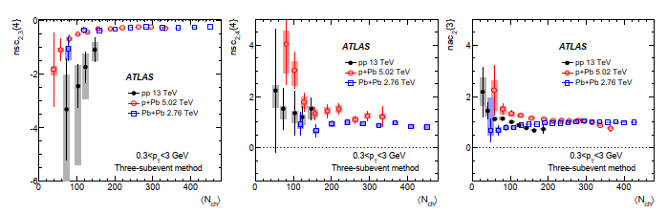

Flow magnitude fairly independent of Nch?
Geometry: eccentricity vs # sources
sublead./leading v₂ mode
(aka factorization violation)
v₂,v₃,v₄ vs N_{ch}
1312.6555
v₂
response coefficient v₂/ε
v₃
1708.07113
v₄
largely by accident !
  v_{n} ~ κ ∗ ε
    κ ↓ ~ 1/(1+S/N)
    ε ↑ ∼1/√N
Normalized Symmetric Coefficients
(aka nonlinear mixed harmonics)
1106.4345
1807.02012
1303.1794

Slide 9
Why are small systems interesting ?
'Looking under the hood': what makes the sQGP tick ?
  stat. mechanics (thermo & hydro) hide very well the details: d.o.f & dynamics
    strength & limitation: same results for different underlying 'stuff' (theories/models)
    thermal system knows nothing about how and why it arrived in equilibrium
  go towards and beyond the limits of thermo & hydro
    study deviations due to finite size/finite time (=> small systems)
'Looking for the onset': how does (strong) collectivity emerge f(r, t) ?
  change size & lifetime & density (pp -> pA -> AA)
'Looking for the beginning': universal aspects of soft QCQ ?
  looking for connection & smooth evolution from
  MB pp(e⁺e⁻) to central AA, with pA the bridge in between

Slide 10
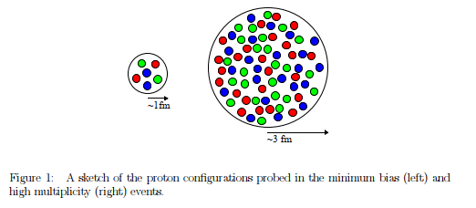
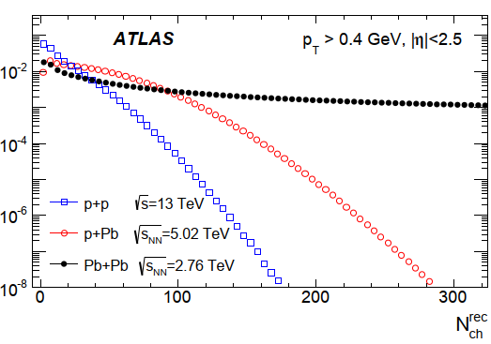
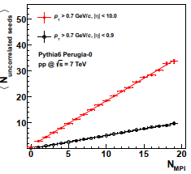
What are we looking at ?
The effect of the fluctuating proton size on the study of chiral magnetic effect in proton-nucleus collision https://arxiv.org/abs/1712.02486
N_{ch} distribution
N_{rec}/2.3
≈ dN_{ch}/dη
parton content of p@LHC (QM2008)
pp@LHC
≈ central SS@SPS,
≈ mid-central CuCu@RHIC
  dN/dη ≈ 50 - 100
  N_{MPI} ≈ 15-20 (≈ N_{coll})
 | SPS | RHIC | LHC
# of partons in proton 3 + ∫ g(x > 2GeV) | 4 | 10 | 30
high p_{T} tracks vs # Multi Parton Interactions

Slide 11
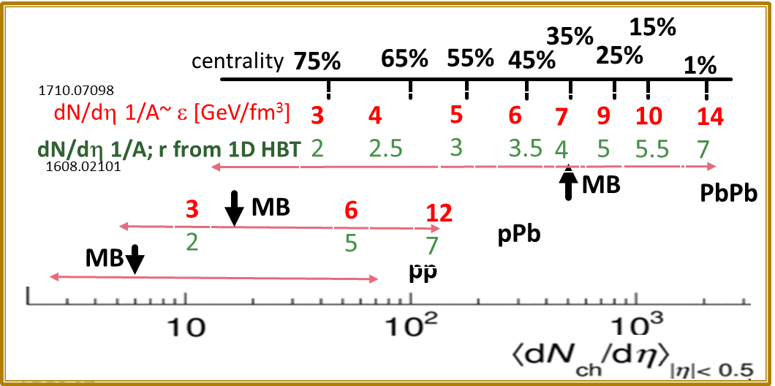
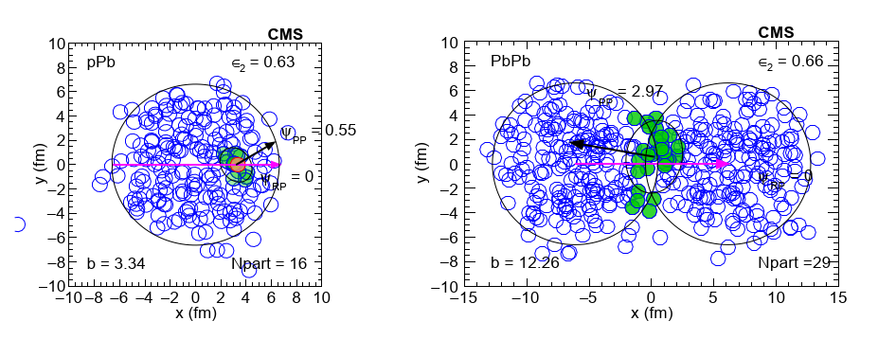
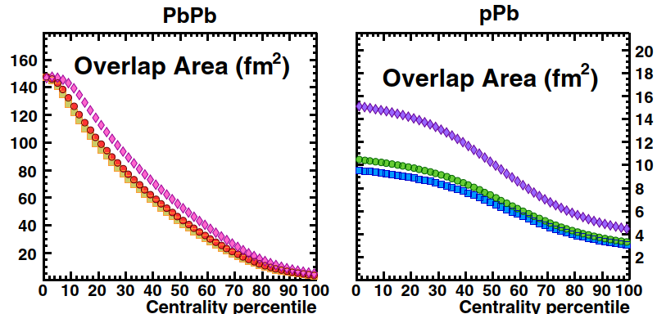
What are we looking at ?
N_{rec}/2.3
≈ dN_{ch}/dη
central AA: dense & large
central pp/pA: dense & small
  ε ≈ AA, S ≈ 1/10 @ same dN/dη
peripheral AA: dilute & large
  ε: pp≈pA»AA S: pp≈pA«AA @same dN/dη
MinBias pp: dilute & small
Proton Area S ?
60 mb/4 => A = 1.5 fm²
r_{rms} = 0.88 => A = 2.4 fm²
r_{HBT}(MB) ~ 1.1 => A = 4 fm²
pp Area ?

Slide 12
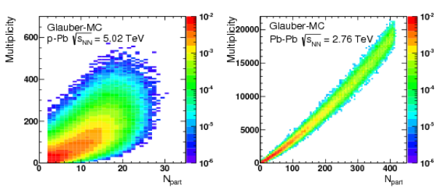
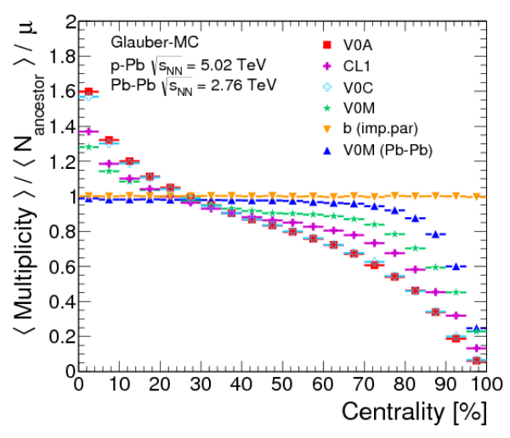
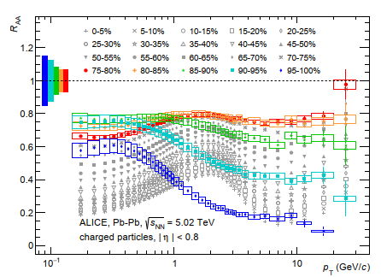
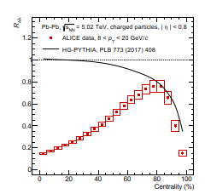
Small systems are tricky !
centrality ≠ geometry (b,N_{part}, ε,..)
  R_{pA} type measurements extremely difficult
  revealed strong R_{AA} bias in peripheral (> 60%)
    no measurable jet quenching
    for very peripheral !
N_{ch} vs N_{part}
R_{AA} vs p_{T}
R_{AA} (p_{T} > 8) vs centrality
95-100%
N_{ch}/N_{part} vs centrality
Phythia bias
PbPb !
R_{AA} ≈ 1 for > 75%
no (measurable)
jet quenching
95-100%

Slide 13
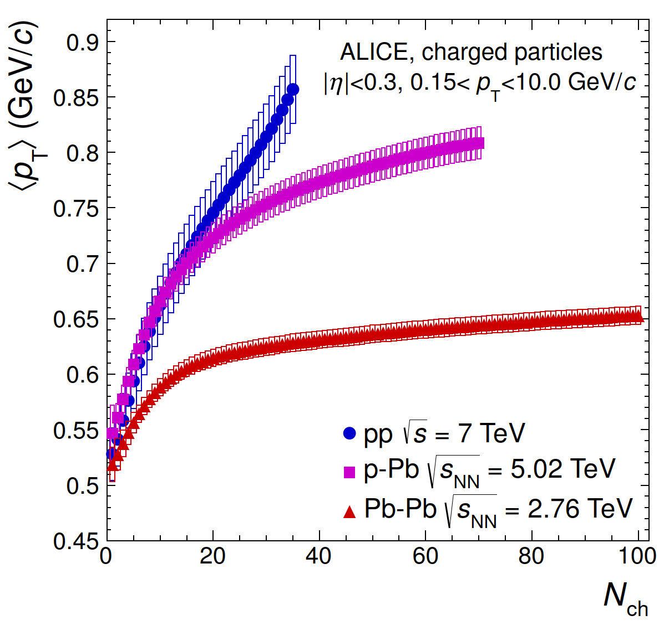
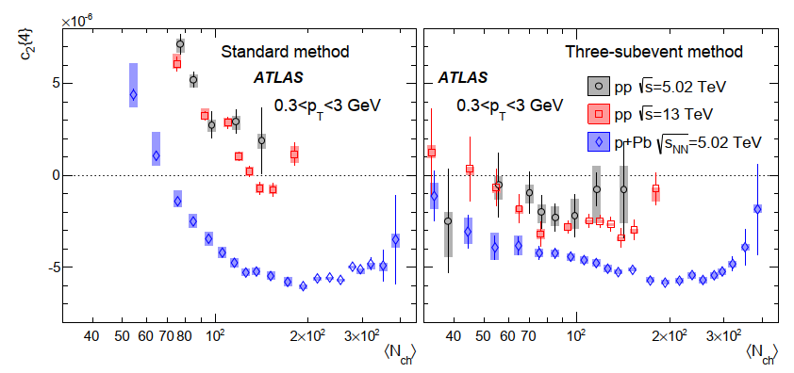
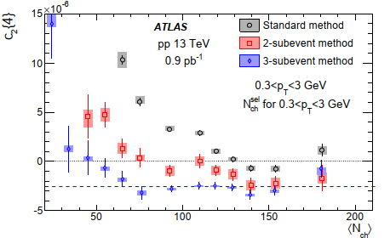
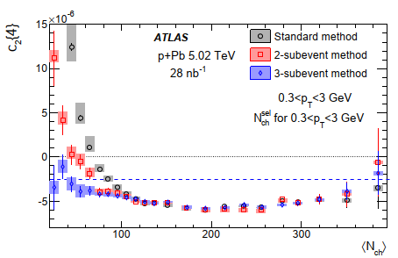
Small systems are tricky !
dynamics bias depends on system and N_{ch} in general stronger in pp than in pPb
<p_{T}> vs N_{ch}
nonflow
~ 1/N
flow ~ const.
c₂{4} vs N_{ch}
v₂ = √-c₂{4}
in general bias is
stronger in pp than in pPb (@ same N_{ch})
=> better (& easier) to use pPb than pp
c₂{4} vs N_{ch} pp
c₂{4} vs N_{ch} pPb

Slide 14

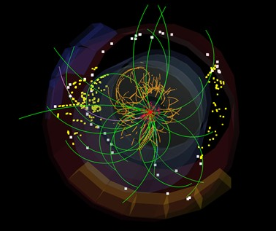
1) Onset: “Flow-like” Collectivity down to dN/dy ≈ 0 ?
=>
7 TeV pp Min Bias
Large&Dense (AA) <-> Small&Dense (centr. pA) <-> Small&Dilute (MB pp)
  TH relevance:
    far outside applicability of statistical mechanics (thermo/hydro)
    special property of sQGP (HIP) -> generic property of QCD (HEP)
  Experimental issue:
    tiny signal, large background (‘non-flow’)
    new analysis methods, new observables ?

Slide 15
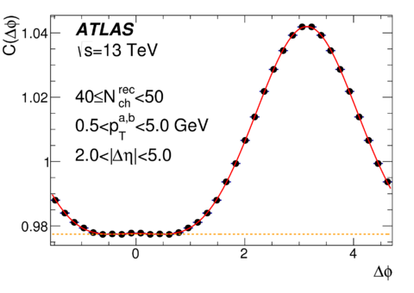
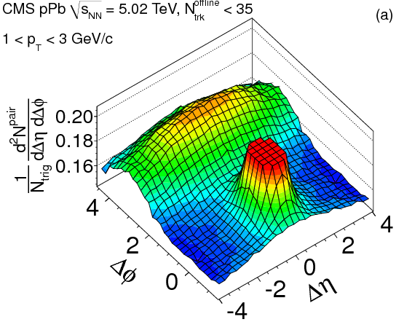
How far down in N_{ch} ?

Slide 16
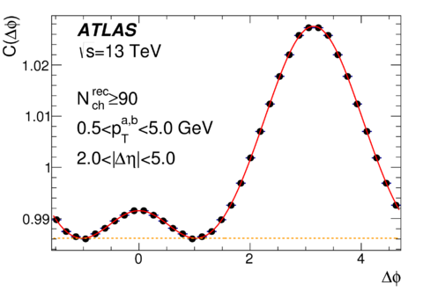
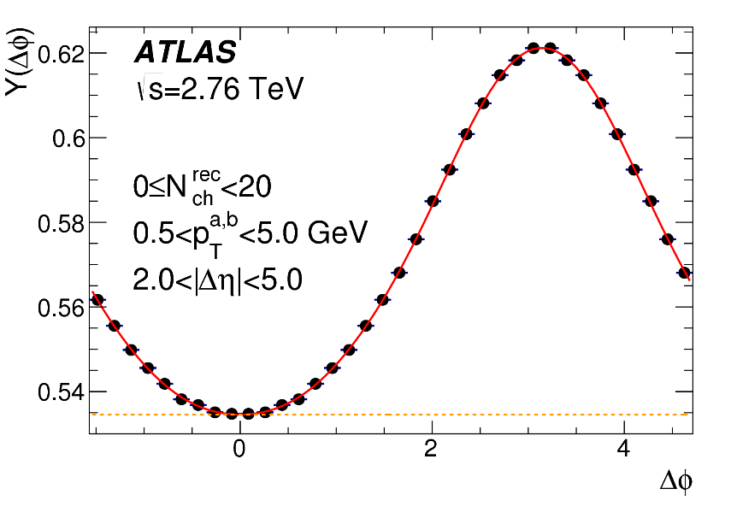
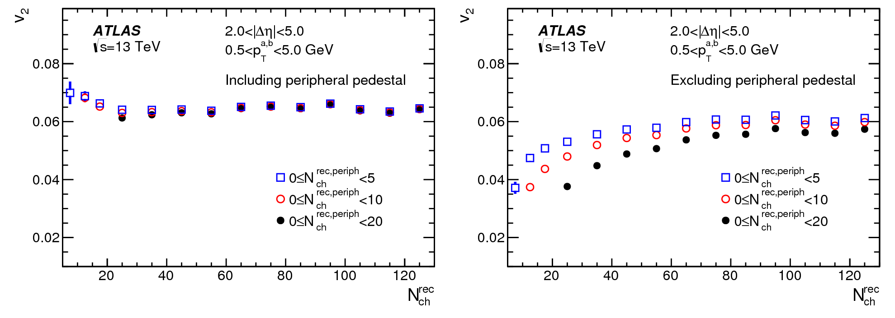
How far down in N_{ch} ?
Assumption: v₂(bin-0) = v₂(bin-1)
Assumption: v₂(bin-0) = 0
dN_{ch}/dη ≈ 3!
MB
MB

Slide 17
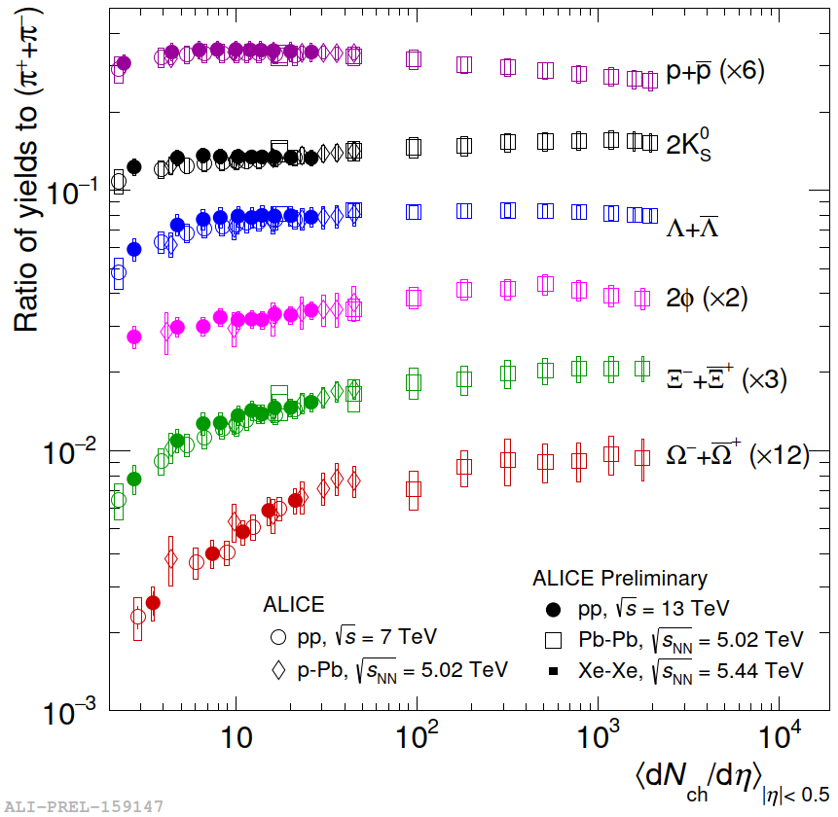
How far down in N_{ch} ?
Questions (2016) & Preliminary Answers (2019)
concerning the “Onset”
  How far down in dN/dy can we find ‘collectivity’ in pp ?
    conceivably dN_{ch}/dη ≤ 3 (< ½ MB)
  What about e⁺e⁻ (no IS geometry, no MPI)
    QM18: no positive signal (upper limits)
  What is the scaling variable (dN/dy, 1/S dN/dy, ε, ..) ?
    ???
  New observables/analysis methods to reduce ‘non-flow’
    Δη gaps, 3(4)subevent method, ..
    “1st-bin” problem unsolved (what would be the “baseline” ?)
pp MinBias

Slide 18
2) Under the Hood: HD-Hydro vs LD-Transport
The questions are NOT:
Can hydro be described by transport ?
Yes, transport theory often IS the microscopic physic of hydro**
Will transport smoothly evolve from free streaming to hydro?
Yes, with in(de)creasing Knudson number (R/λ_{mfp})⁻¹
=
?
Two sides of the same coin (different approximations but similar results)
Or
Different physics & different observable consequences
7 TeV pp Min Bias
K= λ/R << 1
High Density Paradigm: Hydro: # collisions/particle >> 1
  Pressure Tomography: driven via pressure gradients in momentum space
Low Density Paradigm: Transport # collisions/particle < 1
  Density Tomography: driven by density gradients in coordinate space
The questions IS:
Are HD hydro and LD transport observationally distinct ?
i.e. qualitative or significant quantitative differences
in any/all of the relevant systems (pp, pA, AA)
** AdS/CFT
is an alternative

Slide 19
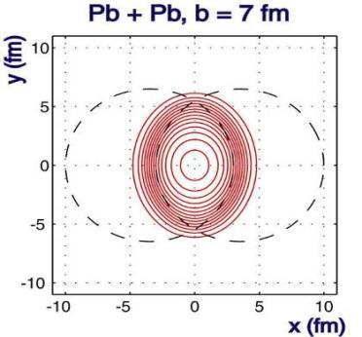
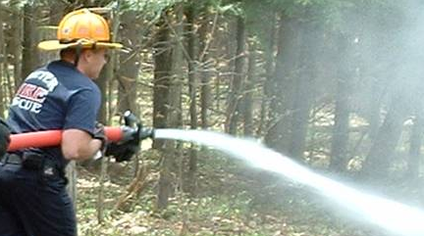
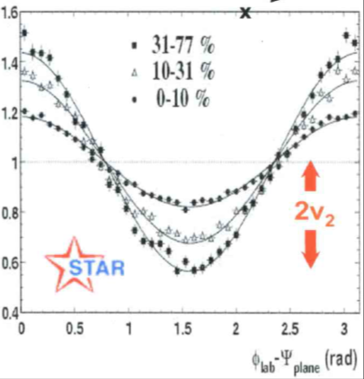
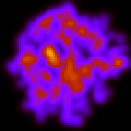
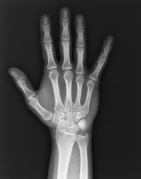
What connects IS and FS ?
Object: Density distribution in XY Space
Picture: Density distribution in XY Space
Multiple scattering of most particles
P_{y}
P_{z}
HD Hydro
y
P_{x}
x
Pressure Δp_{x} > Δp_{y}
All particles close in space have similar momenta
IS Information is in the ‘flowing’ stuff !
dN_{ch}/dφ
LD Transport
x
y
Single scattering of a few particles
All particles drawn from the same single particle probability distribution
IS Information is in the
‘non-interacting’ stuff !
escaping
interacting

Slide 20
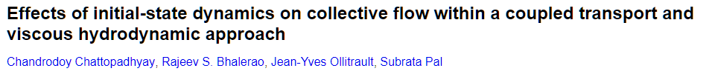
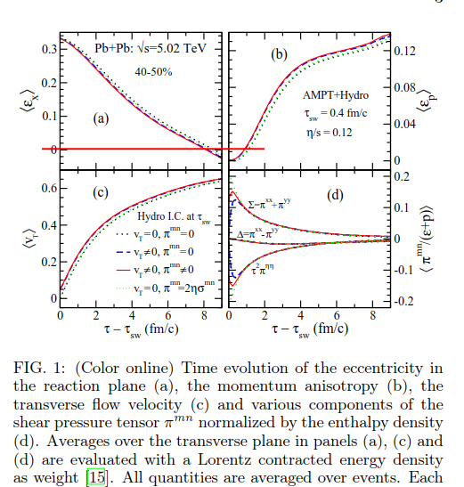
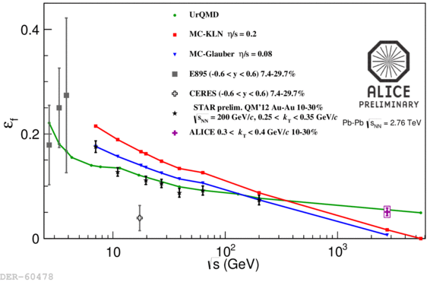
Discriminator I: Expansion Dynamics ?
1710.03050
Prolate ε_{x} > 0
Spherical ε_{x} = 0
Oblate ε_{x} < 0
Conclusion:
There ARE qualitative & observable differences
ε_{f} < 0 => Hydro
Hydro: pressure driven
Can overshoot into oblate (ε_{x} < 0)
Azimuthal HBT: ε @ freezeout
HD hydro vs LD Transport
in pp/pA/AA
Question is still open
may need experimental input
Hydro
LDL: Free streaming
Approaches spherical by ‘dilution’
Geometric shape change (ellipse -> circle) generates nonlinear mode couplings in both HD & LD !
The time evolution however is (presumably ?) much faster in HD and can go ‘beyond round’ !
(e.g. Urs, 1803.02072, 1805.04081)
UrQMD

Slide 21
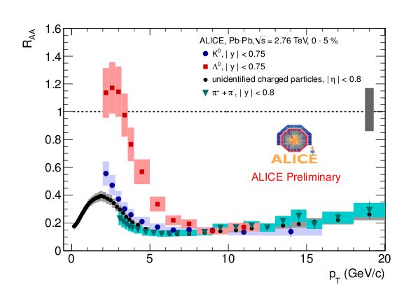
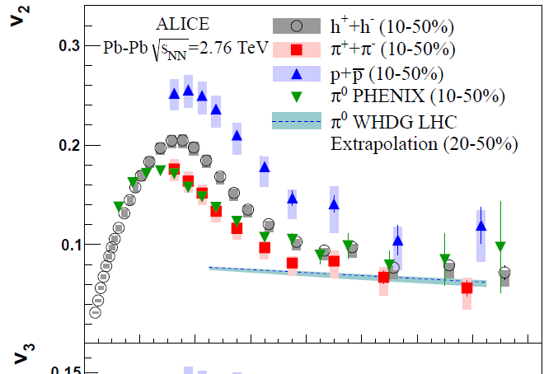

3) What happens after Hydro ?
mass matters, up to a point (again, p_{T} ≈ v₂)..
  presumably, 'falling out of hydro' is a smooth process (over large p_{T} range)
    do we need new physics (eg coalescence) at intermediate p_{T} (4-10 GeV) ?
    or a smooth transition between (hydro+thermo) and (jets+fragmentation) ?
Hydro
?
pQCD
Varying size & density:
What effect in intermediate p_{T} ?

Slide 22
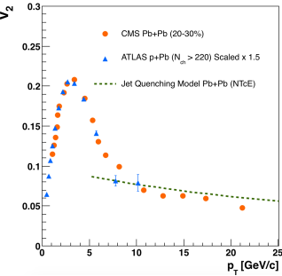
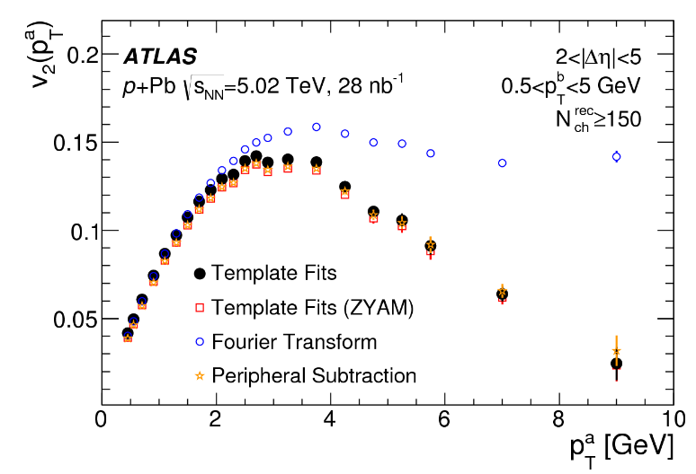

High p_{t} v₂ & Energy Loss
v₂ vs p_{t}
  < 5 GeV: full Hydro
  5-10 GeV: decoupling
    “incomplete hydrodynamization”
  > 10 GeV: jet quenching
Flow ?
Energy Loss ?
Seems we can ‘switch off” jet quenching and study
the hydro decoupling regime in detail in pA !
Data Consistent With:
full hydrolization < 3 GeV
gradual decoupling 3-10 GeV
no (small) E loss in small & dense sytems
(formation time ?)
1801.03477

Slide 23





What else can we learn …
“Non-QGP” physics in pA
  Nuclear pdfs
    shadowing, saturation,
  Color Glass Condensate physics @ small x, large η
    existence (dis)proof for interesting CGC physics at EIC/eRHIC ?
  “Weird” forward (large-x) jets (correlation Q² ↔ “event activity”)
    IS energy loss (‘jet quenching’ in CNM)
    p size (cross section) fluctuations -_ Glauber Gribov
  Ultra-peripheral:
    γ-p (A = source of γ)
Constraining gluon distributions in nuclei using dijets in proton-proton and proton-lead collisions at sNN−−−√= 5.02 TeV
https://arxiv.org/abs/1805.04736
1412.4092

Slide 24


Small Systems .. wherever they lead..
Confront and ‘digest’ the size/density systematics
  Factorize & separate into different pp (CR, CGC) and AA (QGP, hydro) physics ?
    naturally & economically, without epicycles..
    where to put pA ?
  Incorporate into a united thermo & hydro sQGP picture ?
    extend ‘dense matter’ framework down to zero density, non-equilibrium (LDL)
    extend ‘dilute transport’ framework up to central AA (AMPT like ?)
(personal) Hypothesis: The physics underlying soft 'collectivity' signals is the same in AA, pA, and pp:
Even if dominant in AA and hardly discernable in pp
It is a generic property of all strongly interacting many-body (≥2?) systems.
The understanding of soft hadronic physics is changing under the onslaught of LHC pp data …
.. we have an interesting and challenging time ahead of us, where some of the most unexpected new LHC observations may well come in the low-p_{T} region rather than the in high-p_{T} one.
Thermodynamical String
Fragmentation
T. Sjöstrand 1610.09818

Slide 25
Backup

Slide 26


Other Consequences ?
Soft-Hard correlation (both v₂ and R_{AA} ~ ε)
  soft & hard linked to same physics: single scattering + density in homogeneities
Quasiparticles ⬄ Ideal Fluid; value of η/S, ……
HD hydro vs LD Transport
same-same or different ?
Question is still open
may need experimental input
1805.04081

Slide 27

Collectivity
weak (mathematical) definition:
  SIMILAR effect/probability for ALL particles (of some kind, say p_{T}/PID) in (almost) ALL events
    drawn from the same inclusive single particle probability distribution (e.g. dN/dφ)
    probability can be arbitrarily small ! as long as it’s the same for all particles/events
  Collectivity is experimentally proven in AA & pA
v₂{2}< v₂{4}≈v₂{6}≈ … ≈v₂{∞}

Slide 28
‘Collectivity’
'Standard Model' of heavy ion physics
strong definition: {'thermo' + 'hydro'} - dynamics
  emerging-f(t)- strongly interacting equilibrated matter with density/pressure gradients
  hydro-dynamics:
    LO: radial (v₀) & elliptic (v₂) flow for > 95% of all particles (p_{t} < few GeV)
    NLO: higher harmonics v_{n}, PID (m dependence) of v_{n} ('mode mixing' of v₀ & v₂)
    NNLO: non-linear mode mixing (v_{n}≠ ε_{n}), factorization violation r(p_{T}), EbE P(v_{n}), …
  thermo-dynamics:
    particle ratios (Statistical Model) to 10-30%
    in pp/pA: γ_{s} -> 1
  thermo + hydro: => Space Time Evolution (STE)
    HBT f(T, β): (R(m_{T}), R(N_{ch}^{1/3}), R_{out}/R_{side} ≈ 1)
    Charge Balance functions
strong Collectivity consistent with ≈ all data in pp/pA/AA
to (very) good accuracy, where it was measured..

Slide 29





A priori: pp ≈ pA @ same dN/dy
LO pp = pA: N_{ch}, transverse size & shape => Initial State ε(x,y) similar:
  experimentally verified: final state R(pp) ≈ R(pA) < R(AA) @ same N_{ch} (≈ N_{part})
  IF there is collectivity in central pA, THEN there is no reason why not in 'central' pp
NLO pp ≠ pA: some differences expected
  MPI vs N_{coll}, transverse ε-profile,
  dσ/dN => bias, jet fraction, ..
<p_{T}> vs N_{ch}
HBT:
R vs N_{ch}
BW fit: T_{kin} vs β
pp closer to pA than pA to AA
as expected…

Slide 30
Facts & Fiction
Experimental facts:
  weak collectivity proven in AA, proven in pA, limited knowledge in pp
    'all particles in all events' must be part of any physics model
  strong coll. (thermo & hydro) compatible with vast majority of data in AA & pA
    some areas need work, some tests missing in pA
  limited data in pp at high N_{ch}, but compatible with SC !
    final state (HBT, p_{T}-spectra (v₀), ridge (v₂), part. ratios ): pp ≈ pA @ same N_{ch}
Hypothesis: There IS* collectivity in small systems at high N_{ch} !
  1) pA ≈ AA: mostly based on measurements (@same N_{ch})
    many similar phenomena <=> similar underlying physics
  2) pp ≈ pA: based on a priori expectations, increasingly on measurements
    similar IS & FS in pp and pA @ same dN/dy => similar collective physics
    mind the stronger jet-bias in pp !
  3) ≈ ≠ =: differences are interesting and important to study !
    finite size/finite time/non-equilibrium effects teach us about dynamics
* of the same type as in large systems, i.e. AA

Slide 31





The unreasonable success of AMPT
nucl-th/0312124
AMPT in 2003 had correct higher harmonics (v₃, v₄, ..)
i.e. initial state fluctuations and nonlinear hydro,
and nobody noticed !!

Slide 32
AMPT transport
Dynamics is definitely oversimplified and probably wrong
                ‘Micky Mouse billiard balls’ with tons of parameters
  however, the hydrodynamics seems correct !
    what counts is ‘lots of interacting stuff’ (string melting + few mb σ)
Common wisdom: AMPT = (a) kinetic transport underlying hydro
  and as such smoothly extrapolates to dilute & small systems with large K
Monkey wrench: ‘Anisotropic parton escape is the dominant source’ (1502.05572)
escaping
d-Au
interacting
Au-Au
Information is in the
‘non-interacting’ rays !
<N_{col}> = 5 (1) in AuAu(dAu)

Slide 33

AMPT & Hydro in pp
So far, both describe small & dilute systems
2) Open Questions:
- Are HD hydro and LD transport observationally distinct ?
If yes, which regime are we in pp/pA/AA
(various indications that even AA is not in full therm+hydro equil.)
If no, why does hydro work so well where it shouldn't ?
(and what do we measure in pp, η/s means what ?)
http://arxiv.org/abs/1404.4129
1701.07145
Possible differences:
Direct photon v₂ ?
Nonlinear mode mixing (v₄~v₂²) ?
Shape evolution: pressure vs free streaming ?
Hydro:
more gradient
more flow
more N_{ch}
more γ ?
Transport:
less matter
less scattering & BS
more N_{ch}
less γ ?

Slide 34

Centrality in Large Systems is ‘trivial’
cc
A few minutes after the first Pb collisions at LHC:
Copy from logbook (predicted calibration: 9 hits = 1 dN_{ch}/dη )
Data Quality Monitoring
considered event size fatal !
TPC event size (in Mbyte); calibration was unknown..

Slide 35

HBT radii vs Nch
pp ≈ pA < AA

Slide 36
PYTHIA8 no flow added

Slide 37
PYTHIA8 add ATLAS v2 (~5%)

Slide 38
PYTHIA8 add CMS v2 (flat before sub)

Slide 39
Some test in MC
Use PYTHIA8 13 TeV pp sample + linear V₂^{input} signal
ATLAS method does not work
CMS method shows over-subtraction, but deviation is smaller towards high multiplicity
PYTHIA8
13 TeV pp
pT 0.3-3GeV
PYTHIA8
13 TeV pp
pT 0.3-3GeV

