Slide 1
Advanced Computing and Cyberinfrastructure in the US : The View from the Texas Advanced Computing Center.
Dan Stanzione
Executive Director
Austin, TX
dan@tacc.utexas.edu

Slide 2
Outline
A little about TACC
My observations around the changes in computational and data science and engineering.
The landscape in the USA.
Our new Stampede-2 platform, that reflects some of these trends.
What TACC is doing about it to evolve and respond

Slide 3
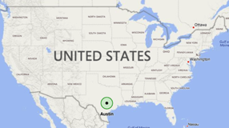
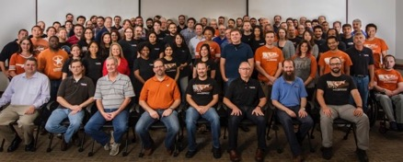
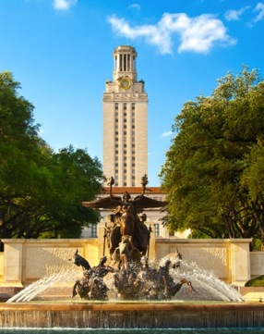
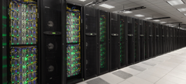
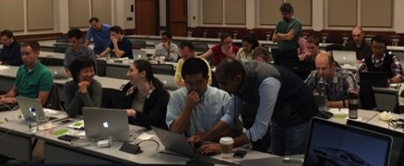
TACC AT A GLANCE
Personnel
  160 Staff (~70 PhD)
Facilities
  12 MW Data center capacity
  Two office buildings, Three Datacenters, two visualization facilities, and a chilling plant.
Systems and Services
  A Billion compute hours per year
  5 Billion files, 50 Petabytes of Data, Hundreds of Public Datasets
Capacity & Services
  HPC, HTC, Visualization, Large scale data storage, Cloud computing
  Consulting, Curation and analysis, Code optimization, Portals and Gateways, Web service APIs, Training and Outreach

Slide 4
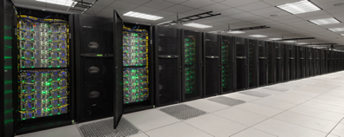
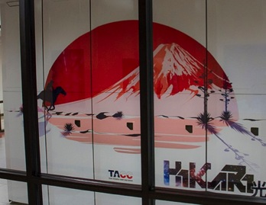

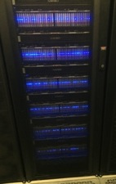
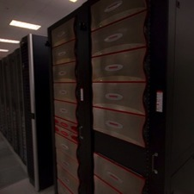
Extreme Scale Supercomputing
Stampede-2
~ #12 HPC system in the world for computation 350k CPU core 18 PF
Lonestar 5
Texas-focused Cray XC40 30,000 Intel Haswell cores 1.25 PF
Wrangler
0.6 PB usable DSSD flash storage w 1 TB/s read rate + 10 PB Lustre
Maverick
132 Fat nodes w dual 10 core Ivy Bridge + NVIDIA Kepler K40 GPGPU
Chameleon & Jetstream Cloud
1400 nodes OpenStack
Disk and Tape Storage
100+ PB storage in HIPAA-aligned data center
Hikari
380V DC Green computing system parternship with NEDO and NTT. 10k Haswell cores. HVDC and Solar (partial)
Support for container ecosystem
Notes:
Talk a little about what we mean by BIG INNOVATIVE SYSTEMS
Then, spend the rest of my time talking about how we are HELPING PEOPLE GO FAST
Cloud systems weave all this together
We also have testbed systems online or coming in next 6 mo
Altera FPGA, POWER/NVIDIA, HP APOLLO powered by solar HVDC

Slide 5
TACC supports an Incredible Amount & DIVERSITY of Research
Our request rate continues to be about 5-6x what we can deliver (cycles).
  More than 2,000 unique users run jobs in any given month
    (More than 12k people have run in production on Stampede, spanning 3,500+ projects).
  2+ million successful jobs last year.
  We estimate well 0ver 35,000 use TACC systems via Web or API.

Slide 6
[Broad Trends: My oBSERVATIONS in Computational Science]
Notes:
mention we were tasked to include an experimental HPC component

Slide 7
Broader HPC Context
More cores (or GPU), complexity and concurrency rapidly increasing, apps not keeping up.
  Hundreds of thousands of cores commonplace.
  Even ”traditional” CPUs have reached 24 cores per socket.
  GPU has spread some – particularly in Machine Learning -- but still can’t handle some of the scientific workload.
    In the Blue Waters SPP benchmark suite, only 3 of 11 *self-selected* applications have full CUDA ports – and several can’t be run *at all*.

Slide 8
Broader HPC Context (2)
Divide between ”high end” and ”Broader science”
  None of the new leadership systems rely on “conventional” processors anywhere in the world.
    Phi, GPU, and more exotic things, plus some increasing heterogeneity.
    DOE:
      Theta (Argonne), Cori (NERSC), Trinity (LANL) on Knights Landing
      Summit/Sierra >90% GPU.
  Meanwhile, a huge amount of computational engineering and science is heading the other direction.
    Rise of R, Python, Matlab.
    Push towards interactive analysis with JuPYter, etc.
    Vast user communities entering via Web Service/Science Gateway
      Often with virtually zero ”traditional” computational skills, i.e. command line, C/Fortran coding; less than zero in parallel programming, performance tuning, etc.

Slide 9
US CYBER TRENDS: The University Space
In absolute terms, the investment in HPC is falling.
A lot of this is because the total investment in Cyberinfrastructure is the same, but the number of CI demands is increasing:
  Recognition of long term underinvestment in software
  Recognition of the need to also invest in workforce
  Investment in datasets, data infrastructure, machine learning, and cloud.
    Data Infrastructure Building Blocks, Big Data Hubs, Research Data Alliance
    Domain specific efforts like Earthcube and Cyverse.
These have become competing priorities, instead of complimentary ones.
  Which is, in my opinion, unfortunate.

Slide 10
US CYBER TRENDS: The University Space
Machine Learning/Deep Learning is both a real thing that needs attention, and also a concept on the ”hype curve” that is eating perhaps too much attention.
  Demand for GPUs for network training has ruined GPU discounts for HPC!!! (Perhaps not really a crisis)
There seems to be a slow realization that the fundamental algorithms for ML/DL, and the fundamental algorithms behind, say, Partial Differential Equations, are not that different.
  Is back propagation of a neural network that much difference than matrix inversion?
  In the end, isn’t it all just calls to GEMM?
  If the math is similar, likely the scalable systems are too.

Slide 11
[Some progress on those complex high end chips]
Notes:
mention we were tasked to include an experimental HPC component

Slide 12
Stampede-2 at TACC
Phase 1 of Stampede-2 just entered full operations June 12th!
4,204 Intel Xeon Phi “Knights Landing” Processors.
  68 cores, 4 hardware threads per core, 512 bit vectors
  Relatively low clock rate (1.2-1.4Ghz)
  High Bandwidth Memory (MCDRAM) on package; 16GB that can be used as cache or user-managed flat memory space.
Lots of extra complications for programmers!!!

Slide 13
Early Results --Generalizations
Everything runs, but. . .
  Carefully tuned codes are doing pretty well, but with work.
  “Traditional” MPI codes, especially with OpenMP in it do relatively well, but not great.
  Some codes, particularly, not very parallel ones, are pretty slow, and probably best run on Xeon.
Mileage varies widely – but raw performance isn’t the whole story.

Slide 14
Our Experience with Xeon Phi
Xeon Phi looks to be the most cost and power efficient way to deliver performance to highly parallel codes.
In many cases, it will not be the fastest. For things that only scale to a few threads, it is *definitely* not the fastest.
But what is under-discussed:
  As far as I can tell, a Dual-socket Xeon node costs 1.6x what a KNL node costs, even after discounts.
    A dual-socket, dual GPU nodes is probably >3x a Xeon Phi node.
  A KNL node uses about 100 less watts per node than a dual-socket Xeon node.

Slide 15
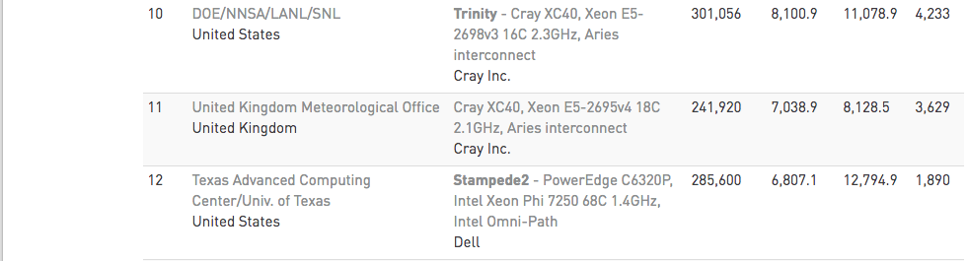
Power from Top 500
List unveiled last week at ISC17 in Frankfurt
Stampede-2 uses half the power of a roughly equivalent performance system (see 11 vs 12)

Slide 16
Our Experience with Xeon Phi
Xeon Phi looks to be the most cost and power efficient way to deliver performance to highly parallel codes.
Is “fastest” our only metric? Are we maximizing for an individual user, or most Science &Engineering computing output for the amount of investment?
  In straight Xeon, we would have had at least a thousand less nodes.

Slide 17
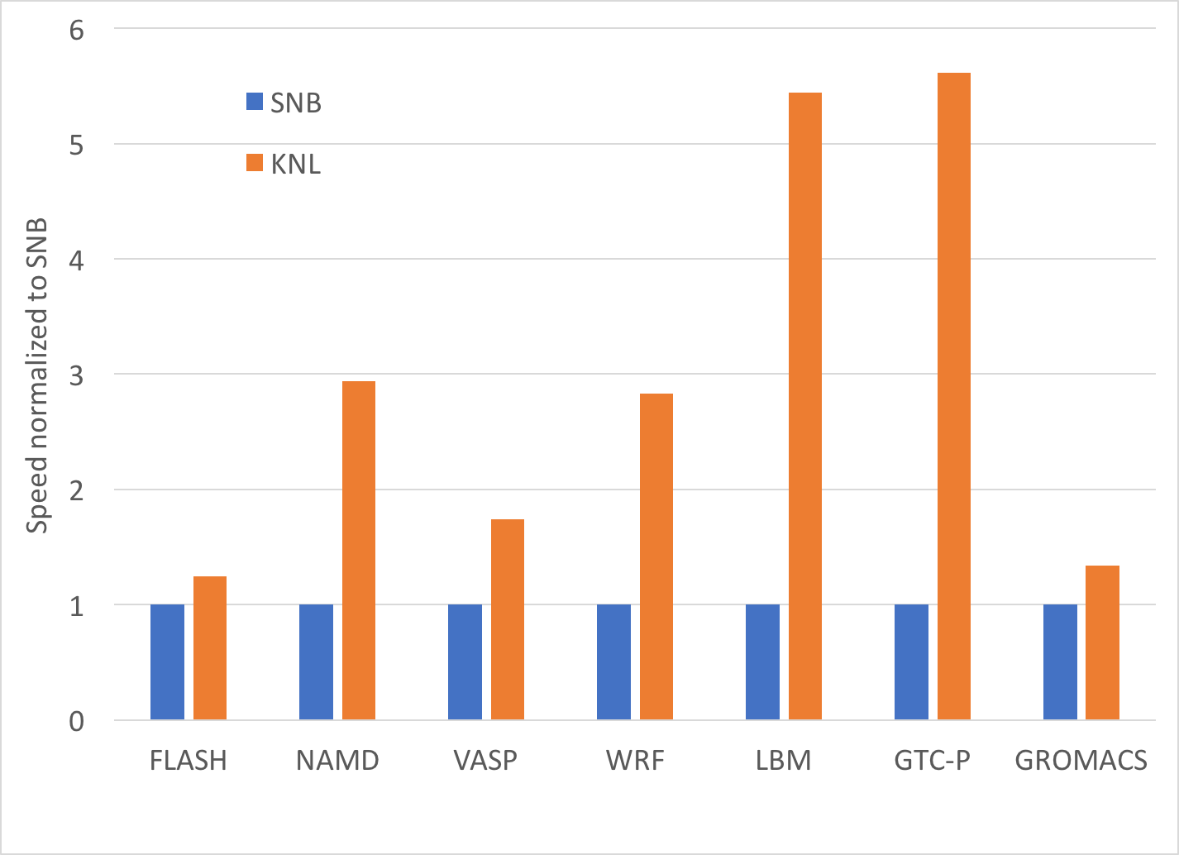
Reference Application Graph
Measured Performance between Stampede and Stampede-2 nodes.
Codes are unmodified versions, as checked out from the source repository, to accurately reflect the “average user” experience.
(There is nothing less fair than comparing optimized codes on one platform to un-optimized codes on a different platform – except maybe US Politics. )

Slide 18
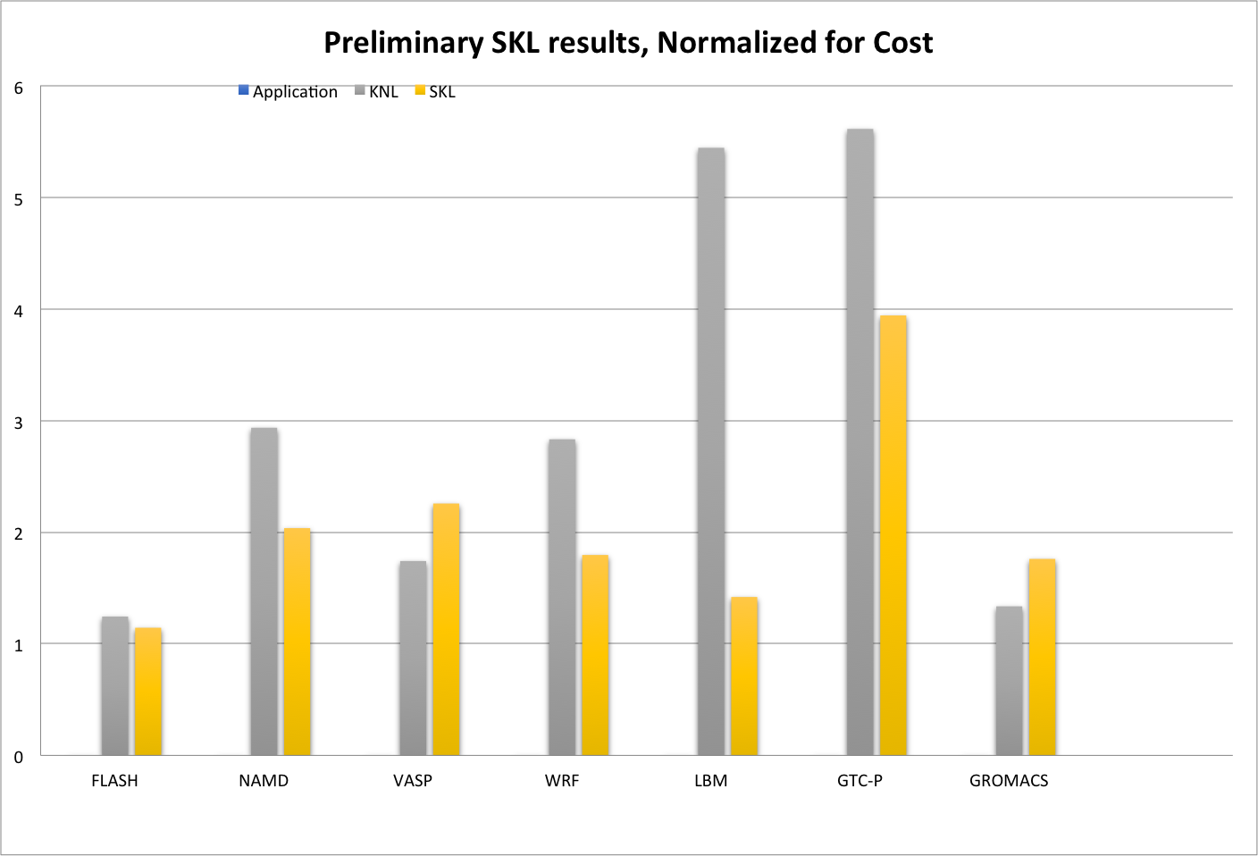
Reference Application Graph –Normalized for Cost
This compares Xeon Phi Performance on major parallel applications to our projections for “Sky Lake”, the next generation Xeon, in a dual-socket configuration with top bin parts.
The KNL wins on price-performance in many applications with *no* optimization (but not always in absolute performance!).

Slide 19
Machine Learning Apps

Slide 20
Stampede 2 Design
Stampede 2 supports a wide range of use cases – but not all of them.
We have broadened our array of systems to deal with some of these issues:
  Wrangler (high speed/high IOPS Flash filesystem – Hadoop/Spark and other metadata-intense workloads
  Jetstream – OpenStack Cloud – JuPYter Hub and interactive uses.
  Maverick – GPU-based for interactive visualization and certain ML/DL use cases.
  Chameleon – Bare metal access to support computer science research
  Hikari – Support for protected data (personalized health information)
Systems aren’t enough. . .

Slide 21
The NEW E-Science
Many of the challenges we see today are largely driven by large scale computation – And computation centers like mine have of course focused on these kinds of problems for decades, with tremendous success – but many new kinds of problems are not just about computing.
The new E-science is largely a problem of integrating, at scale, data collection, curation, and storage with advanced computing and analysis (mining, visualization, machine learning).
A few examples of the “new” model:

Slide 22
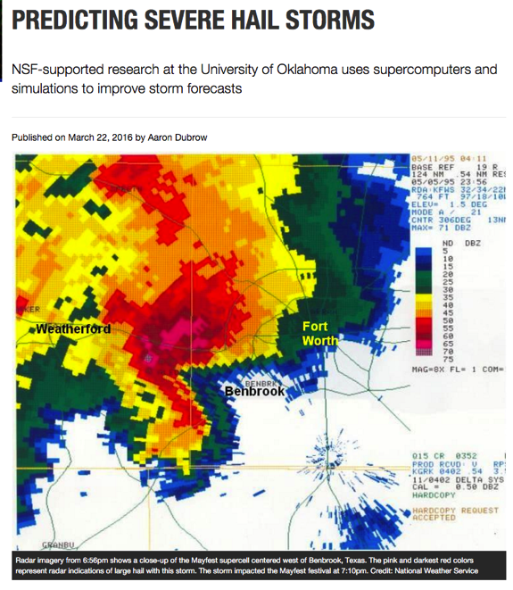
E-SCIENCE ADVANCES RESEARCH PACE AND OUTCOMES
Blending Ensemble Simulations, data ASSIMILATION+INTEGRATION, and Machine learning EXTENDS hail forecasts from 2 hours to 24 hours

Slide 23
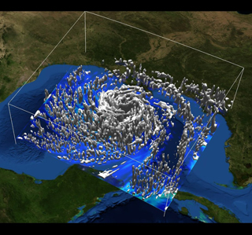
E-SCIENCE ADVANCES RESEARCH PACE AND OUTCOMES
Ensemble Simulations ON 40K CPU USING DATA STREAMED FROM NOAA IMPROVED PREDICTIONS OF LANDFALL LOCATION & INTENSITY FOR HURRICANE IKE

Slide 24
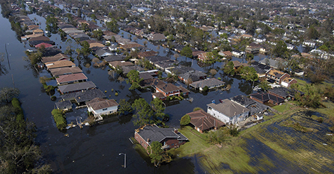
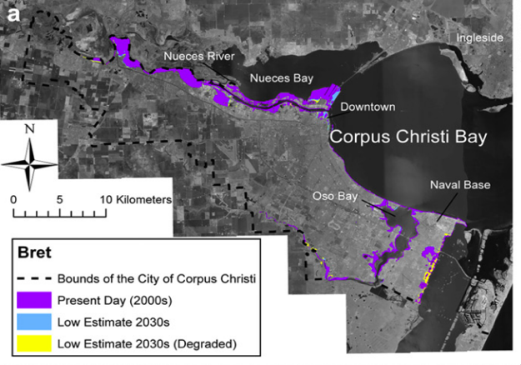
E-SCIENCE ADVANCES RESEARCH PACE AND OUTCOMES
SIMULATION COUPLED WITH CLIMATE PROJECTIONS HELPS CITY PLANNERS IN COASTAL CITY OF CORPUS CHRISTI, TX MITIGATE ECONOMIC, HEALTH, AND WELL-BEING IMPACT OF STORM SURGES

Slide 25
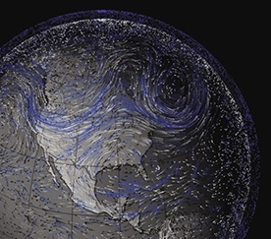
E-SCIENCE ADVANCES RESEARCH PACE AND OUTCOMES
200+ TB DATA FROM NASA MERRA + WEB SERVICES + HADOOP + WEB WORKBENCH ENABLES RAPID ANALYSIS OF HISTORICAL, MULTISCALE SATELLITE DATA BY RESEARCHERS WORLDWIDE

Slide 26
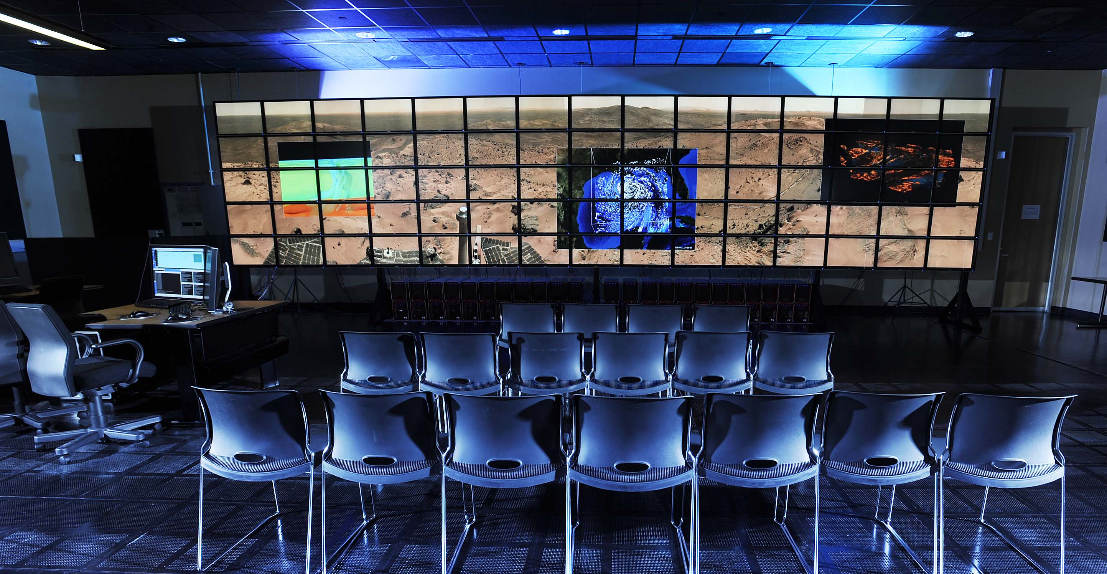
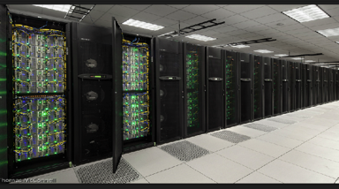
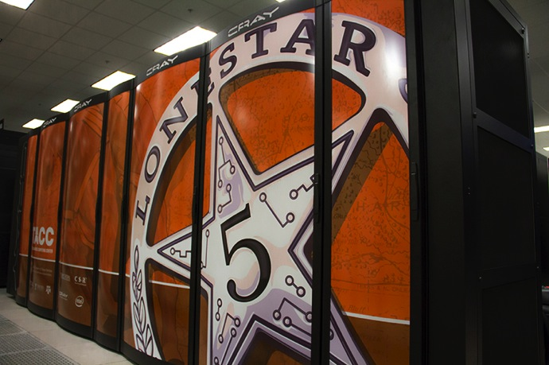
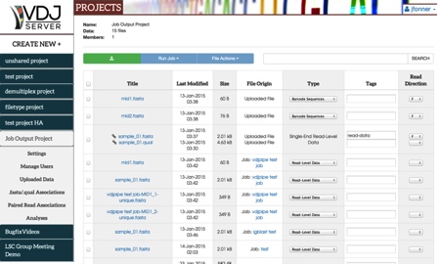
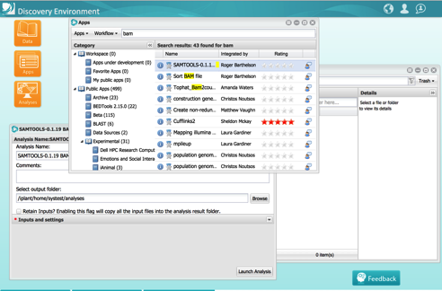
THE EVOLUTION OF A CYBERINFRASTRUCTURE
Ten years ago, cyberinfrastructure was largely about building the hardware and networks to support large scale science.
Today, it’s about new interfaces to support data analysis, collaboration and sharing,reproducibility as well as easy access to simulation

Slide 27
Stampede 2 Design - Redux
Stampede 2 supports a wide range of use cases – but not all of them.
However, innovation in the software/ operations approach lets us support many more things than a “traditional” leadership machine.
  Stampede 2, like all TACC systems, has a REST API that will support gateways/web applications/automated workflows.
  Through Singularity, we have increased our support for Life Sciences codes to more than 2,000 applications.
  Software Defined Vis for in-situ vis work.
Still needs to be supported by the *rest* of the ecosystem.

Slide 28
A Typical new Contract
Five labs around the country produce genomic and proteomic data and transfer it to TACC each week.
A repository of this data is used by researchers at still more sites to perform machine learning analysis in synthetic biology applications.
The corpus will grow into the petabytes.
  100s of K$ to move back and forth to the cloud.
  Data and compute better co-locate – unless we have enough network to trivially move *petabytes*.

Slide 29
End-to-End Cyberinfrastructure
Today, in the DesignSafe project, both experimental and simulation data from around the country is stored at TACC “in the cloud”.
  A few clicks can issue a DOI and create a permanent data publication with the track of a hurricane, the flooding of a river, or the database of how certain buildings respond to earthquake shaking.

Slide 30
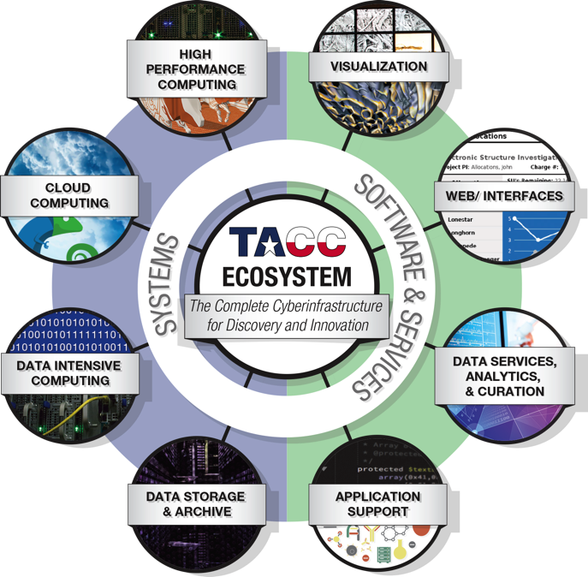
TACC Provides the Software, Hardware, Services and team for end to end computational science for tens of thousands of engineers.

Slide 31
Thanks!
Dan Stanzione dan@tacc.utexas.edU

