Slide 1


Outline
  The 3 pillars of CLASH
  Practical info
  What we are doing in the ALICE group
  What is the end game?

Slide 2
The 3 pillars of CLASH
Development of new theoretical models and generators (mainly theory)
Search for jet quenching in small systems (mainly experiment)
Search for the best observables to differentiate between models for QGP-like effects in small systems
  The main goal of these meetings

Slide 3
Best observables: some ideas
Tool to select events with more or less QGP-like effects, e.g., transverse spherocity
  Can we prove that strangeness enhancement and flow is correlated
φ: can this meson with hidden strangeness (S=0) provide insights into the strangeness production
News
  IPJazma (Nagle and Zajc, arXiv:1808.01276)
  Subevent analyzes

Slide 4

But importantly…

Slide 5
Practical info: people experiment
PIs: Peter Christiansen, new BUL
Ph.D.s: Adrian Nassirpour, Omar Vazquez
Connected people: David, Tuva, Jonatan, Anna, Lisa, Martin
+ there is a large group of experts on flow in small systems at NBI

Slide 6
Practical info: people theory
PI: Leif Lönnblad
Postdoc: Christopher Plumberg
Ph.D.: TBH
Connected people: Gösta, Christian, Smita, Harsh, Korinna, ...

Slide 7
Practical info: interactions
Weekly/biweekly meetings
  Next meeting in 2 weeks: 10/10
Mailings lists (TBD)
  clash: practical info
  clash-talk: discussions
Light website (TBD)
  People, news and talks/publications
  Lucris
Workshop June 2019

Slide 8
Practical info: questions
Do we want to invite some speakers/visitors?
Do we want to try to have a retreat?
(or go to a common conference?)
Other ideas?

Slide 9
Intro to Lund ALICE physics: Naïve picture of two component model
A pp event contains both e⁺e⁻/pp-simulation physics and QGP-like physics
“PYTHIA”
Hard e⁺e⁻ like / jetty
“QGP”
Soft isotropic

Slide 10

Option 1: try to separate the hard and the soft part
“PYTHIA”
Hard e⁺e⁻ like / jetty
“QGP”
Soft isotropic

Slide 11
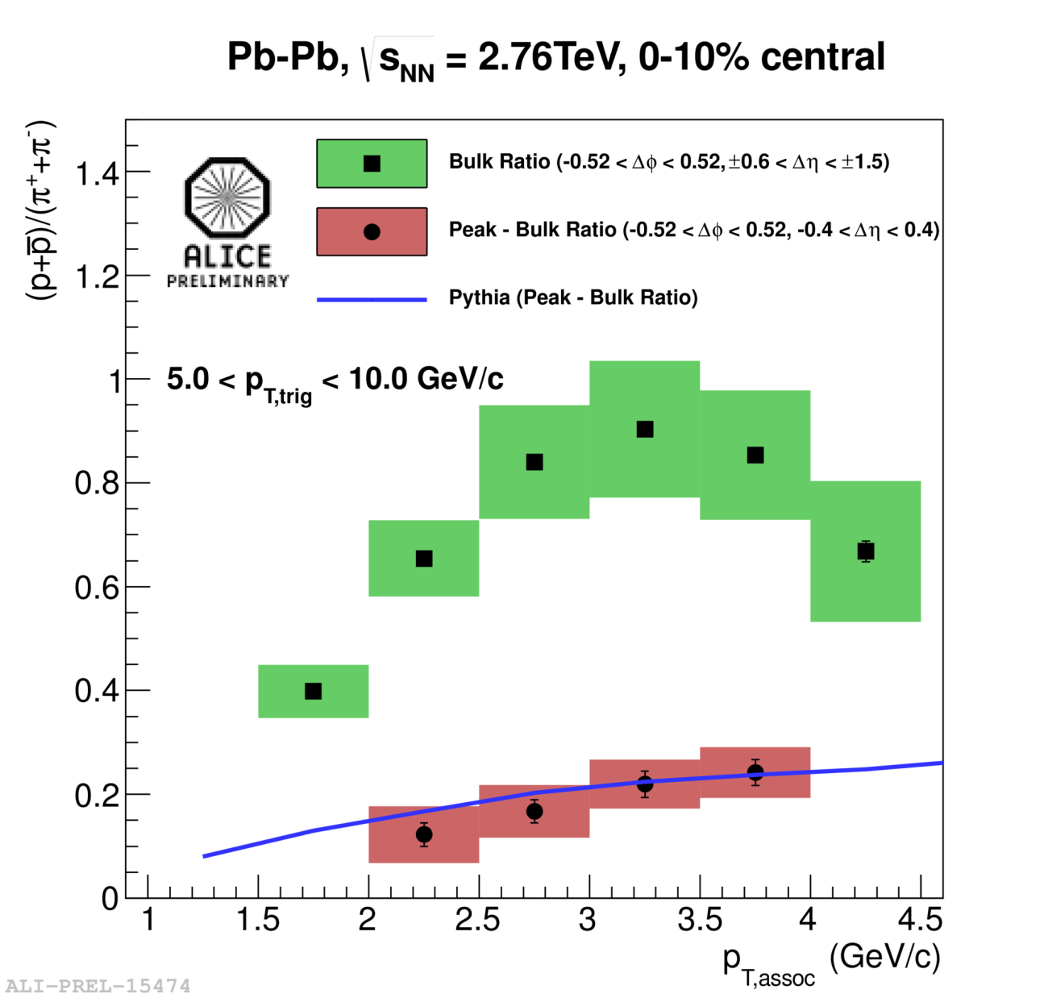
Example
Underlying event
soft part
ee-like hard part
What Tuva is working on

Slide 12
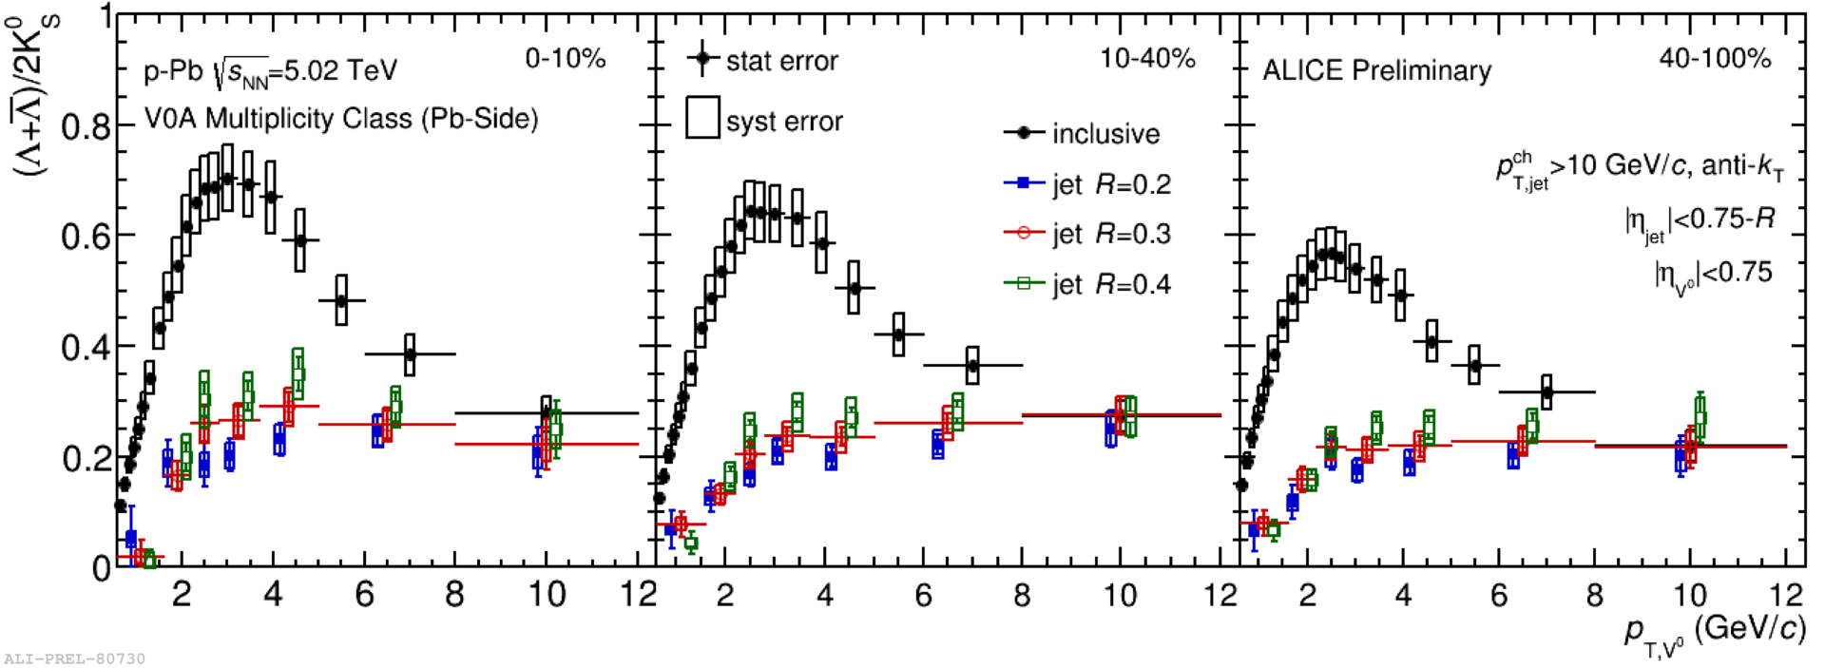
Evolution with mult
Where the focus so far has been on studying the hard scattering to look for modification in Pb-Pb collisions the
“Jet” = “Peak” – “Underlying Event”
study could be a tool to study the Underlying Event in pp
  Especially as a function of mult

Slide 13
Idea of Peter Skands et al

Slide 14
Option 2: try to enhance/suppress the hard or the soft part
Event Shape Analyses
“Jetty” events
“Isotropic” events
“PYTHIA”
“PYTHIA”
“QGP”
“QGP”
What we try to do in Lund

Slide 15
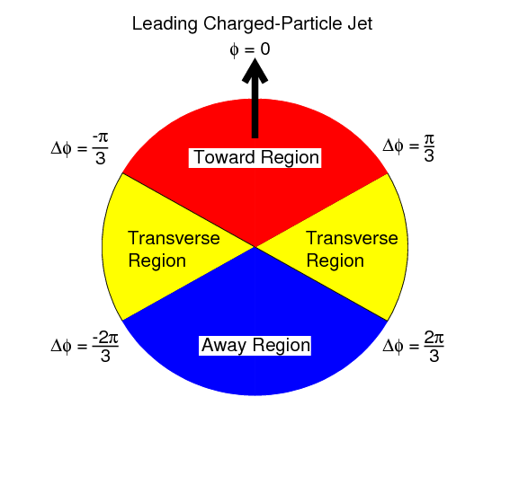
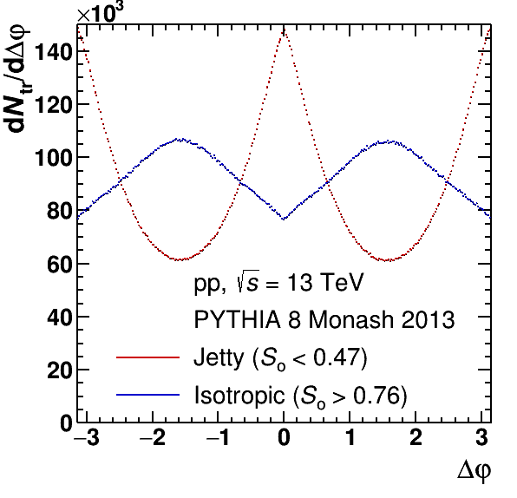
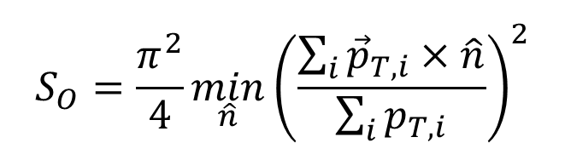
Discovery → Control:
Transverse spherocity
In the following analyses, transverse spherocity, S_{O}, is used to characterize event shapes:
– Low spherocity: “jetty” events
– High spherocity: “isotropic” events
$$S_{O}=\frac{π^{2}}{4}\min_{\hat{n}}{\left(\frac{\sum_{i}{{\vec{p}}_{T,i}}×\hat{n}}{\sum_{i}{p_{T,i}}}\right)}^{2}$$
Jetty: S_{O} → 0
Isotropic: S_{O} → 1

Slide 16
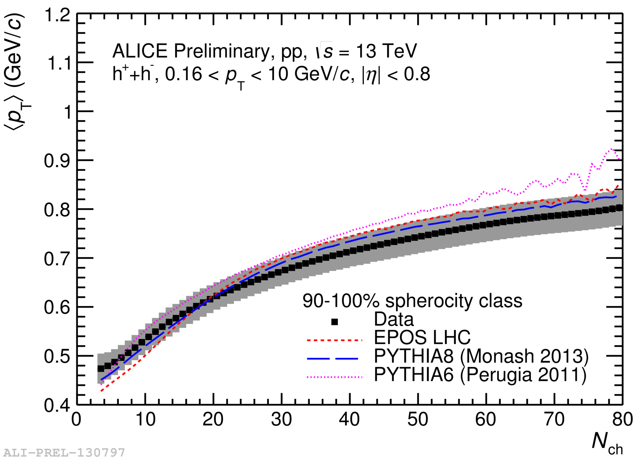
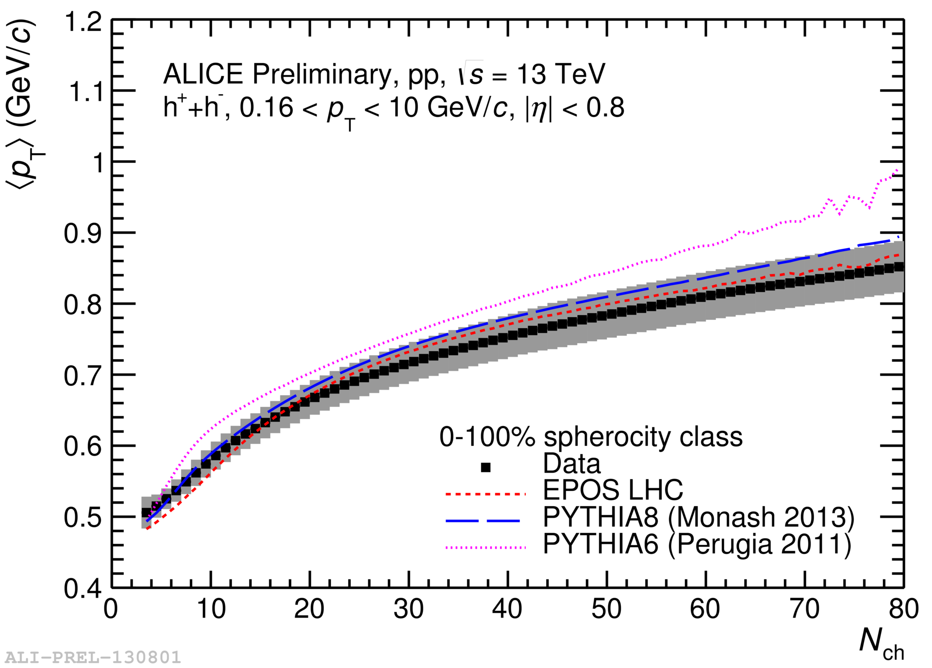
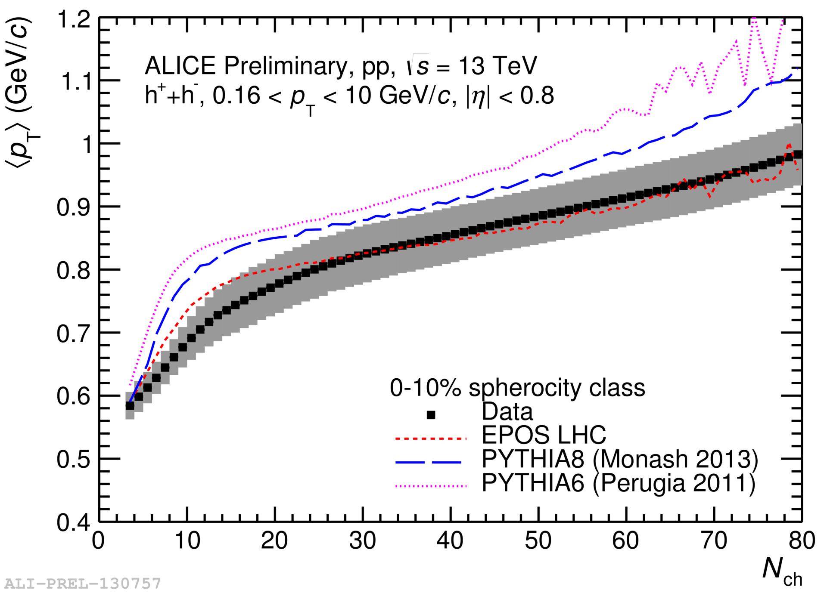
<p_{T}> as a function of multiplicity and S_{O}
Isotropic
Jetty
Analysis done at UNAM, Mexico

Slide 17
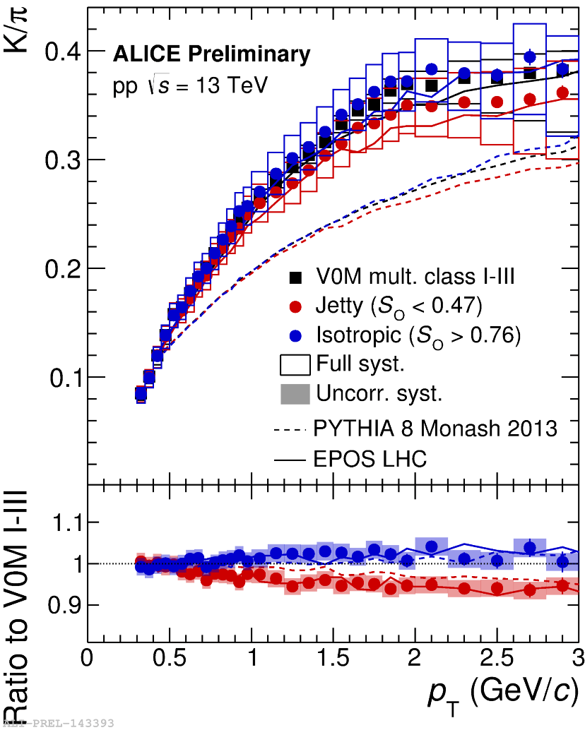
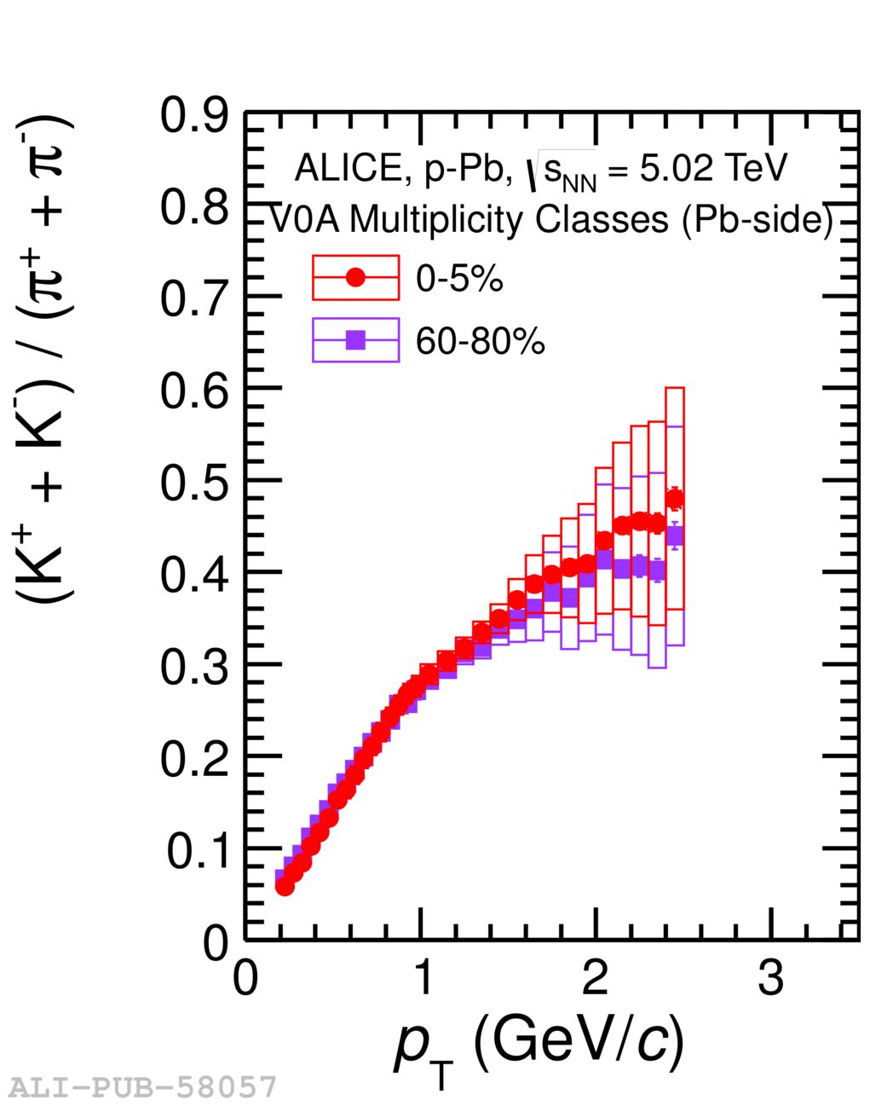
p_{T}-differential K/π ratios as a function of S_{O}
Isotropic:
  No strong modifications of ratios
  expected (à la p-Pb)
Analysis by
Vytautas Vislavicius
Phys. Lett. B 728 (2014) 25-38

Slide 18
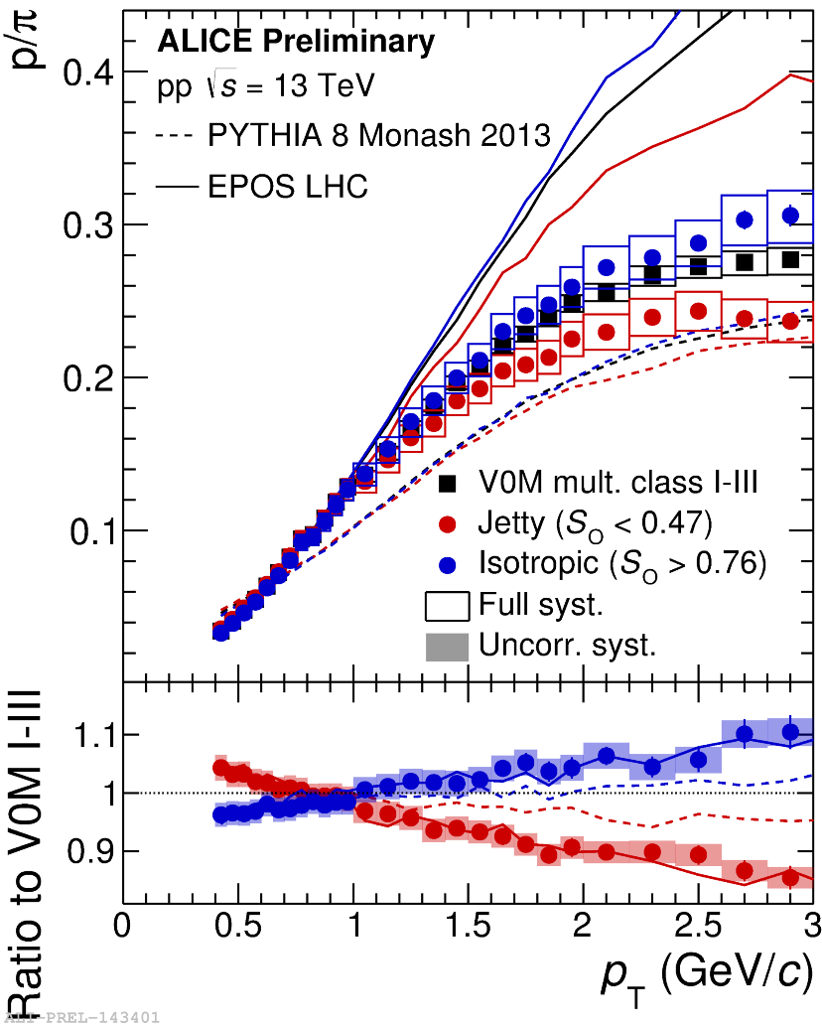
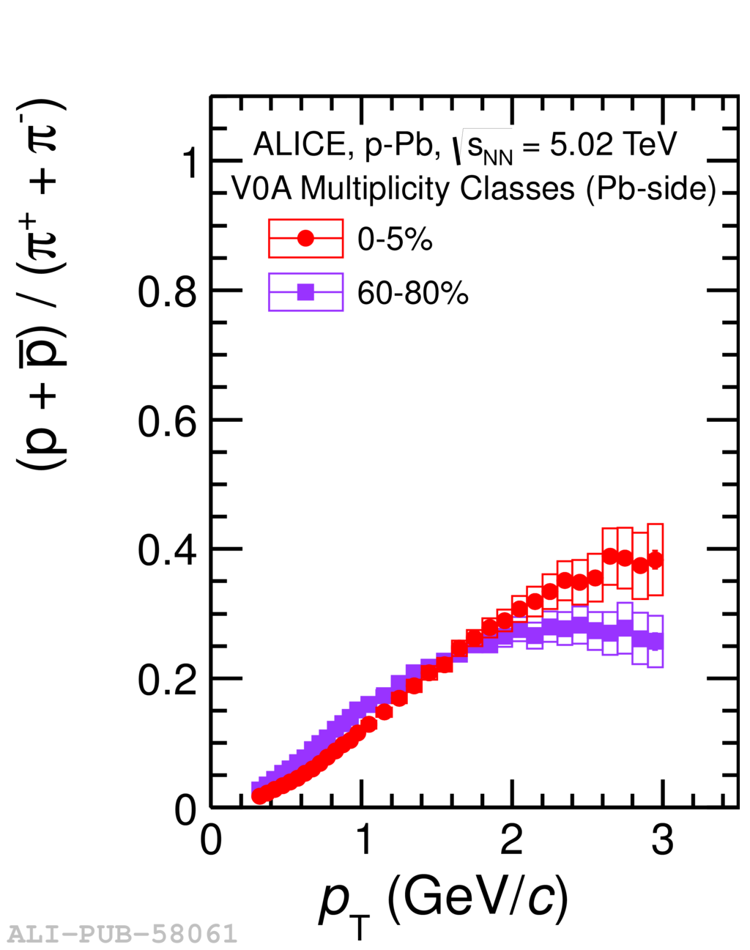
p_{T}-differential p/π ratios as a function of S_{O}
Isotropic:
  In p-Pb, flow manifests via
  boosted proton spectra
Analysis by
Vytautas Vislavicius
Phys. Lett. B 728 (2014) 25-38

Slide 19
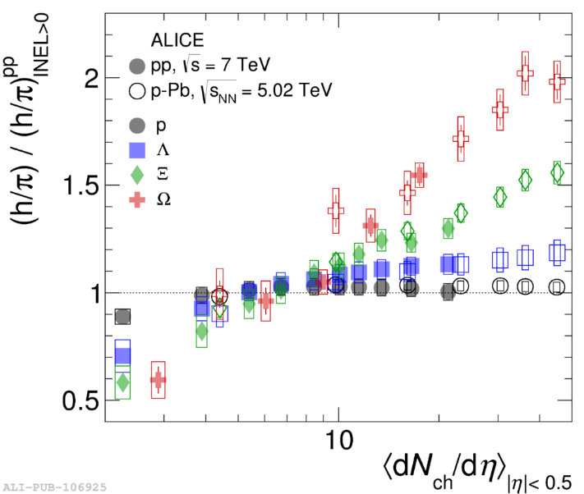
Status and outlook
Preliminary results: Vytautas Vislavicius (now Postdoc at NBI)
φ analysis: Adrian
High p_{T} results: Omar
And possibly:
  Λ and K⁰_{s} (S=1): Maria
  (finished master)
  Ξ (S=2): Martin (master)
  Ω (S=3): Lisa (master)
“QGPmeter”

Slide 20
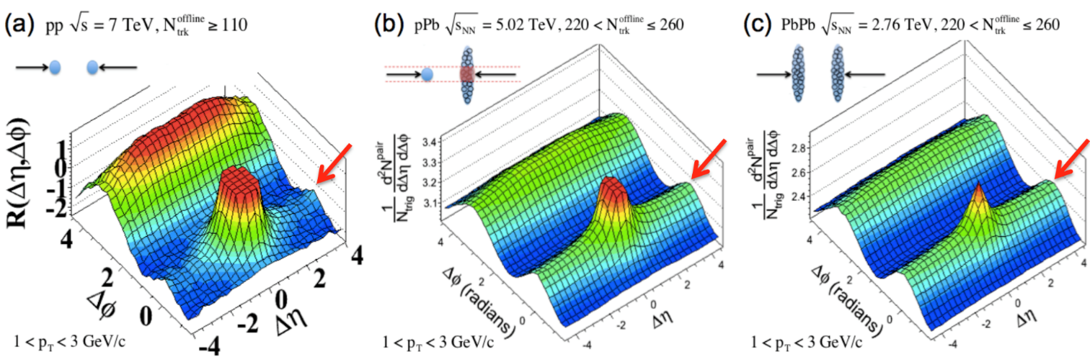
But all is not well…
Jetty: S_{O} → 0
Isotropic: S_{O} → 1
Isotropic events are biased towards an anti-ridge!
(suppression of events with large elliptic flow)
Can we do better? (Anna, master) + hopefully input from Angantyr

Slide 21
Quote from Weinberg:
(“From BCS to the LHC”)
Condensed-matter physicists are often motivated to deal with phenomena because the phenomena themselves are intrinsically so interesting. Who would not be fascinated by weird things, such as superconductivity, superfluidity, or the quantum Hall effect? On the other hand, I don't think that elementary-particle physicists are generally very excited by the phenomena they study. The particles themselves are practically featureless, every electron looking tediously just like every other electron.
…
Most of us do elementary-particle physics neither because of the intrinsic interestingness of the phenomena that we study, nor because of the practical importance of what we learn, but because we are pursuing a reductionist vision. All of the properties of ordinary matter are what they are because of the principles of atomic and nuclear physics, which are what they are because of the rules of the Standard Model of elementary particles, which are what they are because…well, we don't know, this is the reductionist frontier, which we are currently exploring.

Slide 22
What about QCD at LHC?
Interesting “solid-state-like” phenomena:
  Flow/ridges, Strangeness enhancement, Jet quenching
But what are we learning about the Standard model? QCD will be the same but we will IMO understand its relation to QCD LHC phenomena very differently
I hope that CLASH should not only help resolve the issue of origin but also take us a step in the direction of what QCD picture is relevant for small system physics.
(I hope to give a science coffee on this soon)

