Slide 1


In what way is a QGP interacting?
Peter Christiansen
Lund University
What interactions are needed to reproduce
QGP-like effects in small systems
and how are these interactions related?
Here concretely about the relation between
flow and jet quenching

Slide 2

https://kraftly.com/product/thoughts-in-progress-a5-notebook-1461826391siv

Slide 3
First quote: the high level question
“The theoretical picture of collective effects in heavy ion collisions is vastly different from the picture known from proton–proton (pp). Due to the very different geometry of the two system types, interactions in the final state of the collision become dominant in heavy ion collisions, while nearly absent in pp collisions.” (C. Bierlich, arxiv:1901.07447)
One thing we CLASH about!

Slide 4
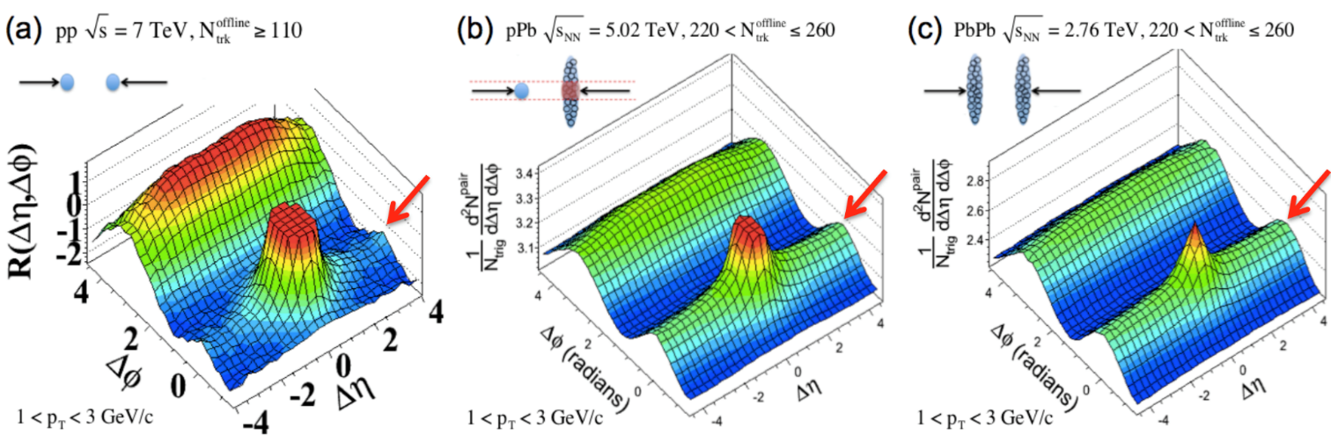
How to understand the ridge variation across systems?
pp
p-Pb
Pb-Pb
The ridge slowly emerges from final state interactions
  Ridge disappears in very small systems and is not fully formed in small systems
  Vs
The ridge is hidden because it scales differently from mini-jet correlations
  Minijet correlations scales as ~1/Multiplicity (~1/N_{MPI})
  Flow correlations are independent of Multiplicity

Slide 5
Second quote: the low level question
“If collectivity in small systems is due to final state interactions, it should be possible to also measure its effect on jets.” (C. Bierlich, arxiv:1901.07447)
Common assumption, but is it really true that hydrodynamic collective behavior implies significant jet quenching or could one expect a more complex relation?
  Goal today: explore this

Slide 6
First comment: signs of other final state interactions in small systems
The strangeness enhancement is a clear indication for violation of jet universality implying final state interactions
  So it is not a black and white question

Slide 7
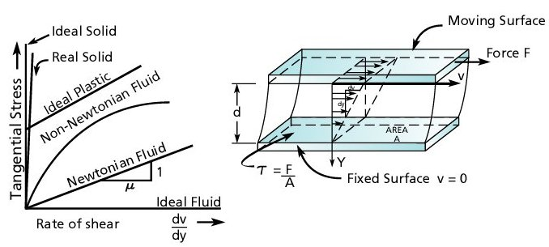
Second comment: “friction” in the perfect liquid is as small as possible
Figure taken from http://www.pumpfundamentals.com/about_fluids.htm
The shear force is given as F=ηAv/d
The shear vicosity-to-entropy density ratio, η/s, is a unitless quantity for characterizing fluids.
For the QGP, η/s is extremely small!

Slide 8
Final state interactions in small systems
Plenty of ideas:
  ”QCD” inspired: parton-parton
  Angantyr: Color Reconnection/Ropes, Shoving
  QGP: hydro, jet quenching, stat model interactions
Note that even all systems are made of quarks and gluons the relevant degrees of freedom are quite different/unknown
My idea: a better understanding of the fingerprints of final state interactions is key to differentiate between different paradigms
  Can we experimentally verify an important feature/assumption of a model?

Slide 9
First model: kinetic theory
A model where collectivity seems to imply strong jet quenching/modifications
Kinetic theory primer: (see C. Plumsberg’s slides from yesterday)
  Weakly coupled!
  Classical (QM/QFT via cross sections)
  Partonic (hard modes)
  Advantage: can be applied out of equilibrium so it can bridge CGC to hydro (thermalization/hydrodynamization)
    Extremely ambitious goal!

Slide 10
Kinetic theory: flow in small systems
https://arxiv.org/abs/1803.02072
Caption: “Free-streaming particles move along the directions of their momentum vectors leading to local momentum anisotropies. In the central region where most collisions take place, there is an excess of particles moving horizontally compared to vertically moving ones. The interactions in the center region tend to isotropize the distribution function, and thus they reduce the number of horizontal movers and they add vertical movers.”
Abstract: “Here, we demonstrate within the framework of transport theory that even the mildest interaction correction to a picture of free-streaming particle distributions, namely the inclusion of one perturbatively weak interaction (“one-hit dynamics”), will generically give rise to all observed linear and non-linear structures. … As a non-vanishing mean free path is indicative of non-minimal dissipation, this challenges the perfect fluid paradigm of ultra-relativistic nucleus-nucleus and hadron-nucleus collisions.”

Slide 11
What does this model predict?
What are its signatures?
Difficult because it is not quantitative (only includes collective effects) so these are my guesses!
Mini jet quenching
  In particular when comparing near and away side jet!
  Must be huge effect in larger systems

Slide 12
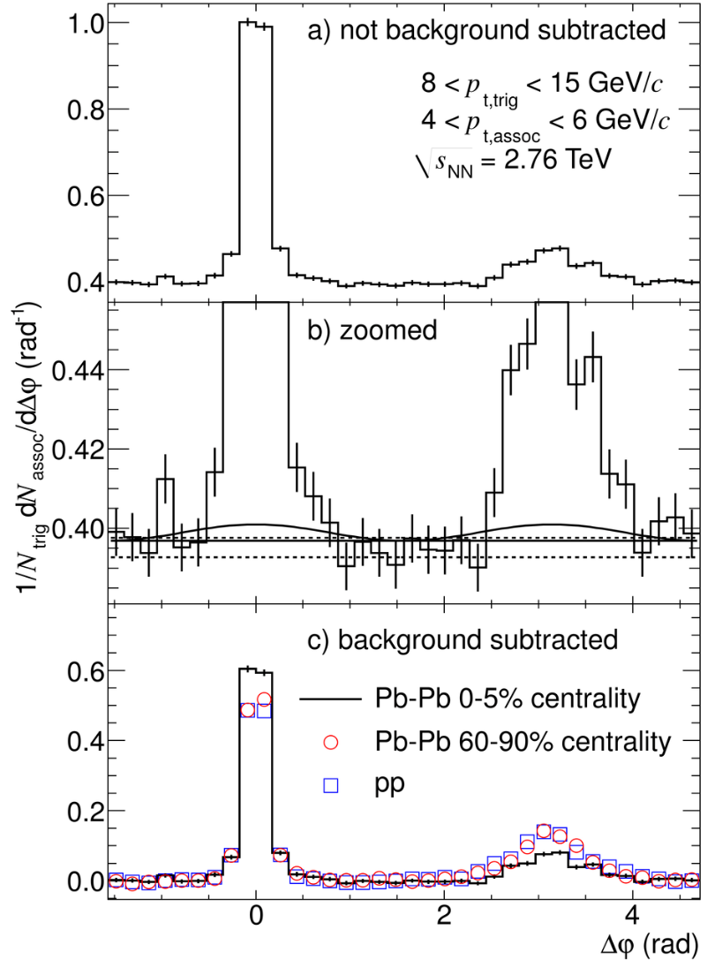
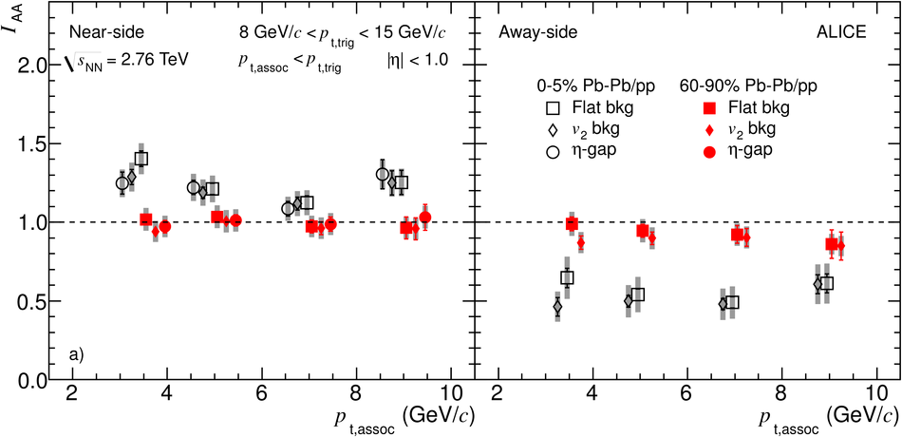
What do we know? I_{AA}
Phys. Rev. Lett. 108 (2012) 092301
Not any evidence that there are significant jet modifications in peripheral Pb-Pb collisions.
In particular the back-to-back structure is the same!

Slide 13
Kinetic theory comments
Large effect → obvious mechanism
Small effect → obscure mechanism
My conclusion: Before kinetic theory can be considered as a serious candidate for non-equilibrium physics, quantitative transparent estimates of (mini-)jet quenching (and ideally more fingerprints) must be done in a way that it can be compared to experimental data (e.g. via the new heavy-ion Rivet, see C. Bierlich’s hand on session on Monday)

Slide 14
Second model: Angantyr
(see L. Lönnblad’s slides on Monday)
Angantyr can be used to study interesting questions:
  There is flow via string shoving
    How does this affect mini jets?
  How small a system can shove?
Study 1 MPI system!
No classical geometry but there are 2 strings and radiation

Slide 15
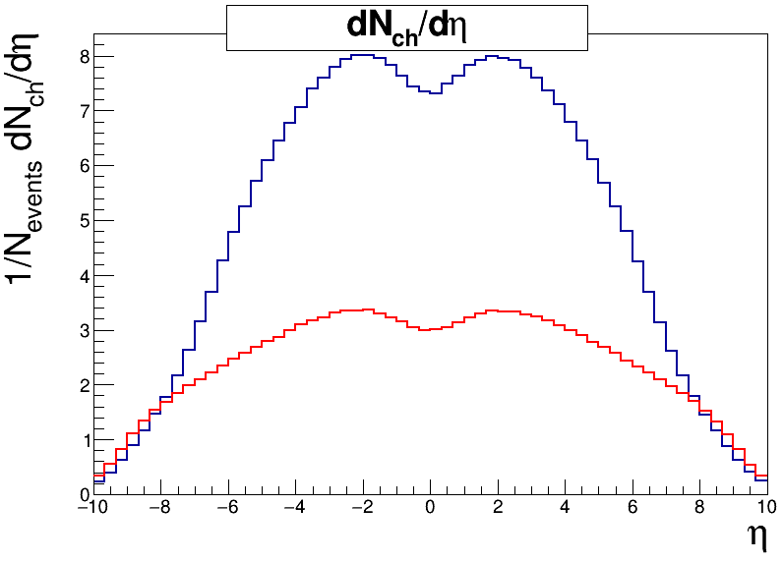
dN/dη (ND √s=13 TeV)
PYTHIA8.240
Example:
Main101
Main101
1 MPI
(switch off
MPIs)
Notes:
15

Slide 16
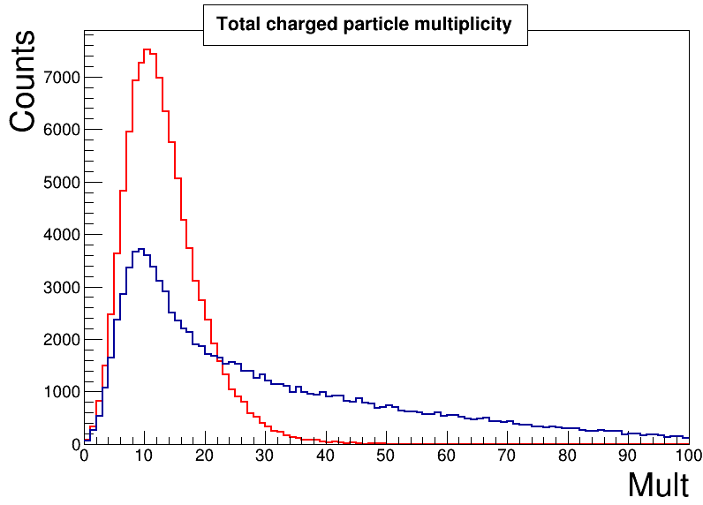
Multiplicity (ND √s=13 TeV)
Main101
Main101
1 MPI
Notes:
16

Slide 17
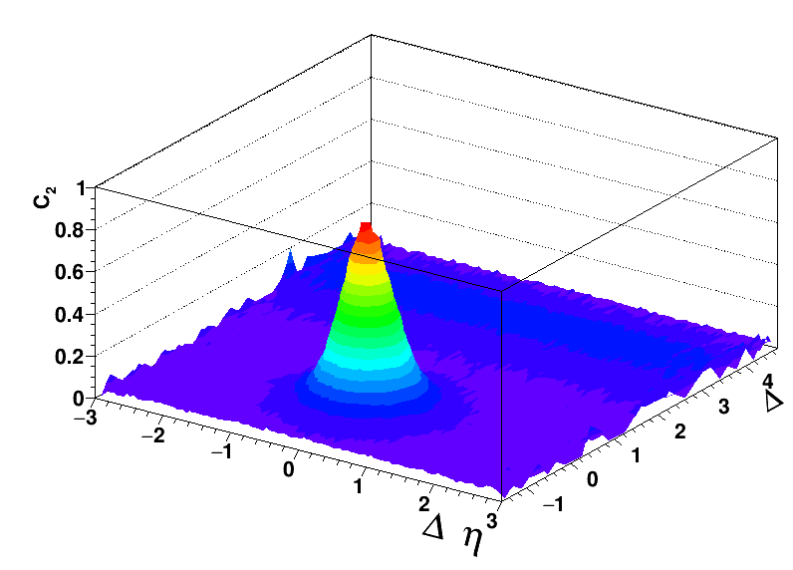
PYTHIA 8.240 default ND
√s=13 TeV 1MPI
NO RIDGE PHYSICS
2 < p_{T,trigger} < 4 GeV/c
1 < p_{T,assoc} < 2 GeV/c
ϕ
Notes:
17

Slide 18

Angantyr (Main101) ND
√s=13 TeV 1MPI
WITH RIDGE PHYSICS
2 < p_{T,trigger} < 4 GeV/c
1 < p_{T,assoc} < 2 GeV/c
ϕ
NB! I do not observe any strangeness enhancement for 1 MPI events!
Notes:
18

Slide 19
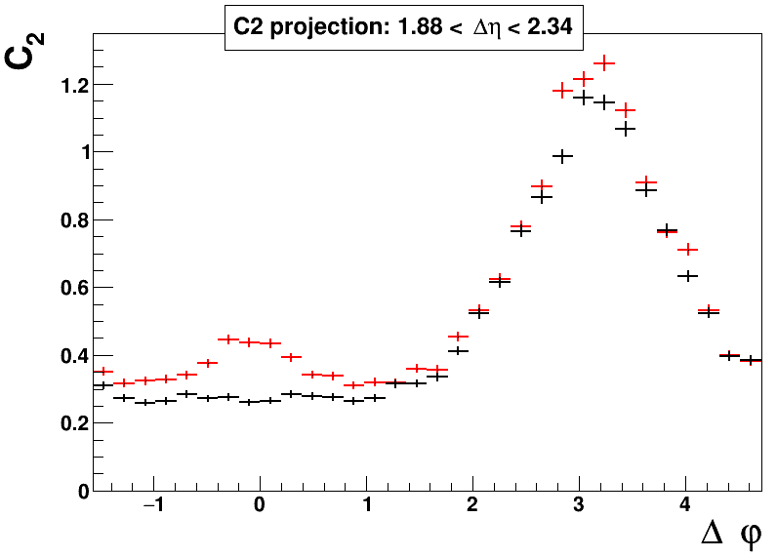
Bulk: Angantyr vs PYTHIA
Angantyr
Pythia
I get a ridge without changing the away side structure significantly
Notes:
19

Slide 20
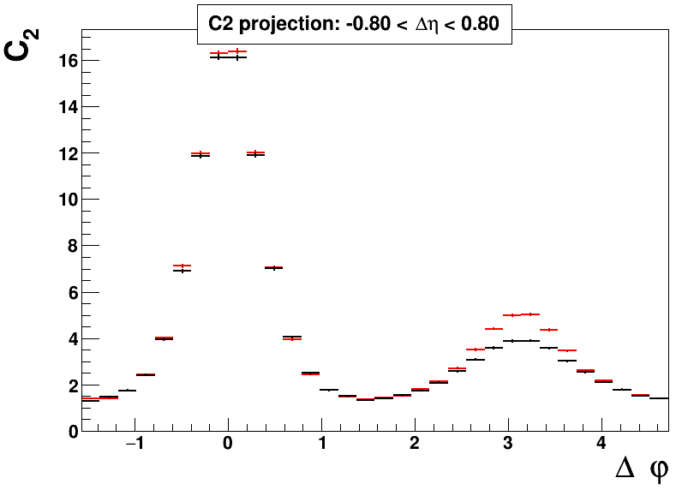
Jet: Angantyr vs PYTHIA
Angantyr
Pythia
Also the jet structure is not changed significantly
Notes:
20

Slide 21
Angantyr vs kinetic theory
And first then it hadronizes!

Slide 22
Angantyr conclusion
There is a small effect BUT WE ALSO UNDERSTAND WHY IT IS A SMALL EFFECT
  It is in some sense a prediction of Angantyr!
  Because the strings/ropes are only boosted by the shoving the direct correlations are minimally affected
And the effect is more a jet modification rather than jet quenching effect
  And what is the reference for observing this if it is also present in 1 MPI events?
Notes:
22

Slide 23
What does that imply for Hydro?
Figure taken from http://www.pumpfundamentals.com/about_fluids.htm

Slide 24
Slight detour:
Hydro “paradox” (1/2)
QGP hydro =
Perfect
  No diffusion or dissipation
  No entropy generation
+ Small viscous correction (η/s)
  Diffusion/dissipation ∝ η/s
  Strength of interaction ∝ s/η

Slide 25
Slight detour:
Hydro “paradox” (2/2)
Best guess: Thermalization ∝ s/η, so perfect liquid thermalizes as fast as possible
But any hot spot will “flow” forever when
η/s → 0, so hot spots do not thermalize
  Well known: this is what allows us to map out initial stage fluctuations
Solution?
  local thermalization is as fast as possible
  Global thermalization is much slower
  Is this hydrodynamization?

Slide 26
What does this have to do with Angantyr? (weak statement)
Local fast thermalized physics degrees of freedom are the strings/ropes
Global thermalizaton proceeds slowly via shoving (~reversible)
So it seems likely that for this type of studies, the results Angantyr and QGP models would be similar

Slide 27
What does this have to do with Angantyr? (strong statement)
Fast local thermalization = strings/ropes
Slow global thermalization = shoving
What is important is that we have two different mechanisms/interactions
And that while they seem to me a bit ad hoc in Angantyr, perfect hydro suggests that they are fundamental aspects of the same property of the final state matter!

Slide 28
Conclusions
Weak (firm)
  Large ridge signals does not necessarily imply significant jet quenching (even in hydro-like models)
Strong (suggestive)
  The perfect liquid nature of the QGP suggests that
    Jet quenching in small systems will be a small effect in agreement with experimental observations
Notes:
28

Slide 29
Backup

Slide 30
Are final state interactions absent in pp collisions?
They could be there
  The perfect liquid nature (as small dissipation as possible) explains why they are hard to observe
  Angantyr picture: the strings/ropes are shoved but they hadronize the same way
Figure taken from http://www.pumpfundamentals.com/about_fluids.htm

Slide 31
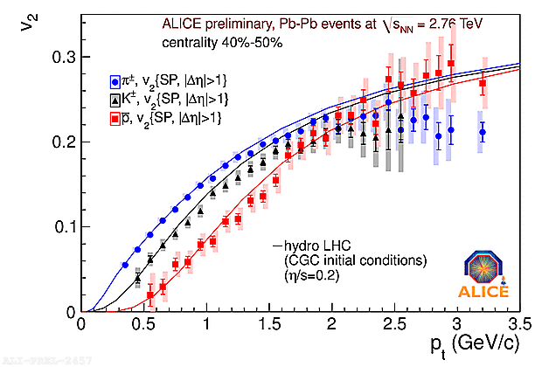
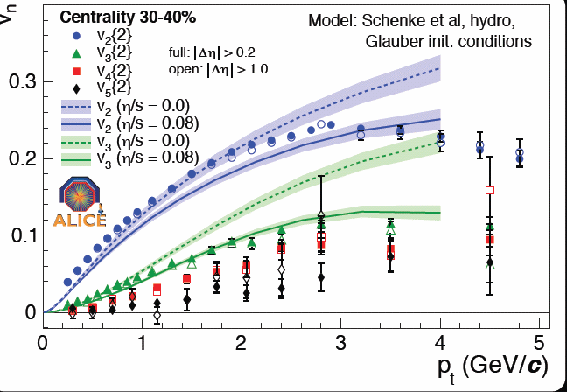
Elliptic flow and triangular flow is almost ideal
Huge flow at intermediate p_{T}:
  2 times more particles in plane than out
  Nearly ideal fluid
Significant higher order flow caused by fluctuations – also described by nearly ideal hydro + initial state

Slide 32
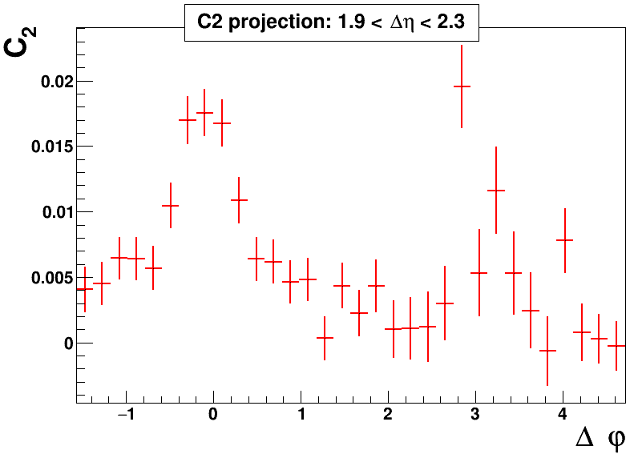
BULK: Angantyr minus PYTHIA
Notes:
32

