Slide 1
EOSC & EOSC-Nordic
NORDUgrid Conference
Lund, Sweden
June 14, 2019

Slide 2

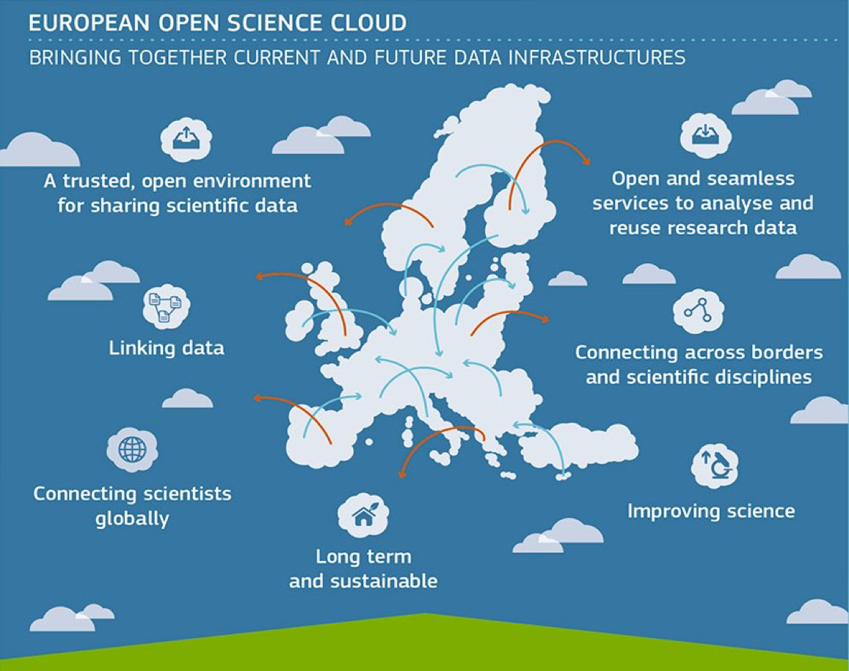
EOSC - European Commission’s vision for Federating Data Infrastructures
Vision for the European Open Science Cloud (EOSC) presented in the Commission communication on the ‘European Cloud Initiative’, as a part of the Digital Single Market Strategy [April 2016]
”A seamless environment enabling interdisciplinary research, an environment to foster data-intensive innovation. The EOSC will allow for universal access to data and a new level playing field for EU researchers.” [EOSC Strategic Implementation Roadmap 2018-2020]
From 2021 fully operational

Slide 3
From vision to implementation
  How to implement the EOSC?
  Not a « project from Brussels » but a community-driven process
  Iterative implementation based on mutual alignment
  Initial phase supported by EOSC-related Horizon 2020 grants
  Initial phase steered by the EOSC governance 2018-2020
  Importance of sustaining engagement and self-commitment
  Subject to an evaluation of the initial phase by the Commission and the Member States
Source: Michel Schouppe, EC DG-RTD Open Science

Slide 4
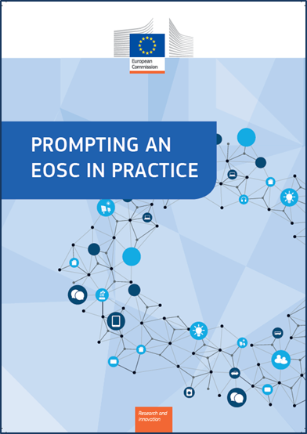

Key issues by end of 2020
  Key issues for the next two years
  The vision (2016)
  New governance model and best-fit legal vehicle for after 2020
  Financing model(s) to sustain EOSC services in the long run
  Rules of participation that will govern future EOSC transactions
  Coordination of EOSC-relevant national initiatives
  Evolution of the EOSC Portal and its interfaces, expansion of the EOSC service offering to the researchers
  FAIR digital objects: turning principles into practice
  Widening strategy for the EOSC user base
  EOSC in the international context
  Turning FAIR into Reality: Report and Action Plan: https://doi.org/10.2777/1524
  Prompting an EOSC in practice: https://ec.europa.eu/info/events/2nd-eosc-summit-2018-jun-11_en

Slide 5
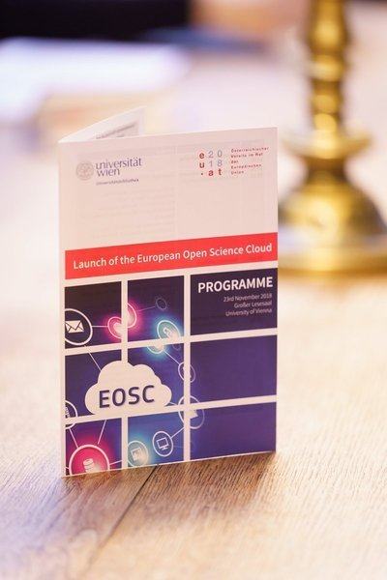
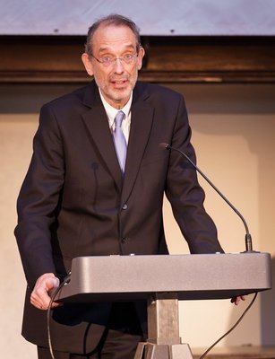
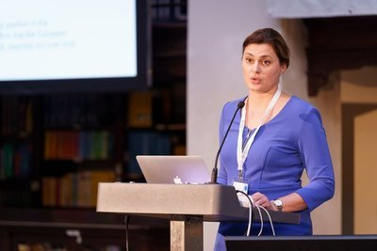
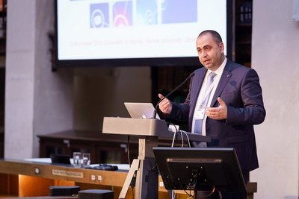
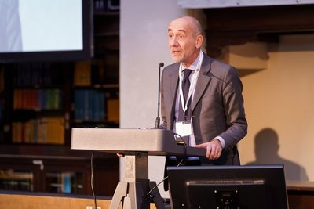

EOSC launch event 23 Nov 2018
Launch of the EOSC – Vienna, 23/11/18
Notes:
Delivered on three items

Slide 6
EOSC 2019-2020: timeline
2019
2020
Q1
Q2
Q3
Q4
Q1
Q2
Q3
Q4
Initial EOSC federating core in place
Connection of most infrastructures and services to the EOSC
Init. registry of data infrastructures & services
Updated catalogue of services and Portal
Initial EOSC catalogue of datasets accessible
Outline FAIR metrics, repository certification and outline PID policy
Updated FAIR metrics, repository certification and PID policy
MS + EC evaluation of Phase 1
Initial Rules of Participation
Revised Rules of Participation
Strategic, financing, organisational model of the EOSC Post-2020
Mapping of EOSC-relevant national initiatives
Set up of Working Groups
EOSC Symposium
EOSC Symposium
Source: Michel Schouppe, EC DG-RTD Open Science

Slide 7



EOSC dedicated activities to prototype the EOSC
INFRAEOSC-06-2019
Enhancing the user experience
Portal
development
INFRAEOSC-03-2020
Portal integration & consolidation
INFRAEOSC-01-2018
Access to commercial services
INFRAEOSC-04-2018
Connecting ESFRI infrastructures
New services
new users
INFRAEOSC-05-b-2018-2019
Coordination of national initiatives
INFRAEOSC-02-2019
Prototyping new services for new users
H2020
INFRAEOSC Calls
2018-2020
> 250 Mio €
INFRAEOSC-07-2020
Increasing the service offer
Governance and policy
INFRAEOSC-05-a-c-2018
- EOSC coordination structure
- FAIR Data uptake and compliance
Source: Michel Schouppe, EC DG-RTD Open Science

Slide 8
It is all about coordination!
  Collaboration agreements
  amongst EOSC-related H2020 projects:
  Supplementing, not contradicting existing H2020 grants
  Common approaches (e.g. dissemination activities,
  links with the EOSC governance and the secretariat)
  Collaboration, synchronisation of specific activities
  Common boards / common advisory structures
  Cross-project Strategic Coordination Board
Source: Michel Schouppe, EC DG-RTD Open Science

Slide 9
EOSC governance in 2019-2020
Advise on / inform
the implementation
Steer
the implementation
Contribute to
the implementation
Stakeholder Forum
Governance Board
EU-funded projects
Users, Service Providers, Public sector, Industry, SMEs, etc.
MS/AC delegates and the European Commission
Proposes
Monitors
Reports
Reviews
Endorses
Orients
Nationally-funded projects and initiatives
Other projects and initiatives
Working Groups
Executive Board
Interact
WG
WG
WG
WG
European stakeholder organisations and individual experts)
Extended Coalition
of Doers
Supports
Supports
Supports/
coordinates w.
EOSCSecretariat.eu
Coordination and Support Action
Source: Michel Schouppe, EC DG-RTD Open Science
Notes:
Users forum
Science Users
Users of PRACE and HPC Centres of Excellence
Industry Users
(b) Technology forum
PRACE, GEANT
Tier-0 supercomputing centres
Industry (ETP4HPC, BDVA PPP, etc.

Slide 10
154 services and resources
Offered by 17 service providers from the public and private sector

Slide 11
Call: INFRAEOSC-05-2018-2019
Participants: 24
Budget: 5.9M€
Coordinator: Gudmund Høst, NeIC Director - Gudmund.Host@nordforsk.org
Project period: Sep, 2019 – Aug, 2022
Kick off mtg: Sep 2-3, 2019 (CSC, FI)

Slide 12
How was EOSC-Nordic established?
IDEA
The idea is born: A Nordic Science Cloud – Why not?
CALL
EU Call announcement spring 2018
COMMITMENT
Nordic commit-ment with NeiC as Coordinator
USE CASES
EOSC-Nordic use cases identified
Proposal
Proposal submission
GRANT
Successful reply from EU
PROJECT START
Official starting date for EOSC-Nordic
2017
2018
2019
May 2017
late spring
2018
Nov 21st 2018
Sep 1st
2019
Spring 2018
July/Aug 2018
Feb 2019

Slide 13
EOSC-Nordic Editorial Lead
CSC: Damien Lecarpentier, Heli Autere
SNIC: Per-Olov Hammargren & Ann-Charlotte Sonnhammer
Uninett Sigma2: Francesca Iozzi & Hans Eide
ETAIS: Ilja Livenson
DeiC: Lene Krøl Andersen
RH net: Ebba Hvannberg
NeIC: Gudmund Høst, Kine Halvorsen, Rob Pennington, Lene Krøl Andersen

Slide 14
24 Participants
Finland
CSC – IT CENTER OF SCIENCE
UNIVERSITY OF HELSINKI
UNIVERSITY OF TAMPERE
UNIVERSITY OF EASTERN FINLAND
FINNISH METEOROLOGICAL INSTITUTE
Norway
NORDFORSK
UNINETT SIGMA2 AS
NORWEGIAN CENTER FOR RESEARCH DATA
Iceland
UNIVERSITY OF ICELAND
Estonia
UNIVERSITY OF TARTU
NATIONAL INSTITUTE OF CHEMICAL PHYSICS AND BIOPHYSICS
Denmark
DENMARK TECHNICAL UNIVERSITY
UNIVERSITY OF SOUTHERN DENMARK
DANISH NATIONAL ARCHIVES
UNIVERSITY OF COPENHAGEN
CAPITAL REGION OF DENMARK
NORDUNET / AS
Latvia
RIGA TECHNICAL UNIVERSITY
Sweden
UNIVERSITY OF UPPSALA
SWEDISH RESEARCH COUNCIL
UNIVERSITY OF GOTHENBORG
Lithuania
UNIVERSITY OF VILNIUS
By Taller345 - Own work, CC BY-SA 4.0, https://commons.wikimedia.org/w/index.php?curid=63245736
Netherlands
GoFair
Germany
DKRZ

Slide 15
Person Months Distribution
NeIC (35)
DeiC (55)

Slide 16















EOSC projects’ contribution to the EOSC implementation roadmap
EOSC Implementation
Roadmap action lines
On-going EOSC projects contributing to the implementation
Architecture
Data
Services
Access and Interface
Governance
Rules of Participation
https://ec.europa.eu/research/openscience/pdf/swd_2018_83_f1_staff_working_paper_en.pdf

Slide 17
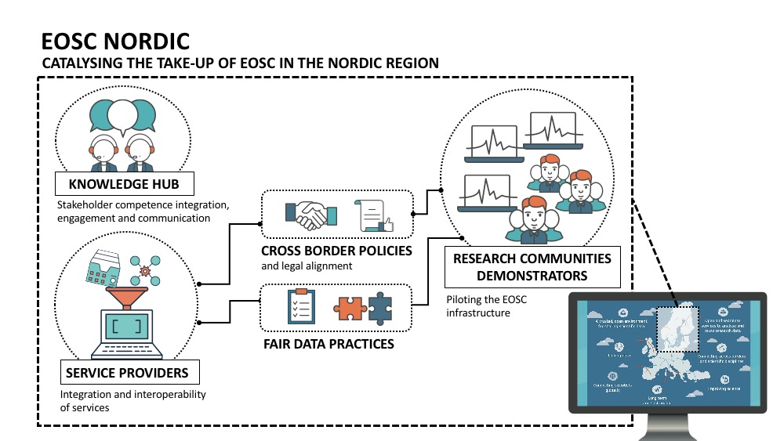

Slide 18
EOSC NORDIC
Objective 2
Increase the discoverability of Nordic & Baltic services. Extend and expand their use by making them accessible through the EOSC portal
2
Objective 1
1
Objective 3
Support coordination, harmoni-sation and alignment of Nordic and Baltic national policies and practices related to the provision of horizontal research data services with EOSC
3
Promote and support the uptake of FAIR data practices and certification schemas across the Nordics
MAIN
OBJECTIVES
Objective 5
4
Objective 4
Provide a Knowledge Hub
to deliver training and technical support to new service providers and communities willing to engage with EOSC during and after the project lifetime
Accelerate the progress and attractiveness of EOSC by piloting & delivering innovative solutions developed and tested in a useful and functional cross-border environment
5

Slide 19
Policies, legal issues and sustainability
in a cross-border environment
Policies and principles
SERVICES AND RESOURCES
LEGAL CHALLENGES
COORDINATE AND ALIGN
Identify & map the open science policies & resource provisioning principles applied in the Nordic and Baltic countries.
Investigate models, roles and responsibilities for the coordinated provisioning and delivery of EOSC services and resources at national level
Identify current and potential legal hurdles associated with the sharing of data and resources across national borders. Suggest solutions.
Discuss and coordinate policy activities, and advise on directions the national initiatives should take to align with relevant EOSC policies.

Slide 20
integration and interoperability of prospective EOSC service providers in Nordic and Baltic countries
Integration
Identify existing Nordic generic and thematic service providers.
Support integration and discovery of their services via the EOSC portal
Interoperability
Foster organizational, semantic and technical interoperability of service providers.
Propose improvements of the interoperability approach within EOSC.
EOSC
Local/national
services

Slide 21
Developing FAIR DATA practices across the Nordic and Baltic countries
Investigate Practices
Investigate and inform about the state of FAIR practices in the Nordics and the Baltics, looking at national policies and practices.
Develop Incentives
Develop and promote incentives for the uptake of FAIR data practices across national scientific communities
Mainstreame Standards
Enable the mainstreaming of standards for data management & certification schemas for data repositories

Slide 22
DemonstratING the potential of EOSC
using the Nordic and Baltic countries as a testbed environment.
analysis and post-processing
Integration of community specific portals with large scale computing facilities and pilot usage of computing resources across borders
discover and re-use
research data
Foster the discoverability and re-use of research data. Harvesting metadata in the future EOSC metadata catalogue.
data management
sharing and archiving
Facilitating cross-borders data sharing by enabling data management on a distributed environment.
Sensitive data and orchestration
Piloting an orchestration mechanism that brings national secure servers together, allowing the analysis of sensitive data without moving data away from the custodian.

Slide 23
EOSC-Nordic Demonstrators (I)
Research Community | Discipline | Service Case/Solution | Infra/service involved
DeepDive | Biodiversity | Enable thematic portal (PlutoF) to access and orchestrate distributed computing resources provided by national service providers / EOSC | National HPC resources, National Cloud resources, National Storages, Cloud Orchestration services (to be identified)
Nordic Language Processing Laboratory | Social Science & Humanities | Create a virtual laboratory able to consume resources from the national service providers /EOSC, and enable cross - border resource allocations and account management | National HPC resources, National Cloud Resources, EOSC Docker Hub services, National Storage Resources, EUDAT HTTP API, B2SAFE (EOSC), PaaS services (to be identified) , EOSC Data sharing services (e.g. B2SHARE)

Slide 24
EOSC-Nordic Demonstrators (II)
Research Community | Discipline | Service Case/Solution | Infra/service involved
NICEST | Climate Science | Provide a trusted EOSC Virtual Research Environment for Earth System Modeling with direct connection to the Nordic High Performance Computing Centers (HPC), Nordic e - Infrastructure for Research Data and Nordic Data archive for long - term data preservation | Galaxy Europe, National Storage services, EOSC Data sharing services (e.g. B2SHARE), Data metadata harvesting (B2FIND), Archiving services, ESGF nodes, EOSC or national DMP Tools (es: easyDMP)
Precision Cardiology | Biomedical Science | Pilot the provisioning of a secure cloud infrastructure for sensitive data as part of EOSC | DTU/ Computerome, TSD, Bianca, ePouta

Slide 25
NeIC Projects engaging in EOSC-Nordic
Deep Dive (Biodiversity data)
Nordic Language Processing Lab (Social Sciences & Humanities)
NICEST (Climate data)
Trygvee (Life Science data) & Nordic Health cloud demo
Dellingr (Waldur platform – cross border computing)
Glenna2 (AI elements)

Slide 26
INTEGRATION AND DISSEMINATION
THE KNOWLEDGE HUB MODEL
EOSC WORK PACKAGES
Regional collaborations
WP 1
WP 2
WP 3
AMBASSADORS
WP 4
INSTITUTIONS
WP 5
WP 6
KNOWLEDGE HUB
TRAIN THE TRAINER EVENTS
International organisations

Slide 27
WORK PACKAGES
STAKEHOLDERS INVOLVEMENT
WP6
e-Infrastructure- and
service providers
Communication and Engagement
WP5
Open Research Demonstrators
Data repositories
WP4
Research communities
and institutions
FAIR Data
WP3
EOSC NORDIC
Support to EOSC
Service providers
Universities & Libraries
WP2
WP1
Research Councils and Funding Agencies
Policies, legal issues and sustainability
Research Councils &
Funding Agencies
WP1
Project management
adm. & Finance
Governmental agencies
and Ministries

Slide 28
WP2(CSC)
Policies, legal issues and sustainability
General Assembly
Chair: The Coordinator
WP1 (NeIC)
Project
management
adm. &
Finance
WP3 (ETAIS)
Support to EOSC Service providers
Executive
Board
International
Advisory Committee
WP6 (CSC)
Communication & Engagement
Project Management Board
WP4 (NeIC)
FAIR Data
WP5 (UNINETT Sigma2)
Open Research
Demonstrators

Slide 29

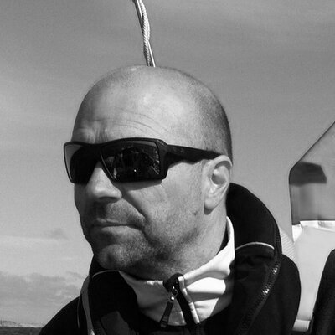

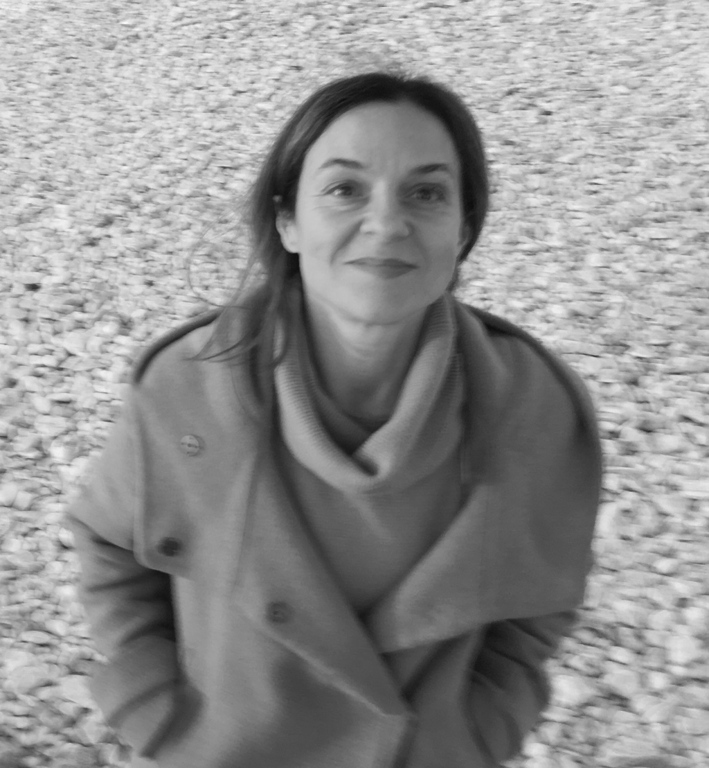


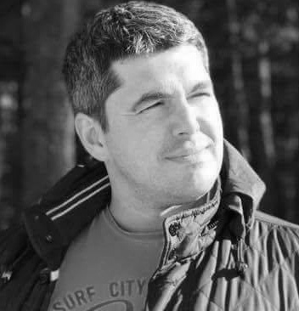
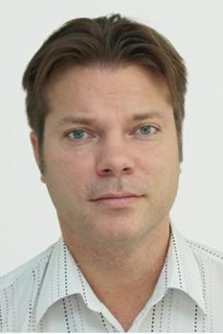
EOSC-Nordic Project Management Board (PMB)
International Liasion
WP 4
CSC Finland
Damien Lecarpentier
Programme Director
Andreas Jaunsen
Senior Advisor
NeIC/Nordforsk
Norway
WP 1
WP 5
DeiC
Denmark
Lene Krøl Andersen
Head of eScience Center
Maria Francesca Lozzi
Senior Advisor
Uninett Sigma 2 Norway
WP 2
WP 6
Saara Kontro
Project Manager
CSC, Finland
Minna Lappalainen
Head of Communications
CSC, Finland
WP 3
Observer
Ilja Livenson
Senior Application Developer
ETAIS
Estonia
SNIC, Sweden
Mathias Brännvall
Adm coordinator

Slide 30
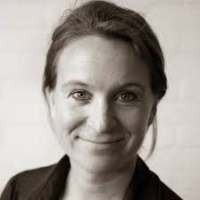
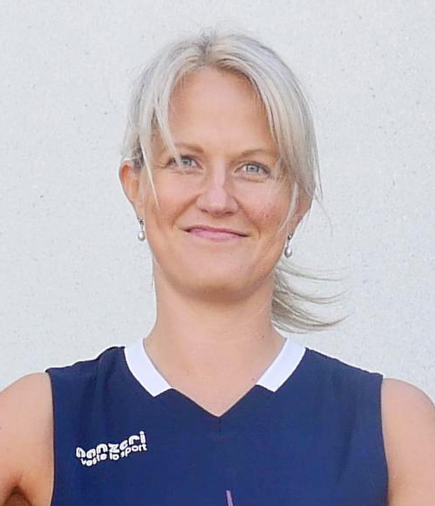
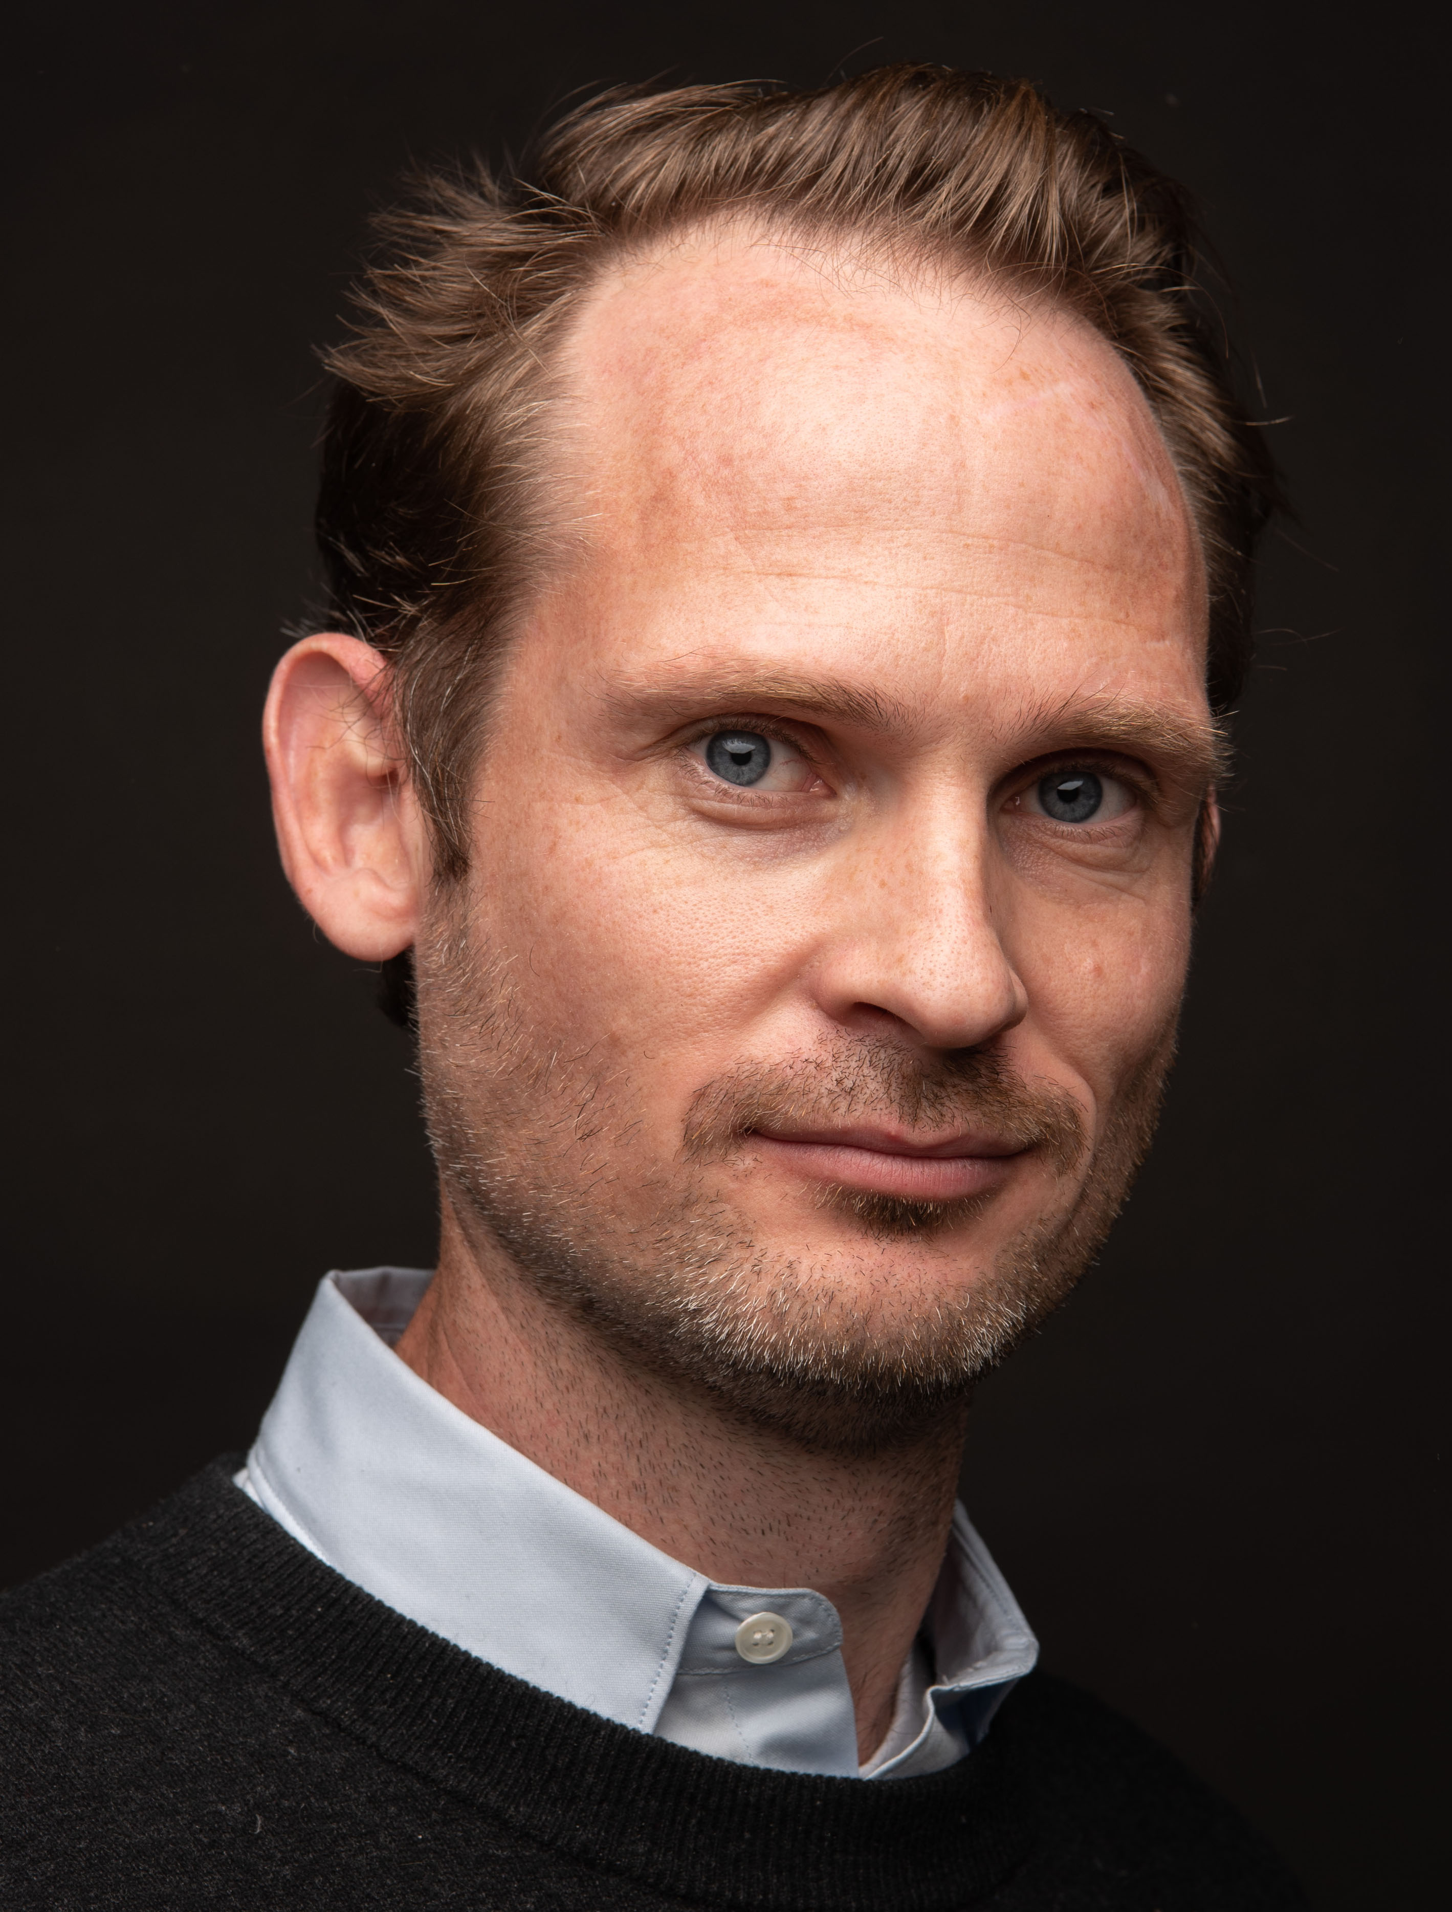
EOSC-Nordic Project Office (PO)
DeIC
Lene Krøl Andersen
Project Manager
CSC
NORDFORSK
Heli Autere
Jens Worm Begtrup
Financial officer
Adm. officer

Slide 31
International Advisory Committee (IAC)
Experts who advise and support the Executive board of EOSC Nordic
Ana Proykova
Professor, Atomic and Molecular Physics, University of Sofia (Bulgaria)
Francoise Genova
Senior Researcher at Strasbourg astronomical data centre (France)
Wilco Hazeleger
Director, Netherlands eScience Center, (Netherlands)
Ingrid Dillo
Deputy Director, Data Archiving and Networked Services (DANS) (Netherlands)
Daniel Mallmann
Head of Data Services, Juelich (Germany)
Andrew Treloar
Director, The Australian Research Data Commons (ARDC) (Australia)
Christine Kirkpatrick
Executive Director, National Data Service (US).
Open seat(s) - to perhaps other 5b interlinking projects (?)

Slide 32
Open invitation to engage…
National Access points through your infrastructure providers
EOSC-Nordic Knowledge Hub
  Train-the-Trainers event
  Policy workshops
  Hackathons, webinars, etc.
EOSC-Nordic Flagship events
EOSC-Nordic Kick-Off: Sep 2-3, in Espoo, Finland

Slide 33

ADVENTURE
AHEAD!
Building the bridges together as we go..

Slide 34
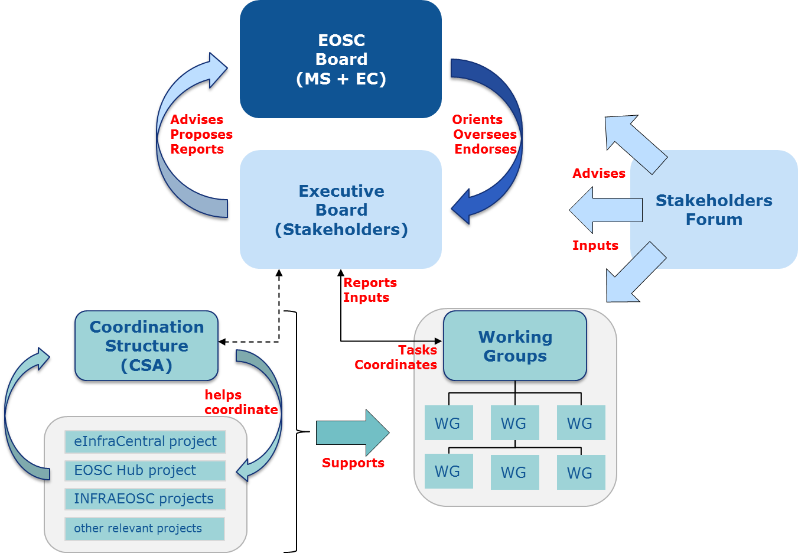
EOSC Governance (as proposed by the EOSC Implementation Roadmap)
National Initiatives
  Architecture
  Sustainability
  Rules of participation
  FAIR
  Landscape
National Initiatives
5 Working Groups. proposed
Coordination of National Initiatives
WG members to be appointed by EOSC governance
Expected to be launched in May/June

Slide 35
EOSC Executive Board
CESAER represented by Karel LUYBEN – CHAIR
CESSDA ERIC represented by Ronald DEKKER
EMBL represented by Rupert LÜCK
European Spallation Source ERIC represented by John WOMERSLEY
GÉANT represented by Cathrin STÖVER – VICE CHAIR
OPENAIRE represented by Natalia MANOLA
Research Data Alliance (RDA) represented by Juan BICARREGUI
Science Europe represented by Stephan KUSTER

Slide 36
EOSC-Nordic Editorial Lead
CSC: Damien Lecarpentier, Heli Autere
SNIC: Per-Olov Hammargren & Ann-Charlotte Sonnhammer
Uninett Sigma2: Francesca Iozzi & Hans Eide
ETAIS: Ilja Livenson
DeiC: Lene Krøl Andersen
RH net: Ebba Hvannberg
NeIC: Gudmund Høst, Kine Halvorsen, Rob Pennington, Lene Krøl Andersen

