Slide 1
Saeid Pirani
Study of superconducting
MB cavity of ESS

Slide 2
Outline
Overview on ESS operation
Elliptical cavity design & fabrication
cavity higher order modes study
Cavity field emission study

Slide 3
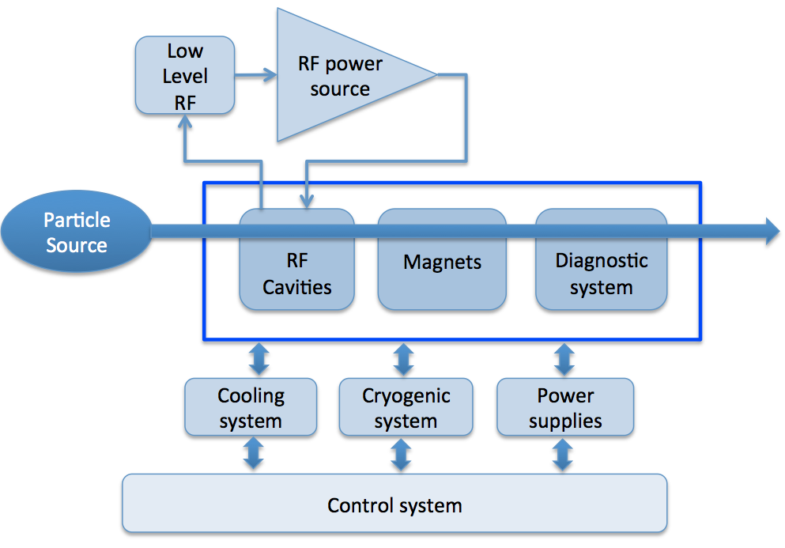
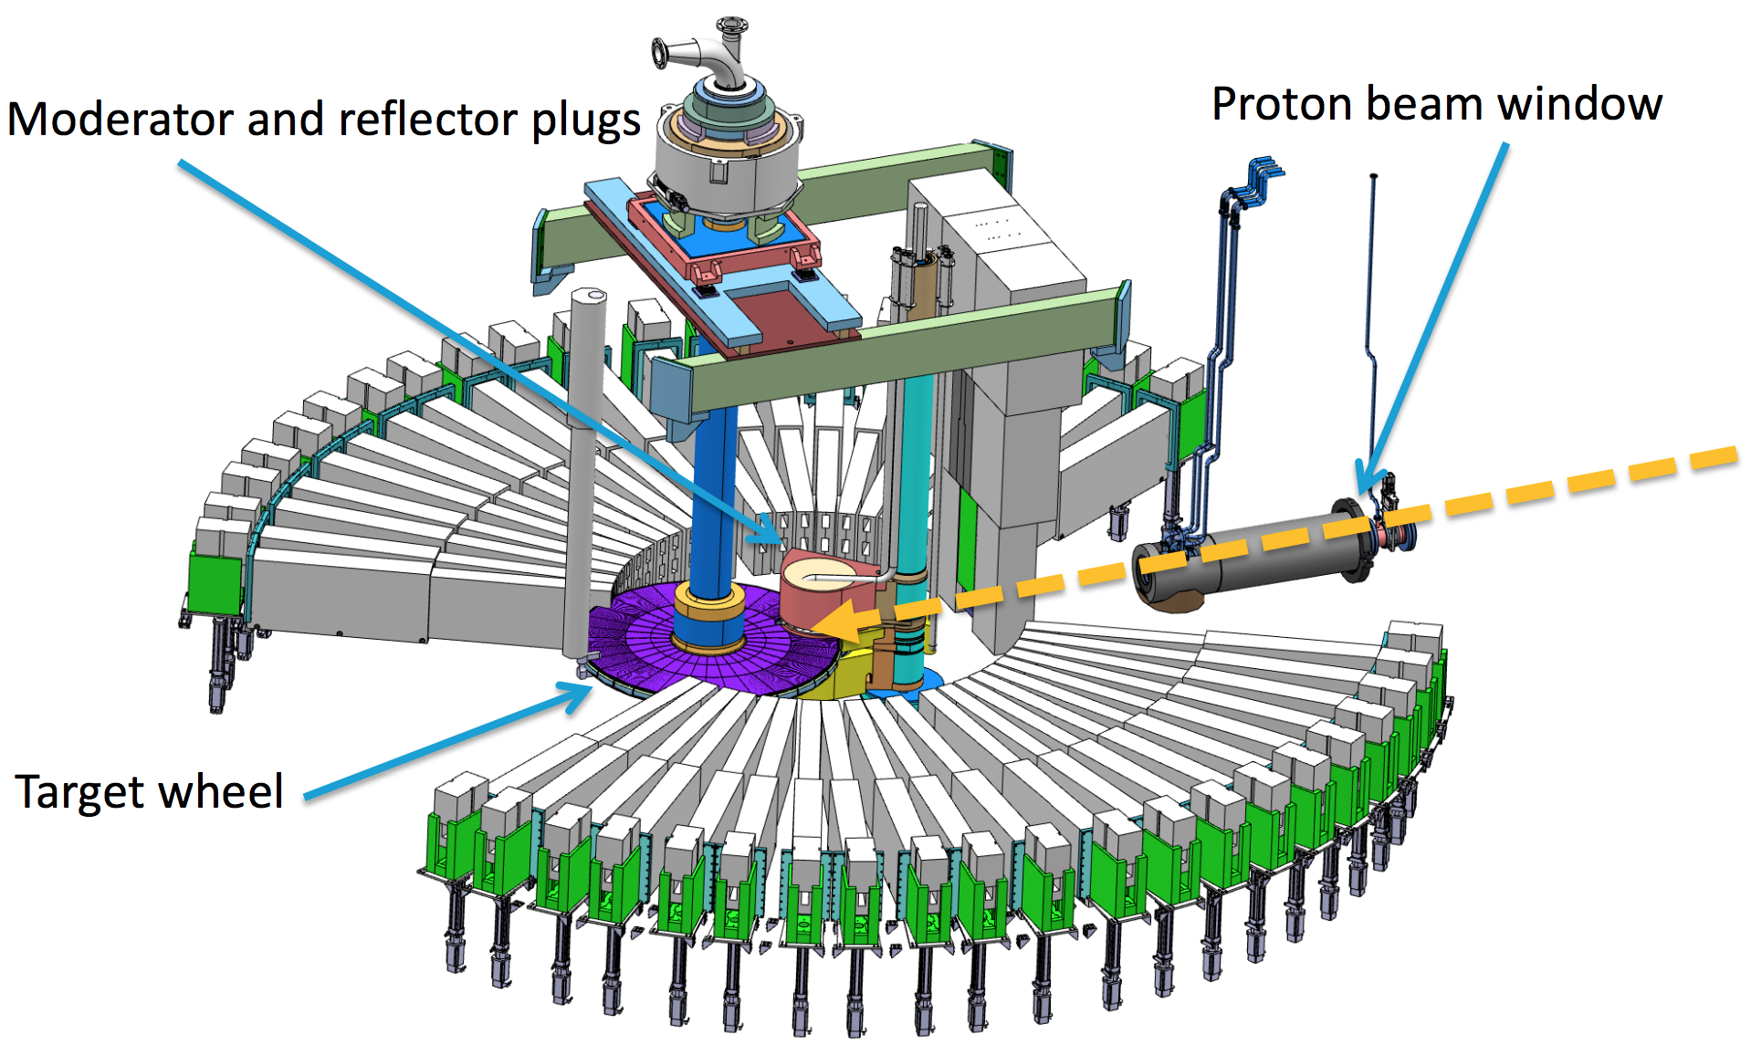
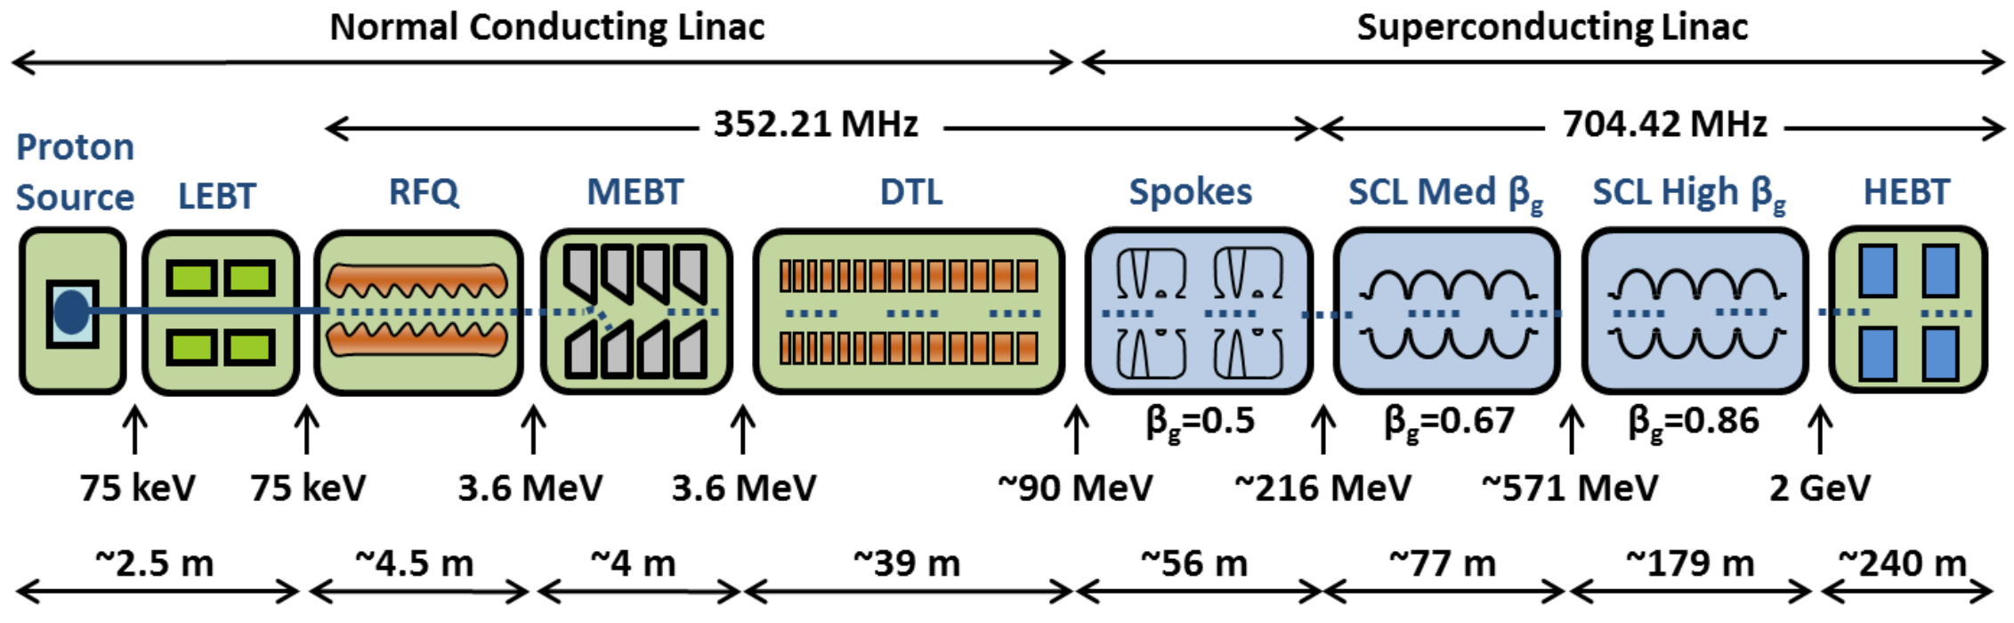
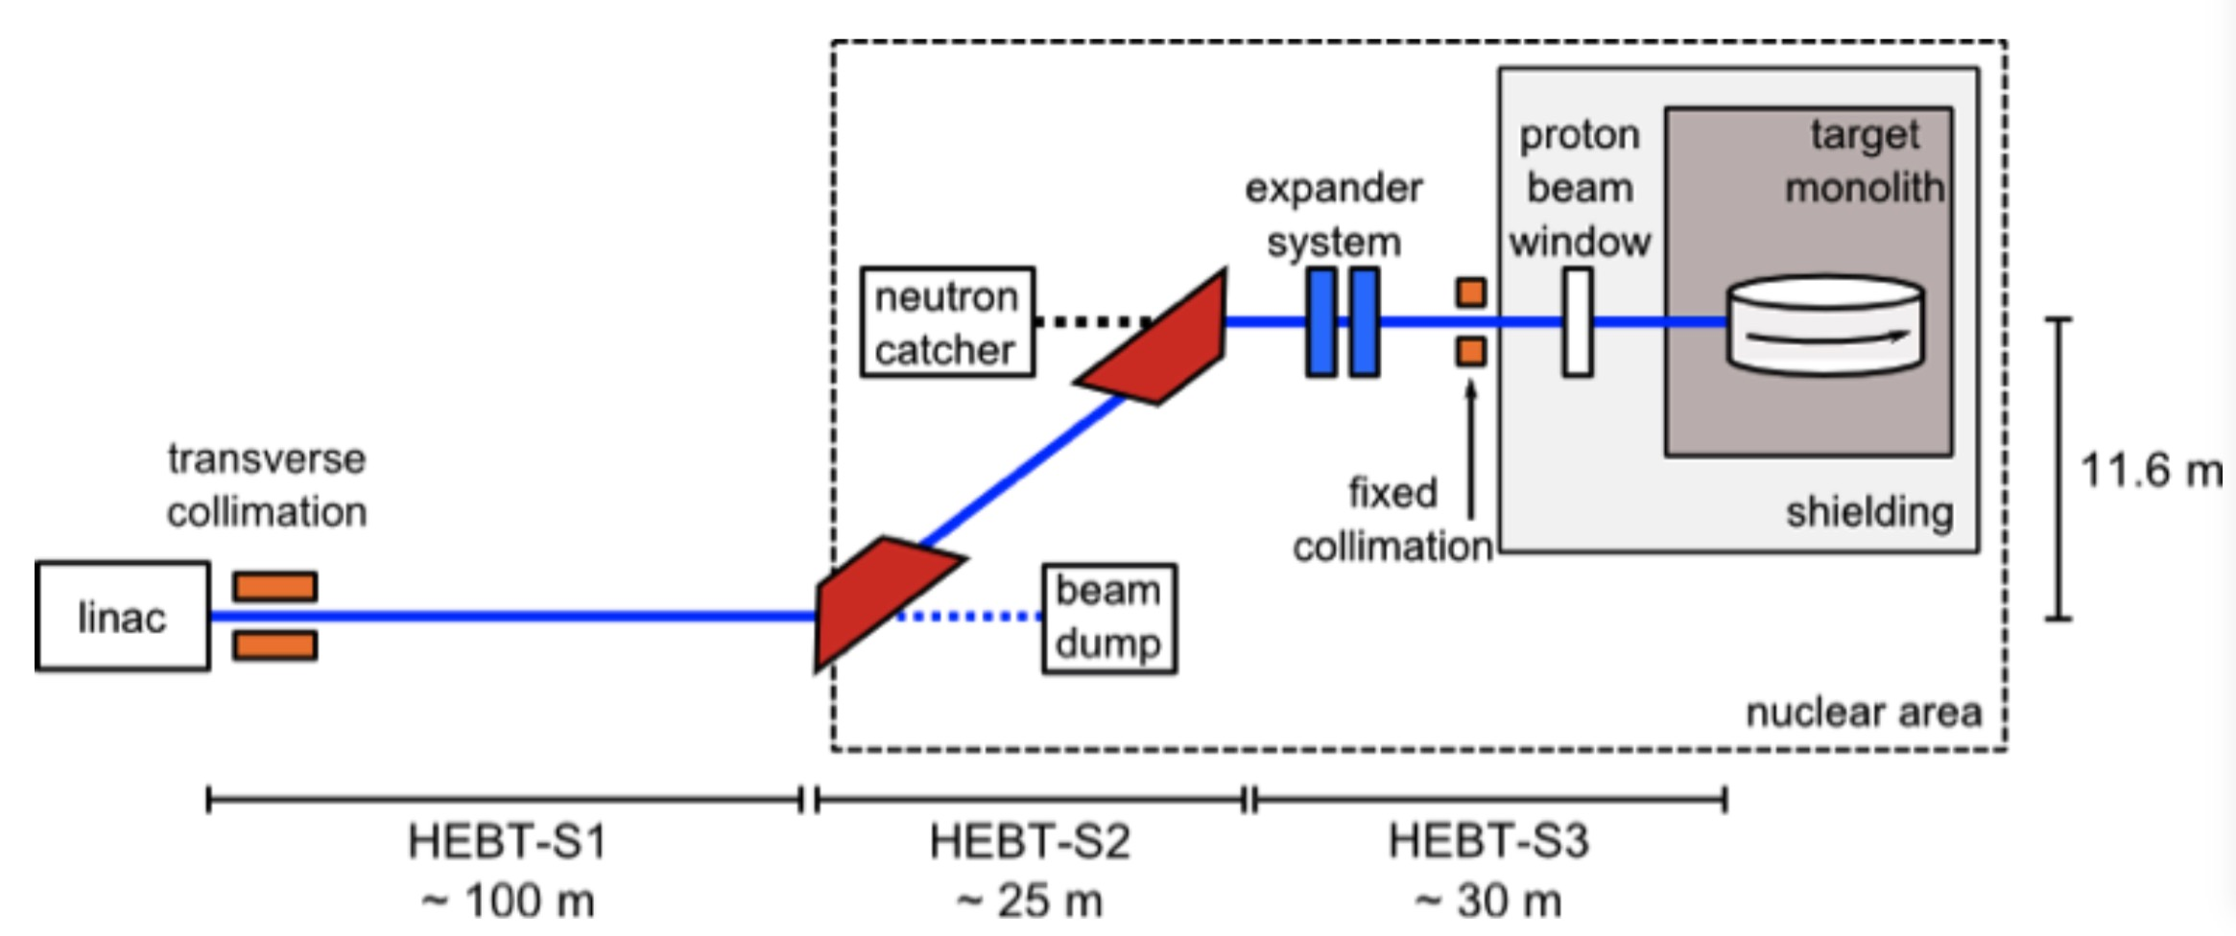
Overview on ESS operation

Slide 4
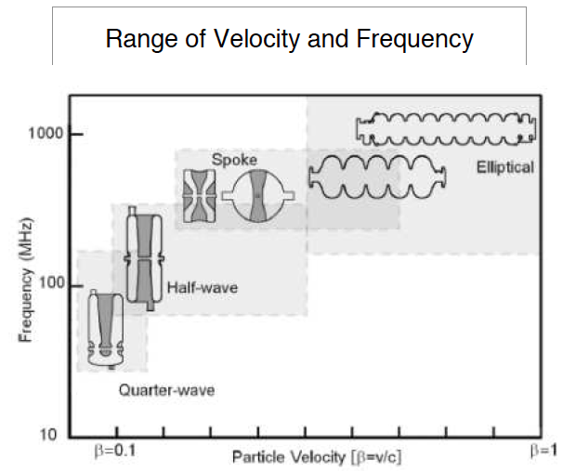

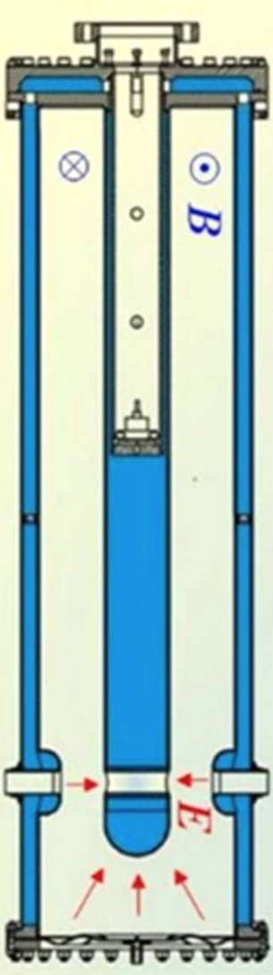
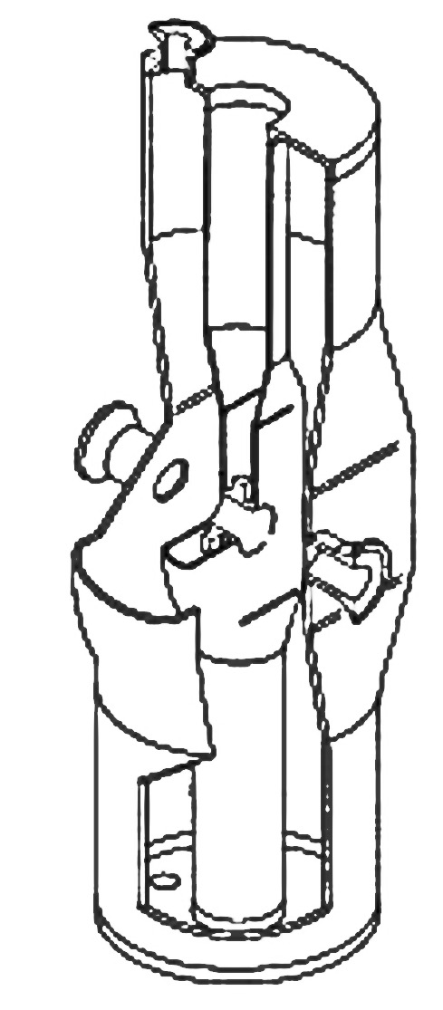
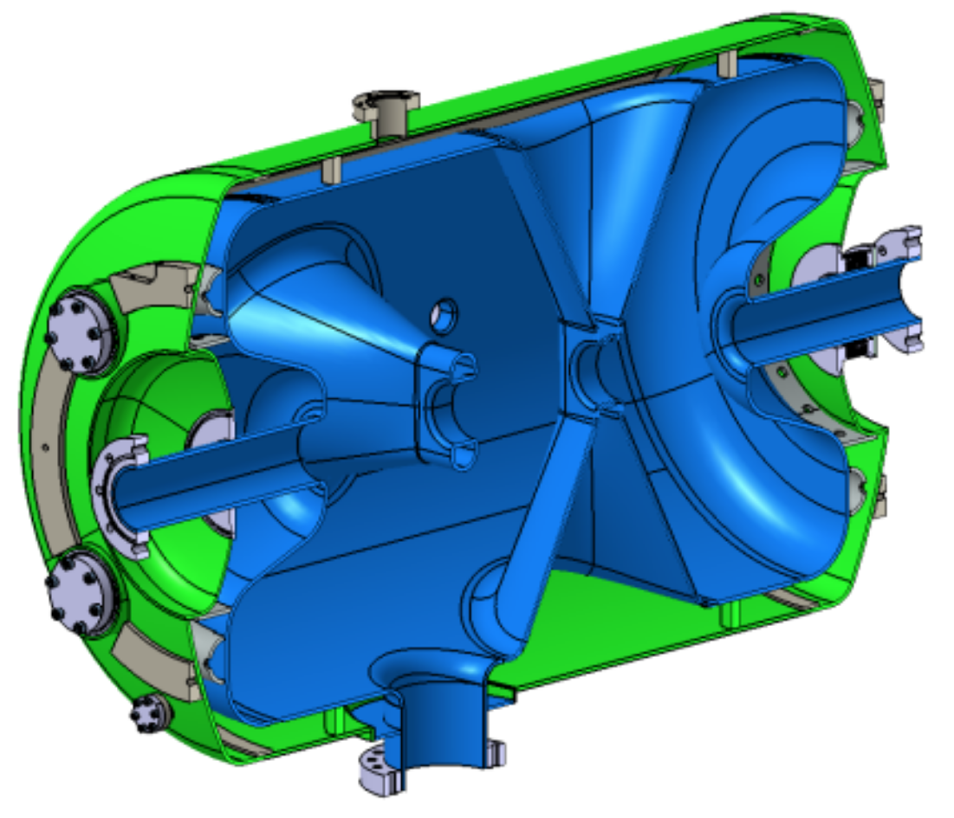
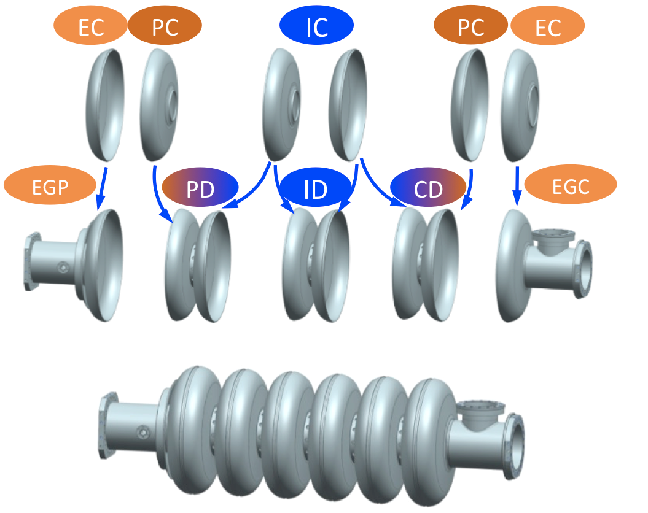
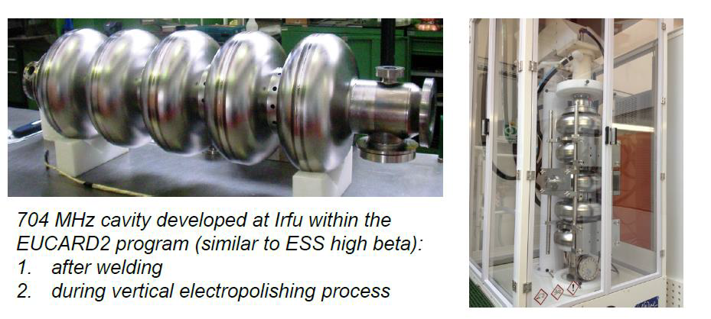
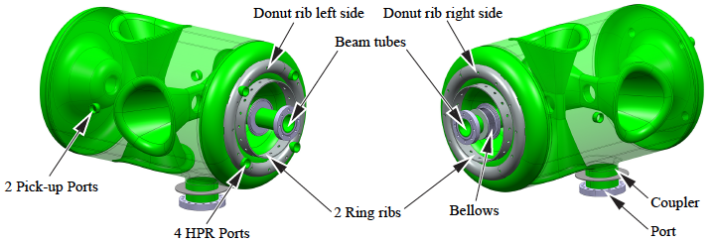
Overview on ESS operation
Why we superconducting cavity?
Cavity power loss increases as square of accelerating voltage
Surface resistance in SRF cavities is roughly 6 orders of magnitude lower than copper cavities
Excessive power loss in CW and long RF pulse limit acceleration gradient in copper cavities to few MV/m, while an SRF cavity can have much higher gradients at 2 K
Application of SRF cavities in ESS linac are based on required high acceleration gradient and long RF pulse length
Main criterias in the SRF section design:
construction cost
power consumption
Reliability
maintenance

Slide 5
Cavity Electromagnetic Design and Construction

Slide 6
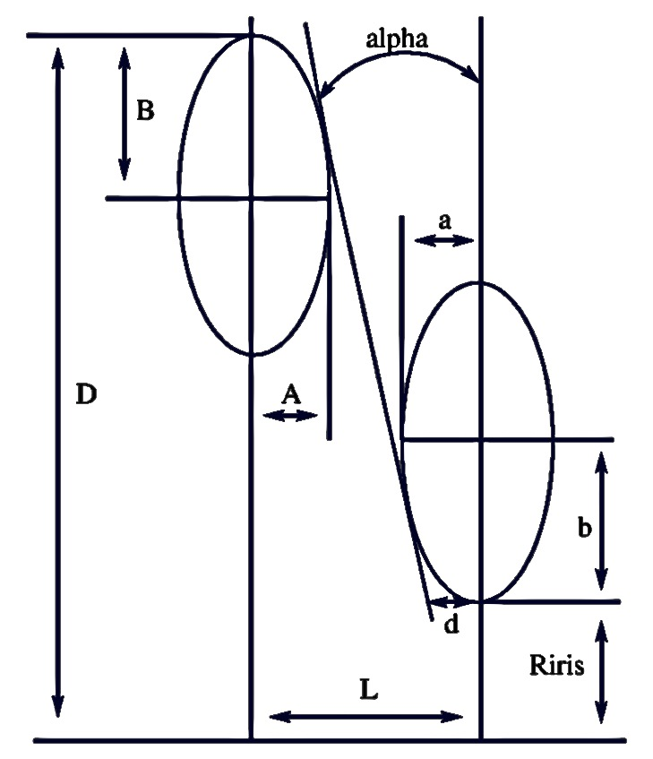
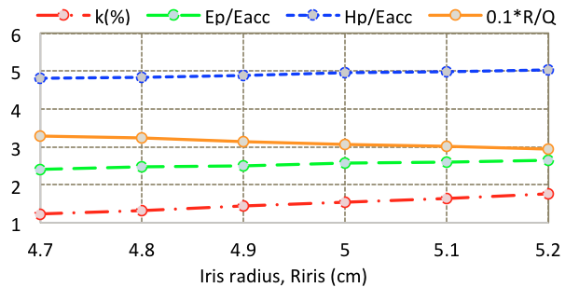
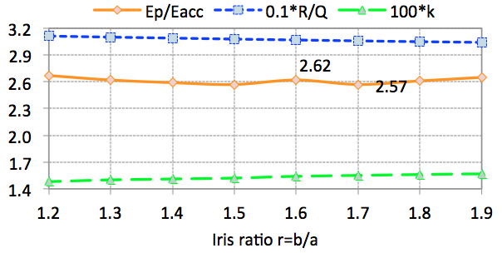
Elliptical cavity design & fabrication
Main considerations in an elliptical cavity design
Large cell to cell coupling factor (kcc)
Equator ellipse ratio equal to one (R=B/A)
Tuning iris ellipse ratio (r=b/a) for lowest Epeak/Eacc
Using the cell radius for half-cell π-mode frequency tuning
Using the sidewall distance to the iris plane to provide balance between E_{peak} and kcc.
Design of the half-cell length based on the π-mode half wavelength and relative velocity of the particle to the speed of light
Considering the beam pipe effect in the end-half-cell design
Tuning the end-half-cell on the main coupler side for the desired coupling (Q_{ext})

Slide 7
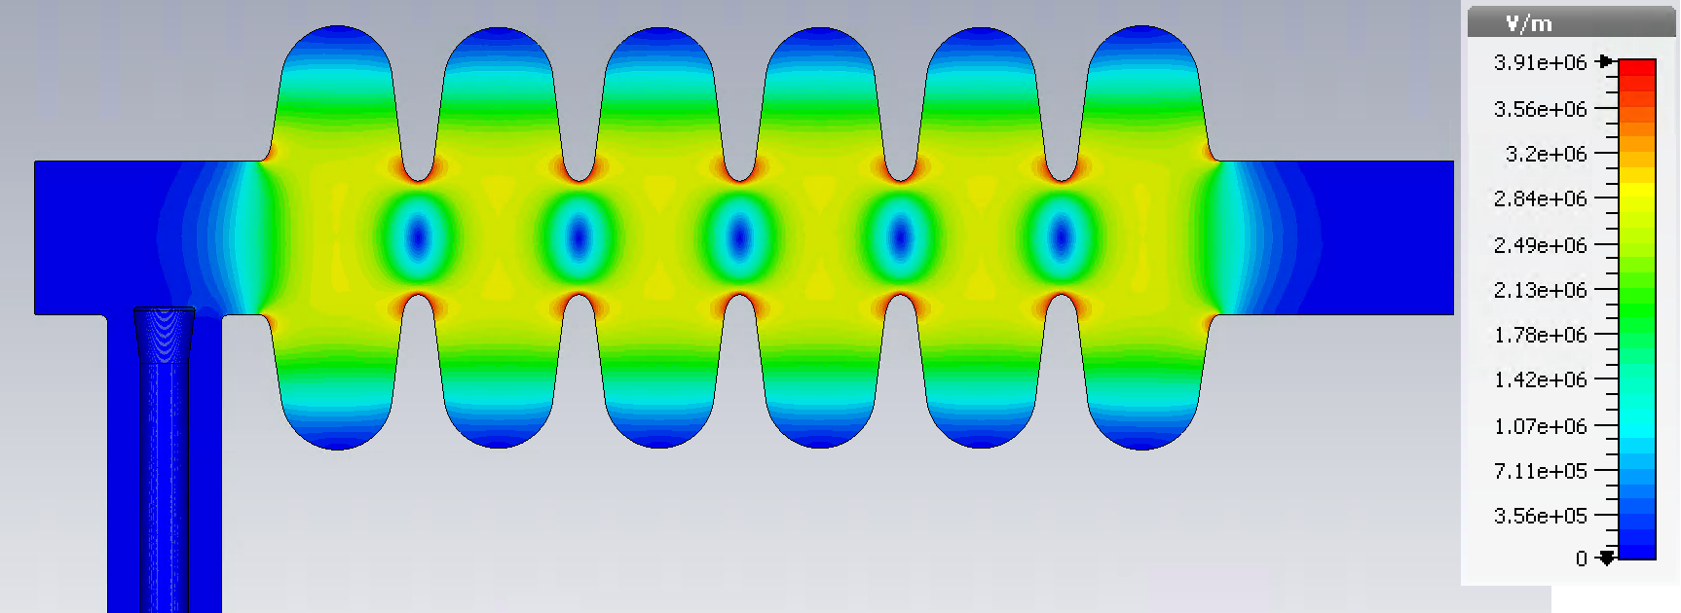
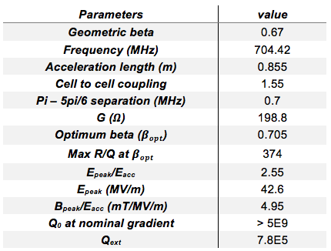
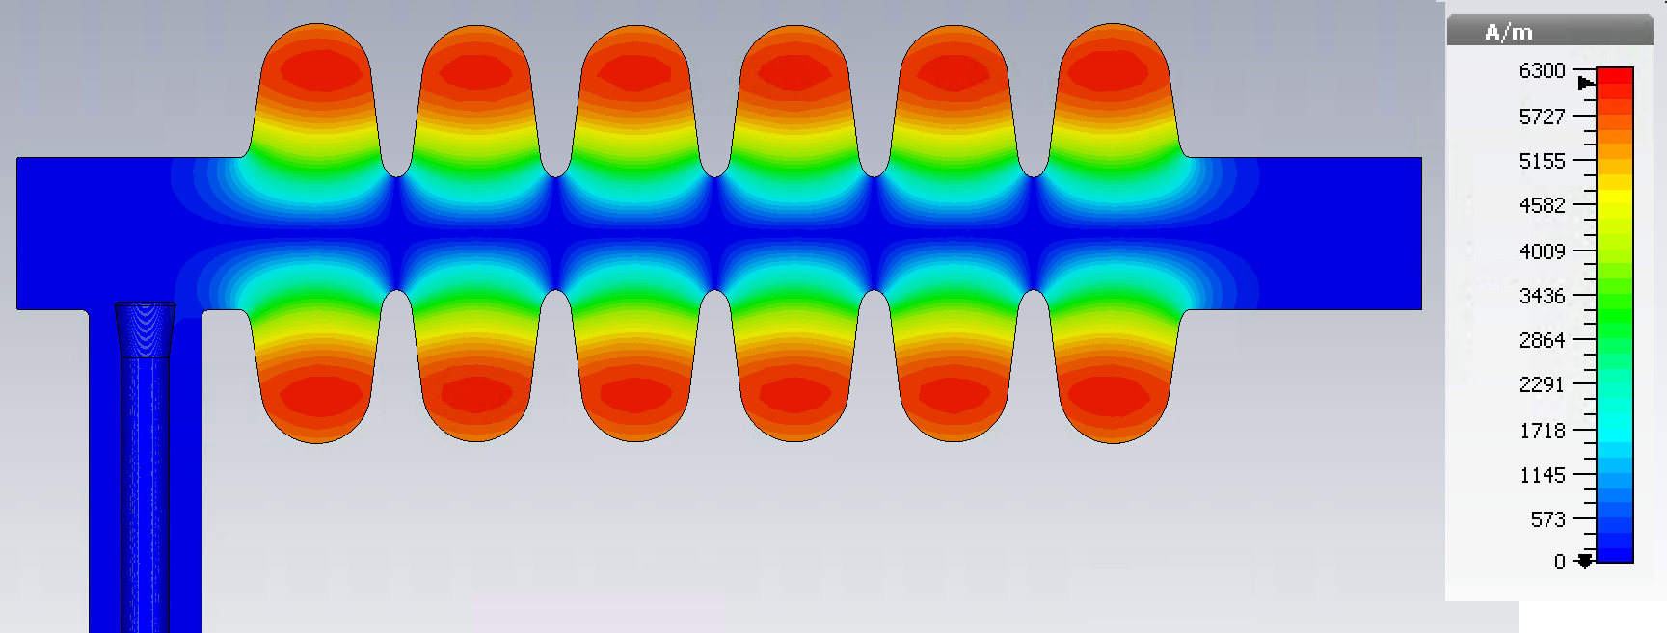
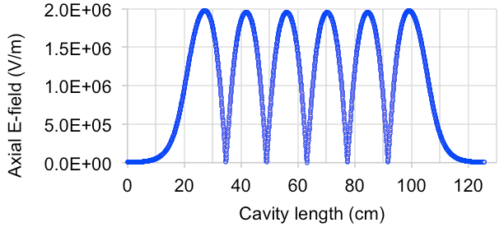
Elliptical cavity design & fabrication

Slide 8
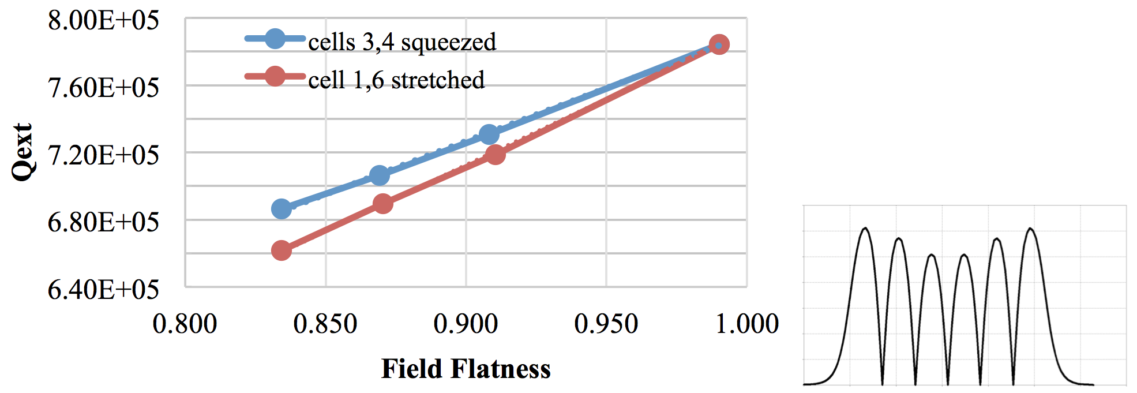
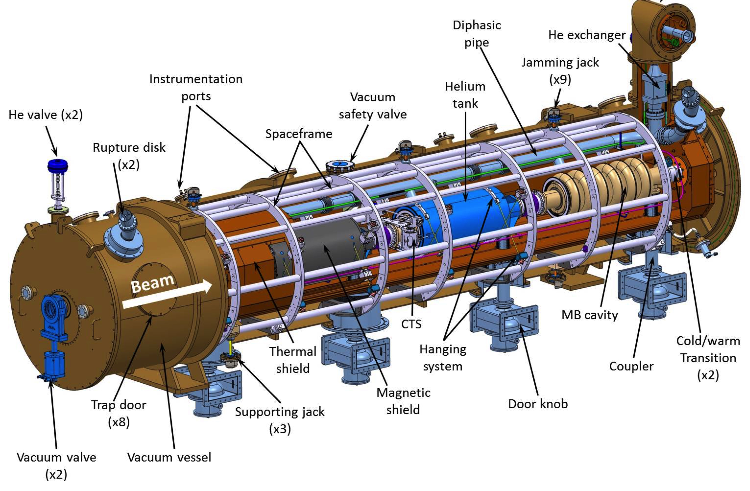
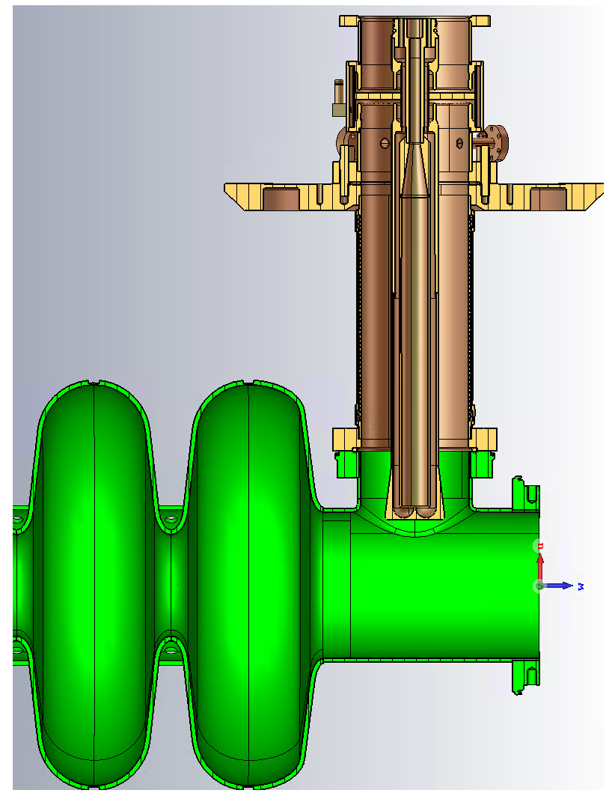
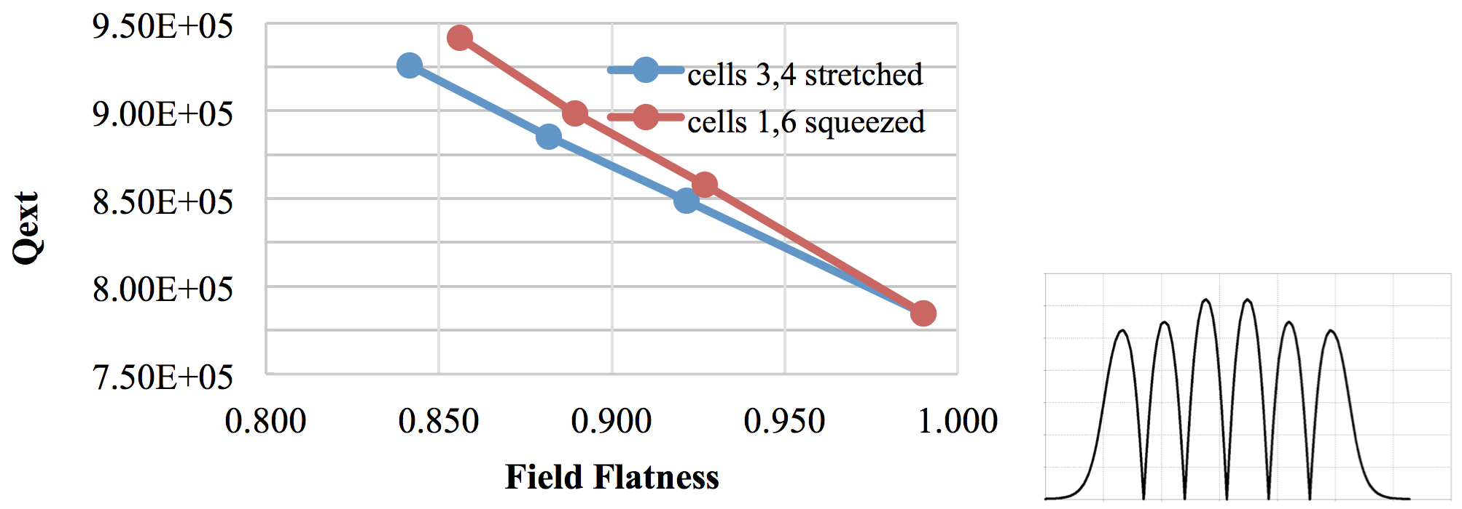
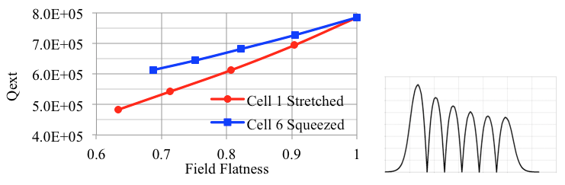
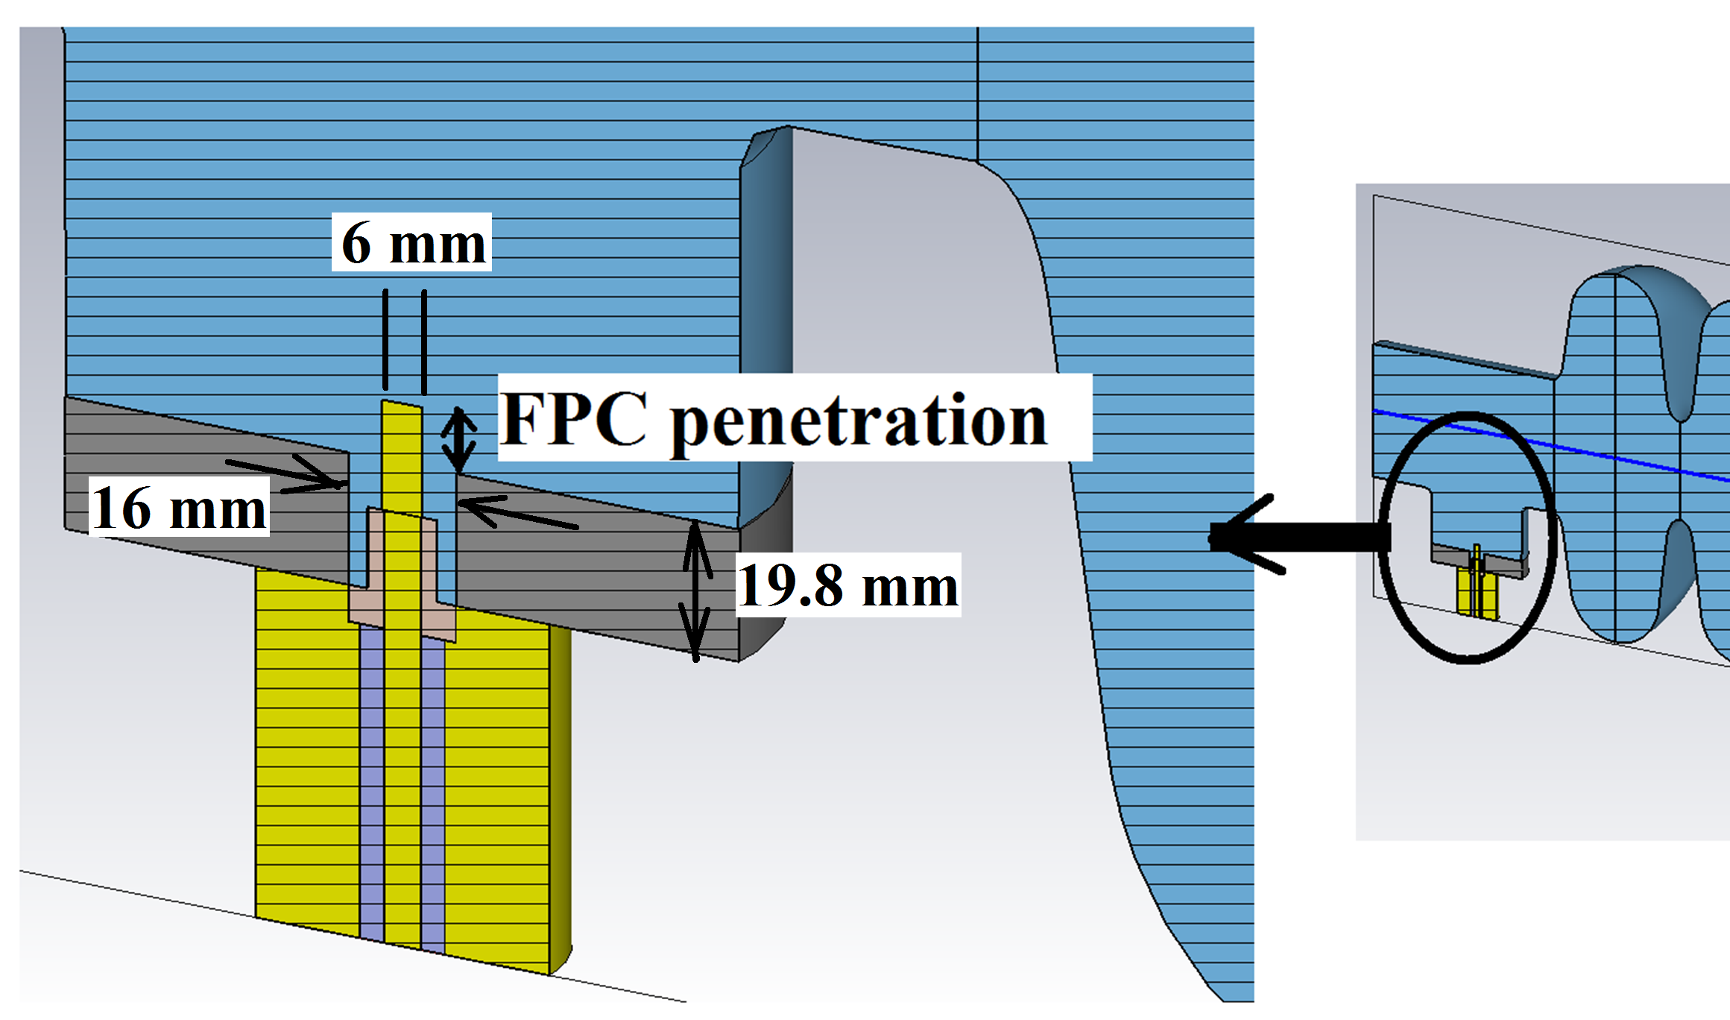
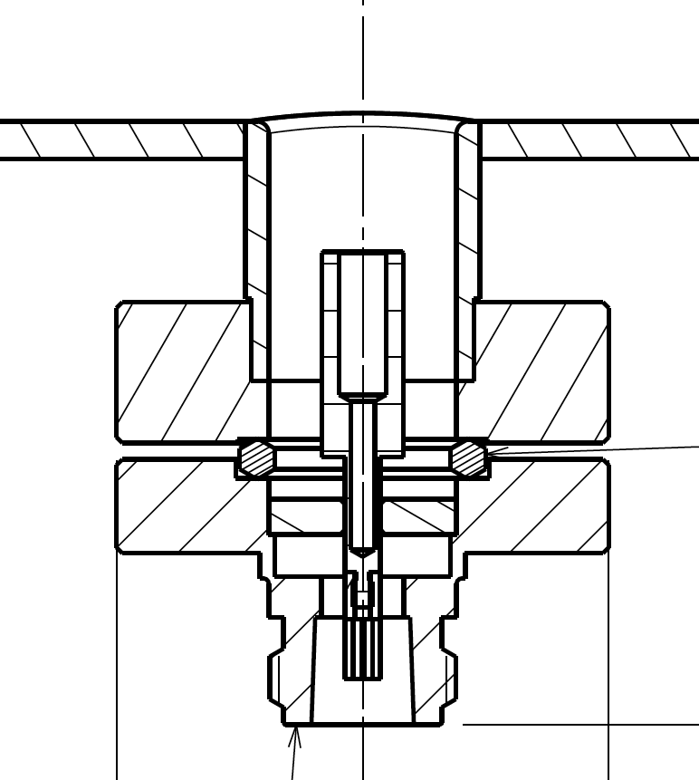
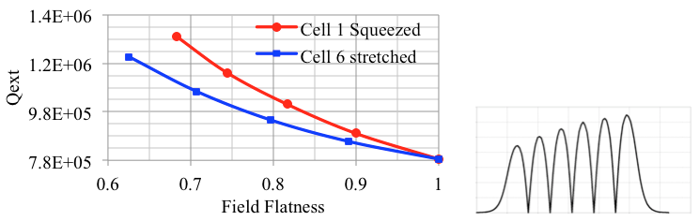
Elliptical cavity design & fabrication

Slide 9
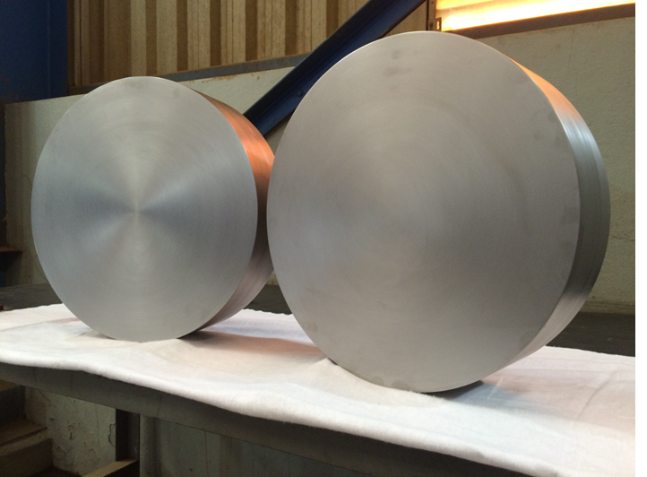
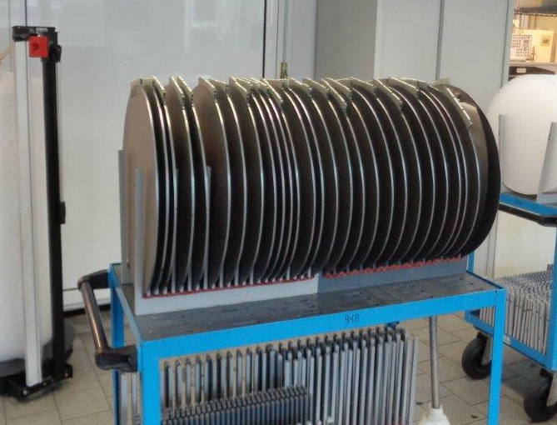
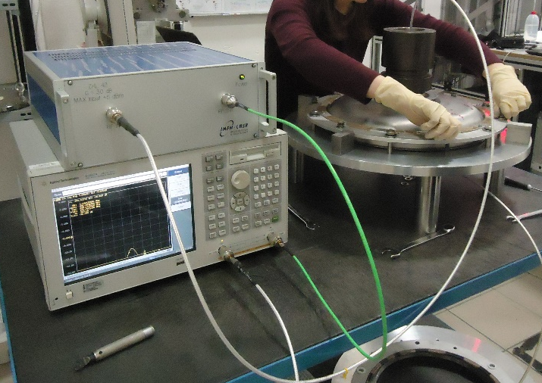
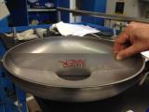

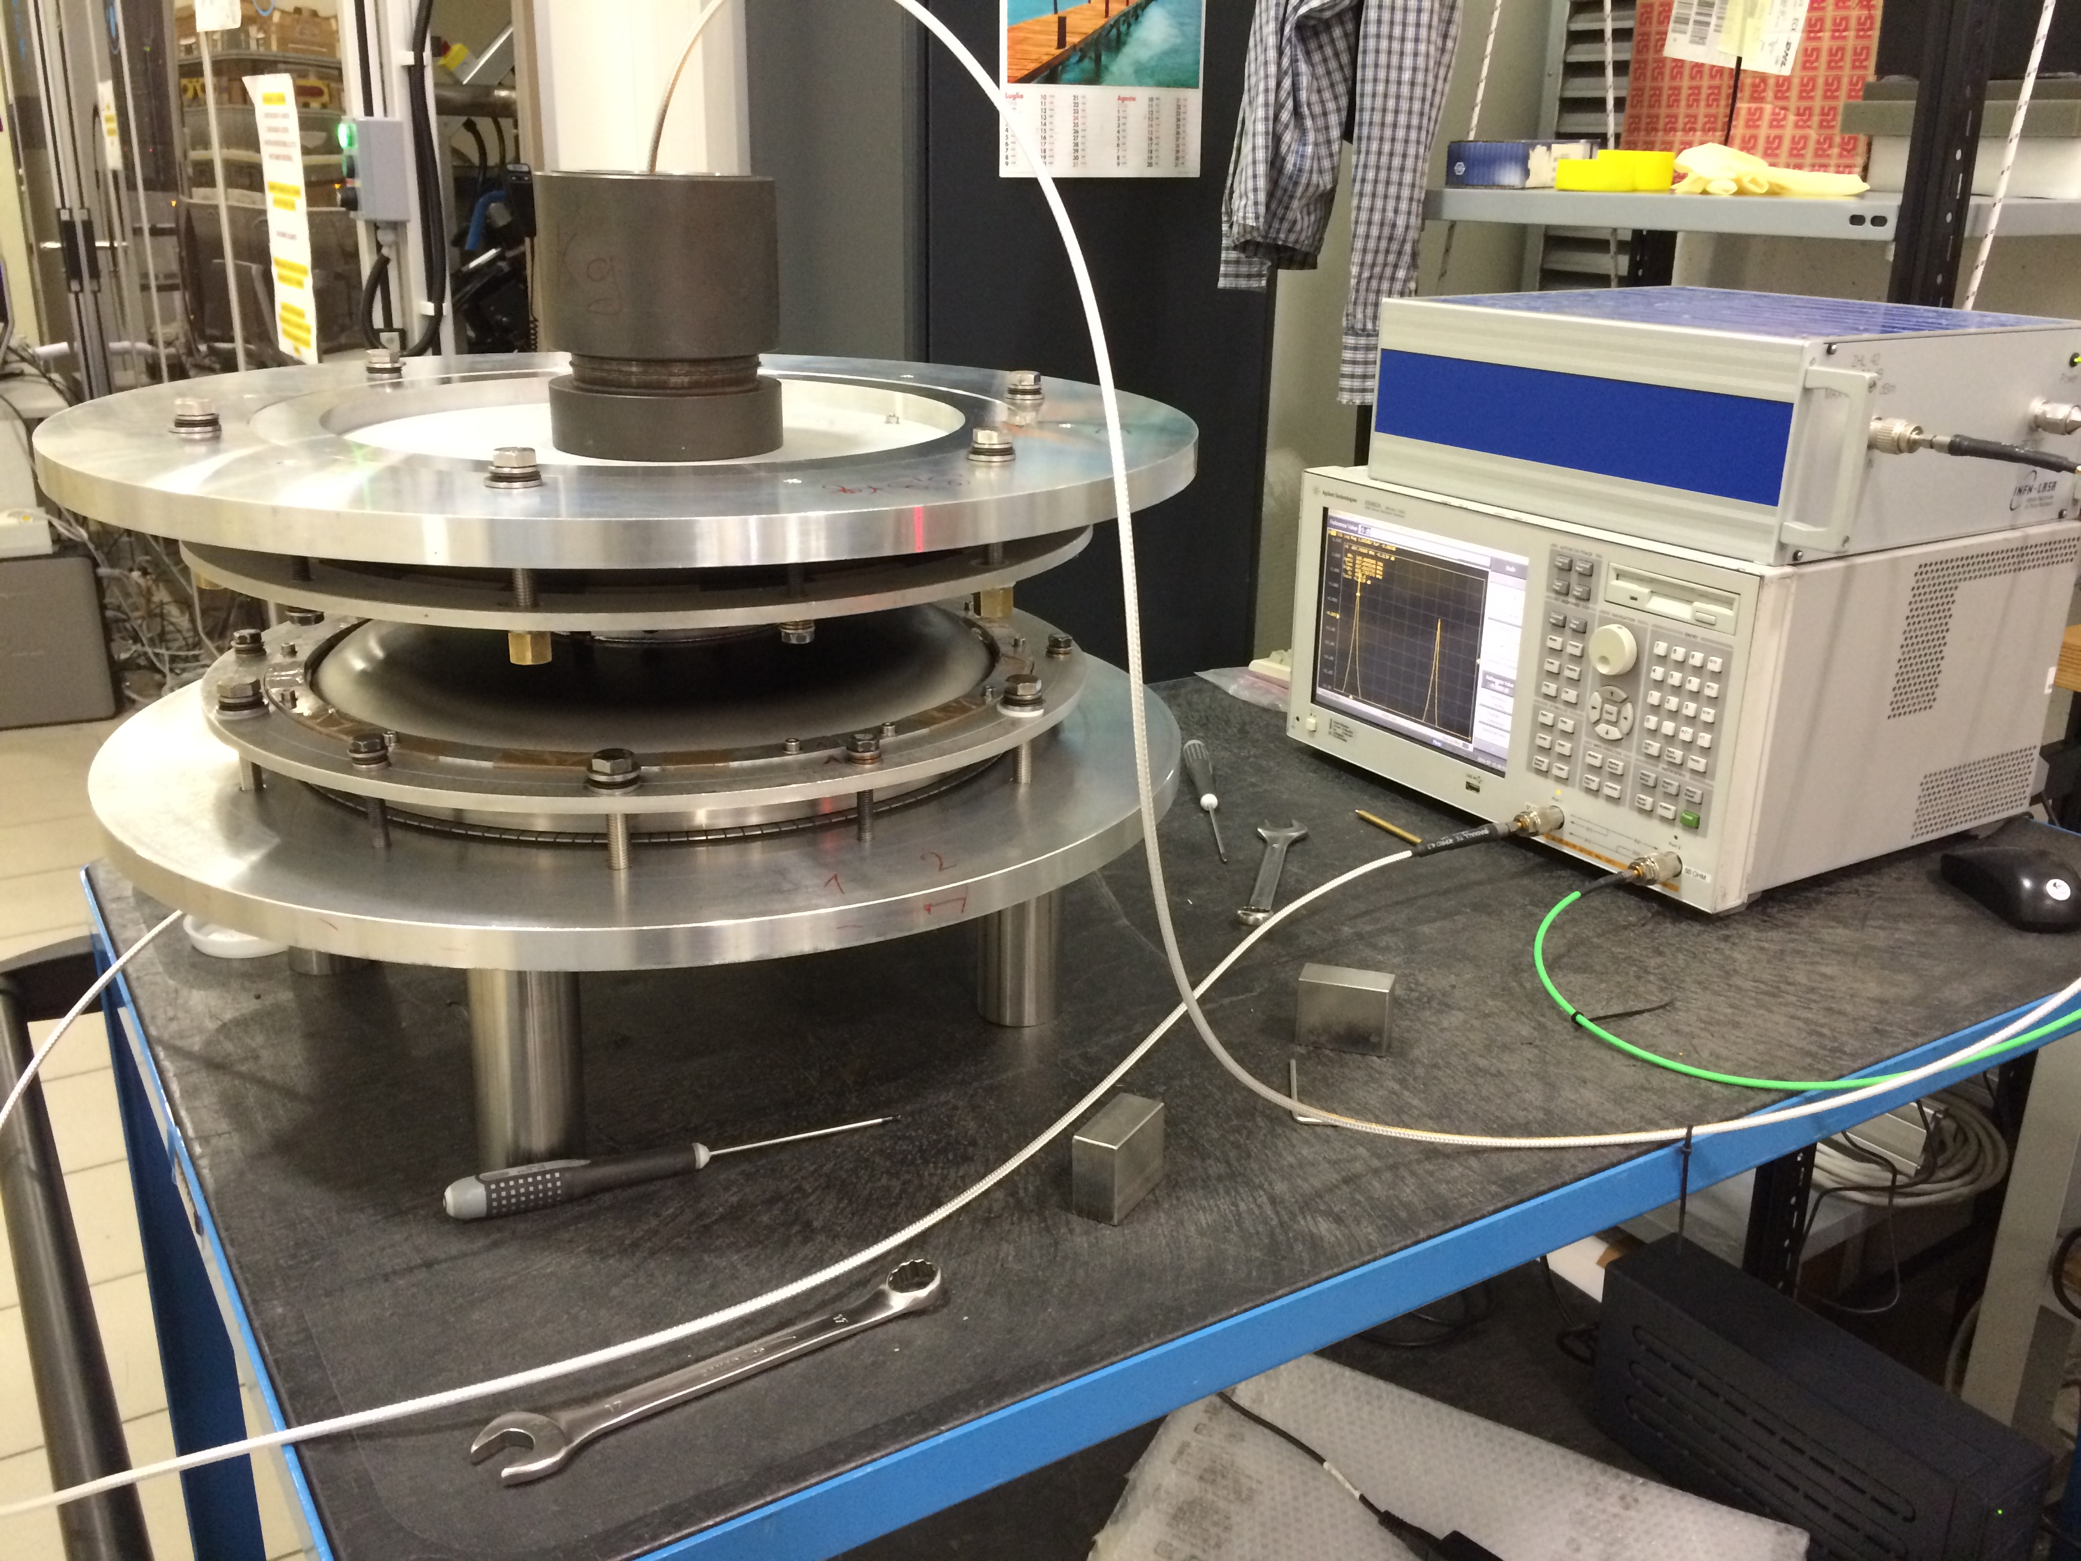
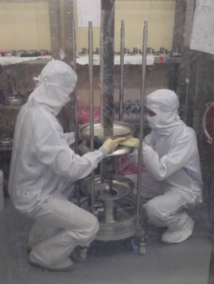
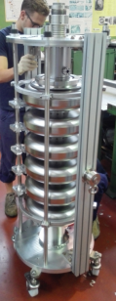
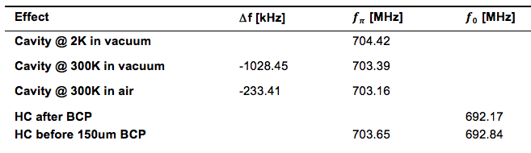
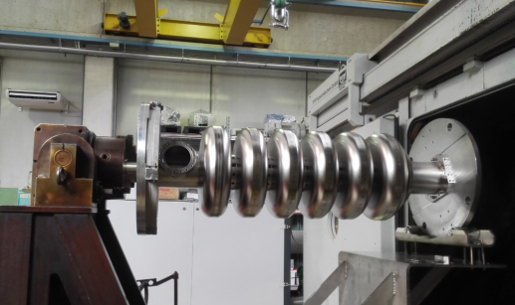
Elliptical cavity design & fabrication
Inner HC frequency evolution from nominal 704.42 MHz

Slide 10
Cavity Higher Order Mode

Slide 11
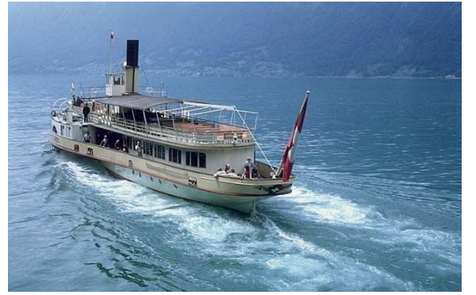
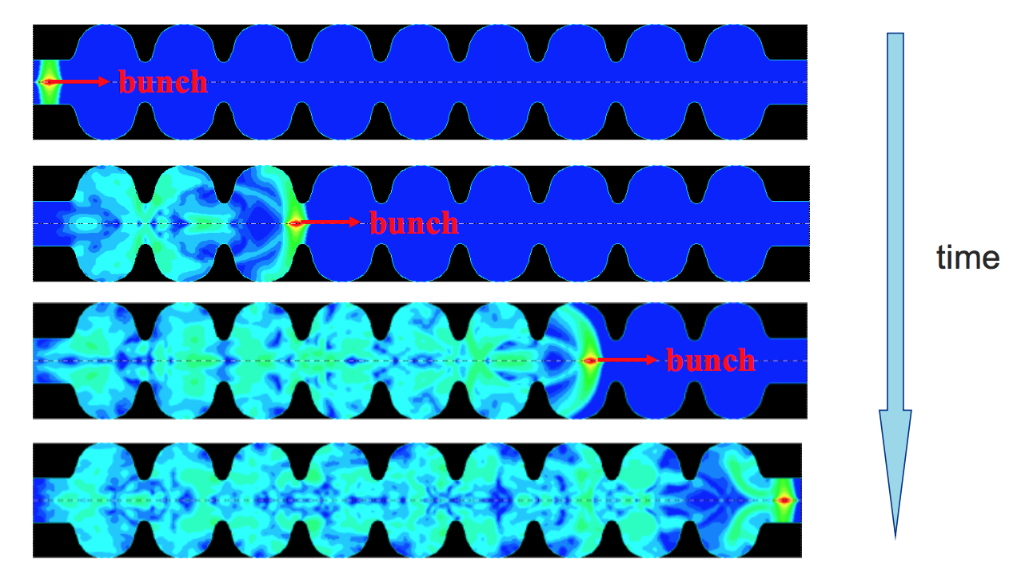
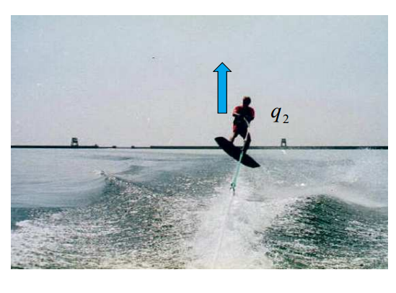
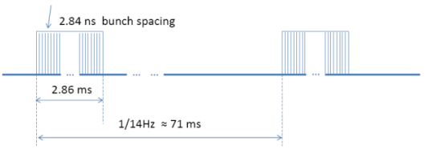


Cavity higher order modes
Beam dynamic studies shows only HOMs that cross machine lines are problem
Trapped HOMs need to be identified during the cavity design
introduce some geometry change in the cavity cells and prevent crossing of the HOM frequency with the machine lines

Slide 12
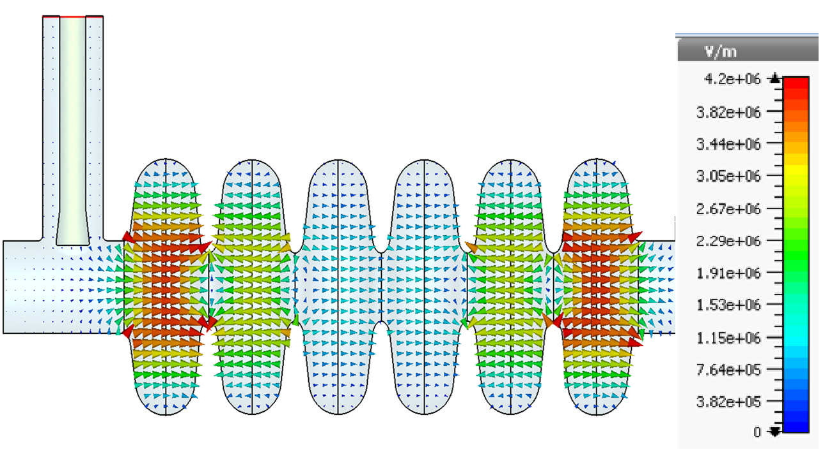
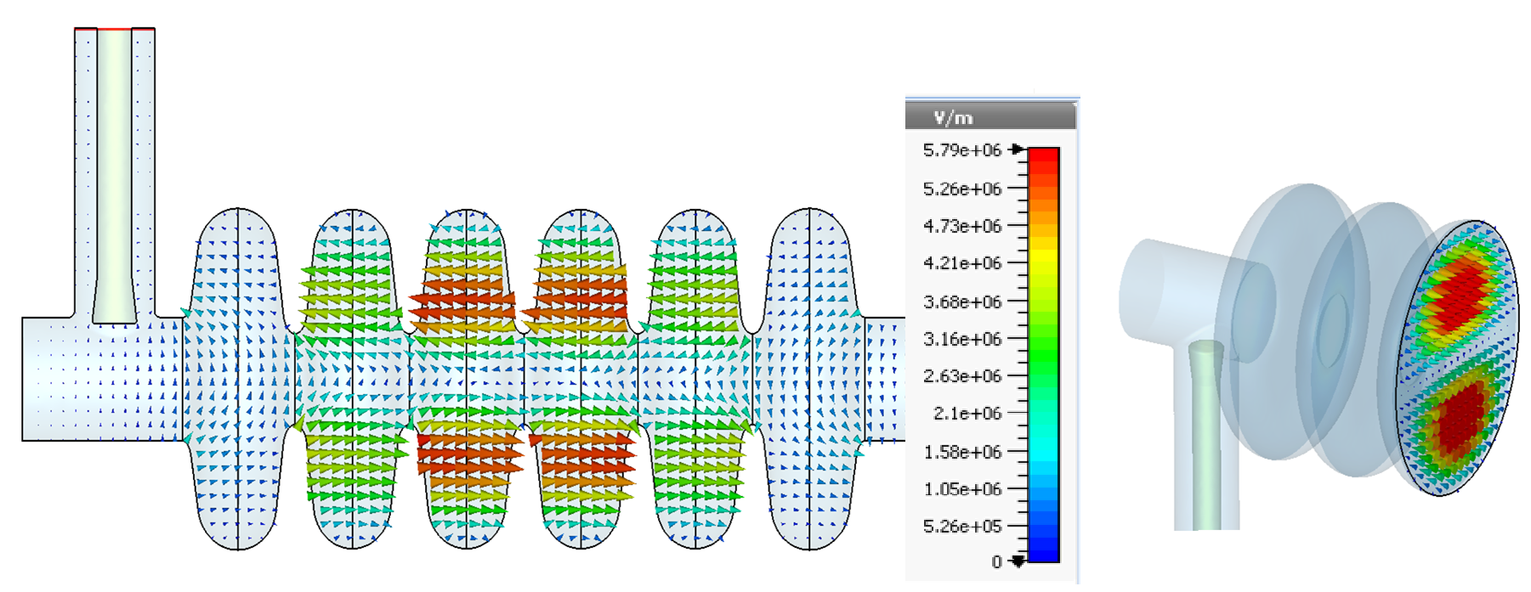
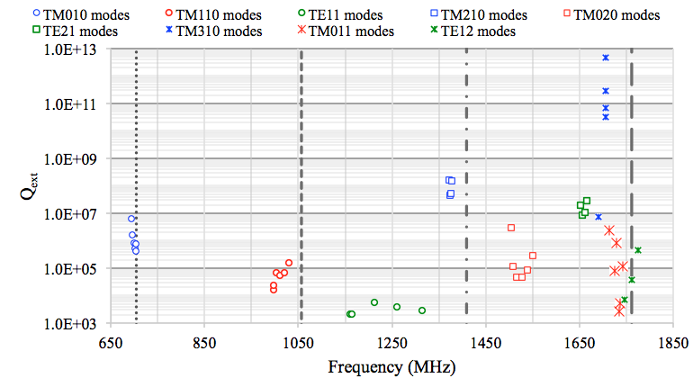
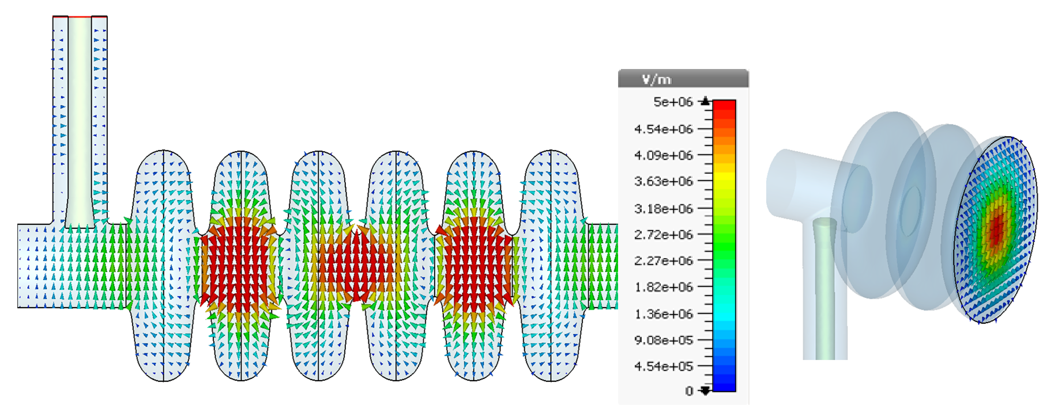
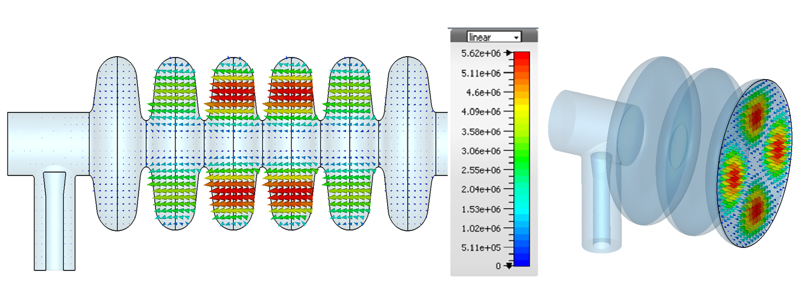
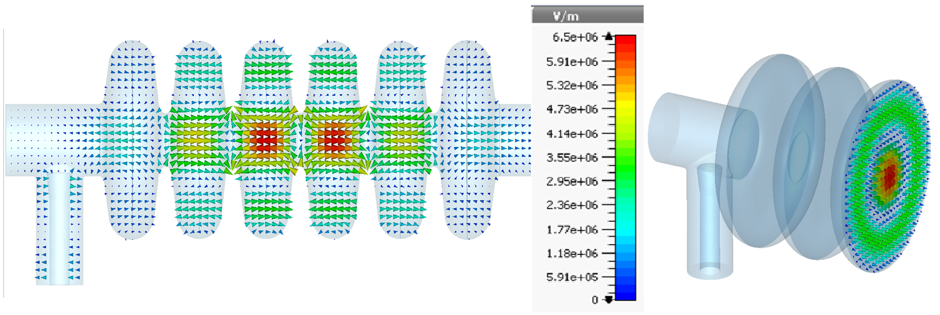
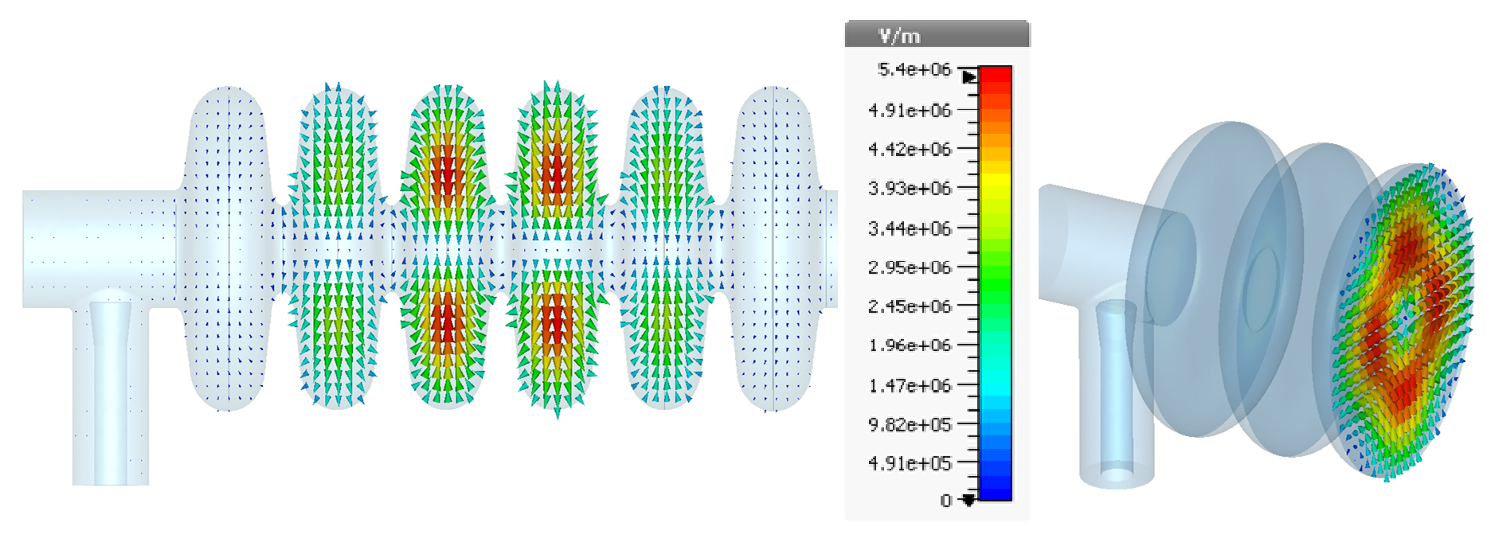
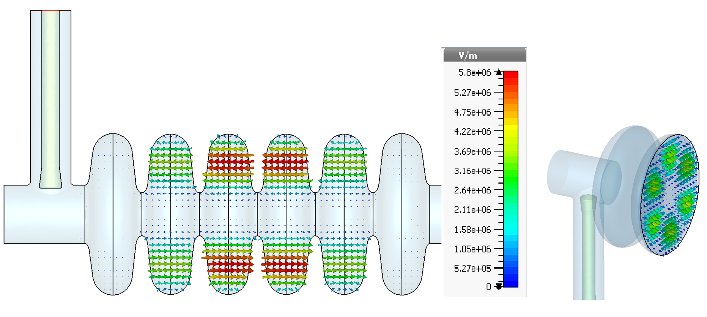
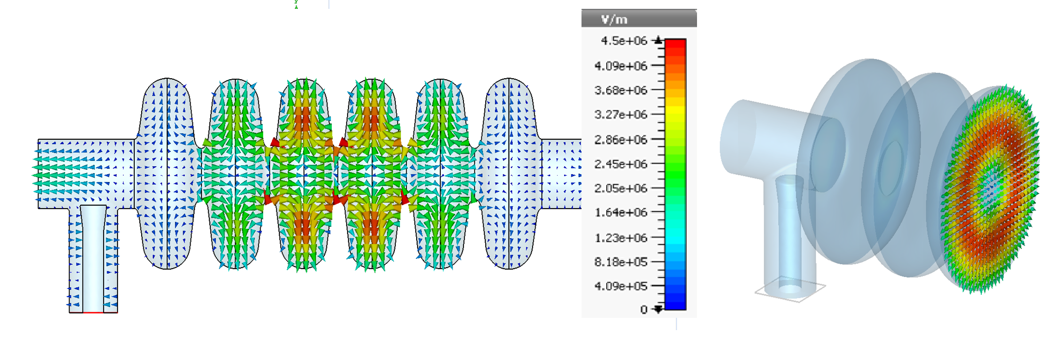
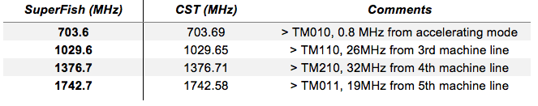
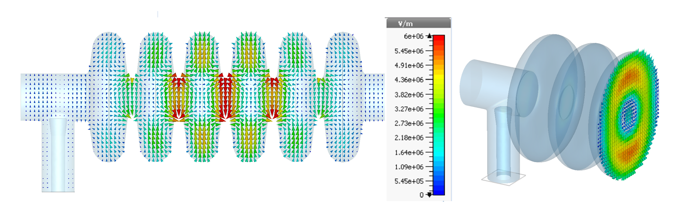
Cavity higher order modes
703.69 MHz TM010
1029.65 MHz TM110
1314 MHz TE11
1376 MHz TM210
1549 MHz TM020
1666 MHz TE21
1705 MHz TM310
1742 MHz TM011
Modes close to ESS machine lines
1773 MHz TE12

Slide 13







Cavity higher order modes
Frequency shift of 1st and 3rd modes in a single cell elliptical cavity
Frequency shift of the 1742 MHz mode due to 0.2 mm geometrical errors (kHz/mm)
Considering 0.2 mm tolerance on all the six geometrical parameters will lead to a less than 6.3 MHz mode frequency change for the 1742 MHz mode.
This result is consistent with study on SNS cavities to obtain a statistical estimation on the possible HOM frequency

Slide 14






Cavity higher order modes
A reliable tool to detect a specific HOM is the measurement of its axial E-field profile by bead-pull measurement

Slide 15



Cavity higher order modes

Slide 16
Cavity Field Emission

Slide 17






Cavity field emission
Cavity surface E-field decreases work function barrier level at metal surface, so electrons of metal due to their quantum wave like nature, will have possibility to tunnel out into vacuum
Emitted electrons absorb RF power, can generate dark current, increase cavity losses, generate radiation and even push the cavity to quench
exponential increase start is from 35 MV/m and it is equivalent to E_{acc}=13.7 MV/m.
Notes:
βFN and Ae are empirical parameters could stay between 10 to 300 and 10-15 to 10 cm² respectively
In the plotted FN graph βFN= 100 and ϕ= 4 eV

Slide 18


Cavity field emission

Slide 19








Cavity field emission

Slide 20






Cavity field emission

Slide 21




Cavity field emission

Slide 22
Thanks for your attention
Questions?

Slide 23


Slide 24




