Slide 1
Distributed computing at P. J. Safarik University
Jozef Černák
Department of Nuclear and Sub-Nuclear Physics
Institute of Physics
University of P. J. Safarik in Kosice
Kosice
Slovakia
e-mail: jozef.cernak@upjs.sk

Slide 2
Institute of Physics and Institute of Applied Informatics
Marek Kocan,
Alexander Dirner,
Eva Cernakova,
Lukas Tropp (student)
Institute of geographic
Jaroslav Hofierka,
Ján Kaňuk,
Michal Gallay

Slide 3
UPJS in NorduGrid Collaboration
-2003, initial motivation was to apply grid computing to study avalanche phenomena (statistical physics)
-2006-2016 UPJS team was responsible for
  operation of testbed http://arc-emi.grid.upjs.sk/ ,
  software testing as well as quality assurance processes,
  development and operation of supporting services, for example ”InstantCA”
  operation of EGI site.
Projects:
  FP6 KnowARC (interational),
  FP7 EMI, http://www.eu-emi.eu/ (international)
  UVP TECHNICOM (national).

Slide 4
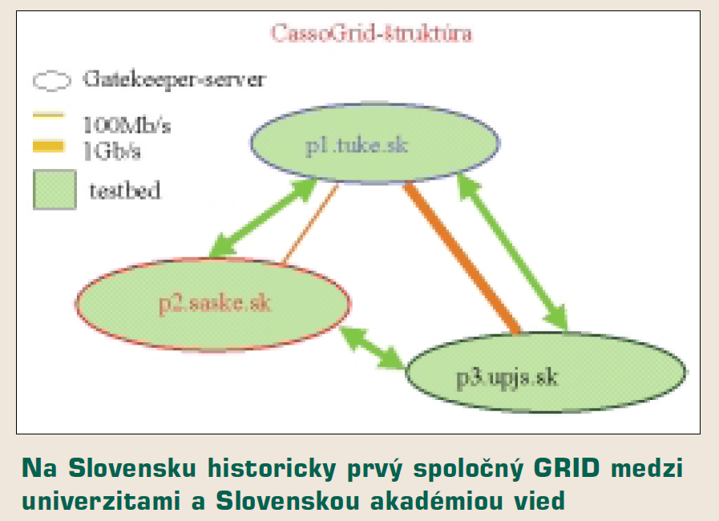
2003-Globus Toolkit, The first Slovakian Grid was built in Kosice
Strong ambition to be part of the US grid infrastructure NMI
http://www.nsf.gov/news/special_reports/cyber/middleware.jsp
2004 We began to be a part of Nordugrid (1PC ☺ )

Slide 5
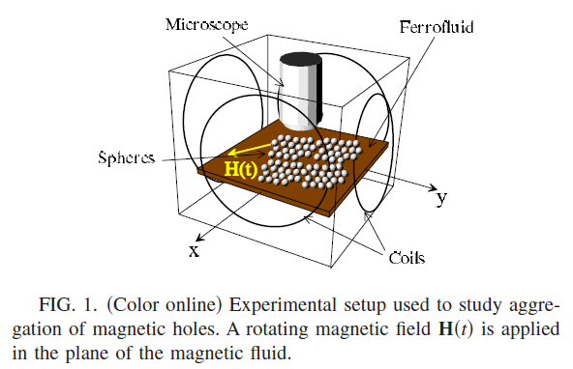
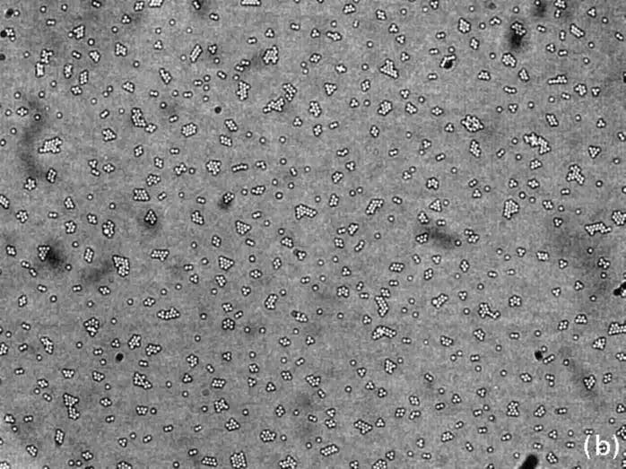
Aggregation phenomena

Slide 6
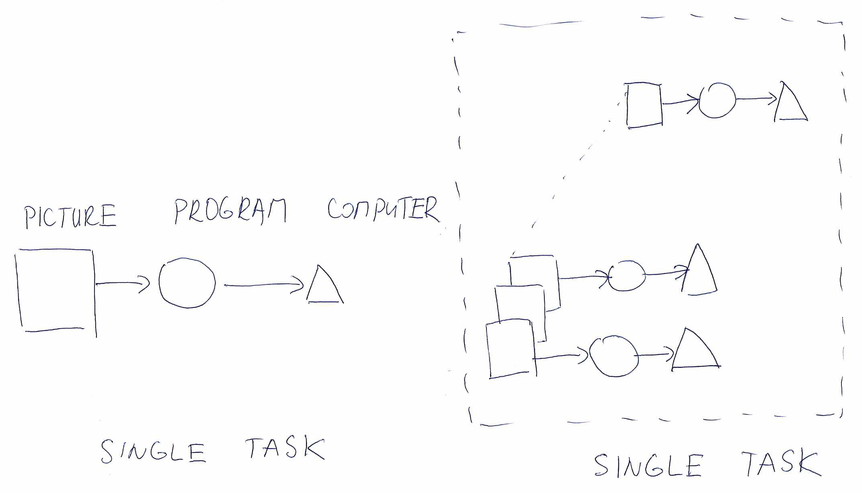

Slide 7
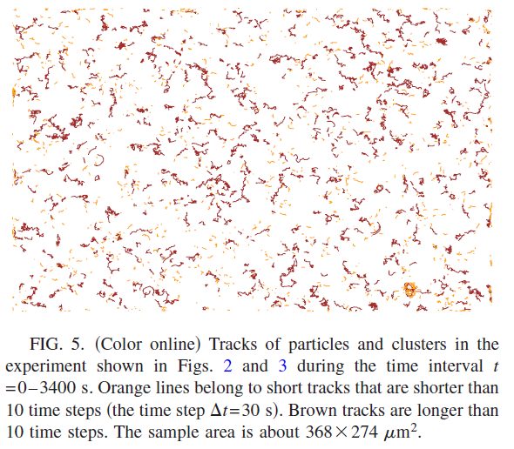

Slide 8
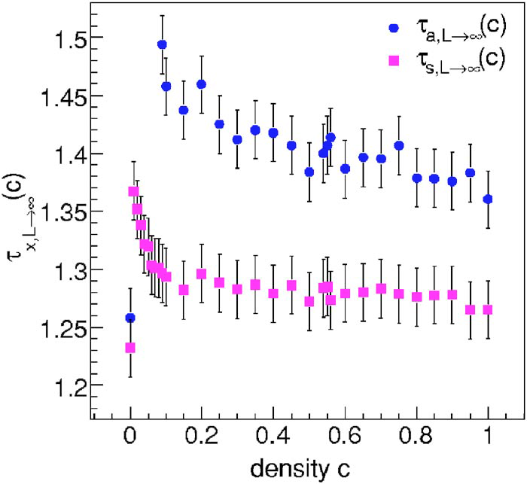
Computer Simulations of Avalanche Phenomena
Computer simulations on several lattices L for several parameters c. More than 1 million avalanches are needed to receive statistically valuable data. Heavy computation task.
Details are published
Physical Review E 73, 066125 (2006), Physical Review E 82, 061116 (2010).

Slide 9
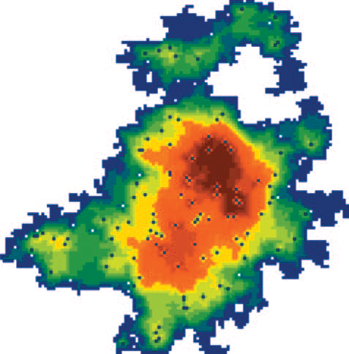
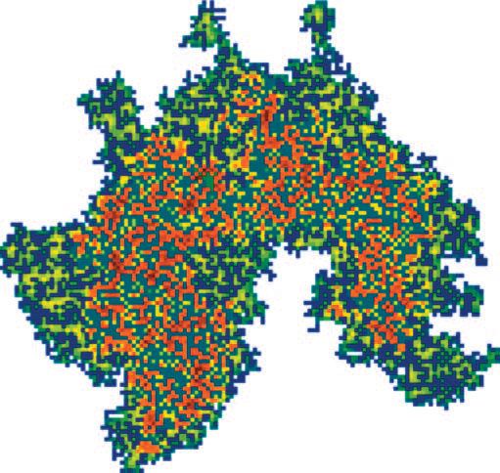
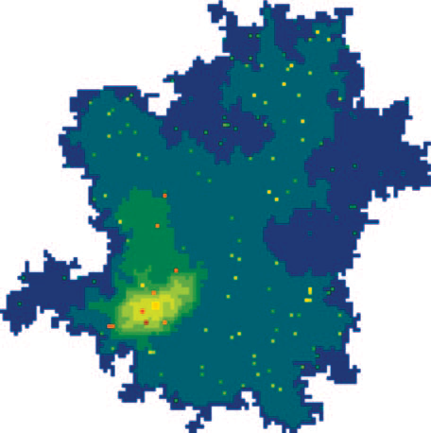
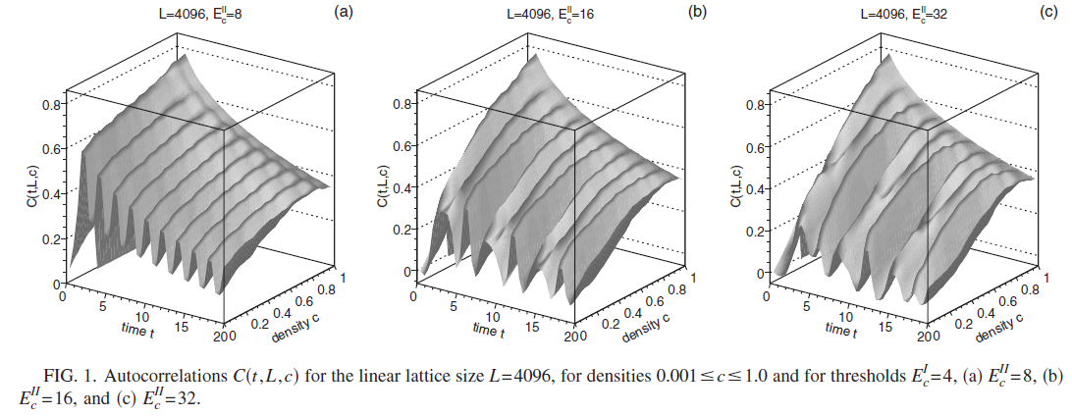
Avalanche dynamics-examples

Slide 10
3D surface reconstruction (student project)-Method and Data
Terrestrial laser scanning method LIDAR was applied to scan a relief of the cave.
LIDAR scanners produce output data sets of points z,y,z (+color).
Many positions of LIDAR scanner are needed to minimize shadow volumes (next slide).
A few formats exist to store data.

Slide 11
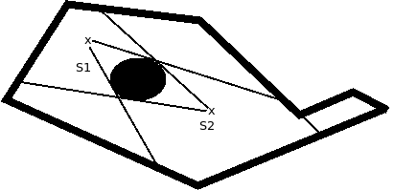
LIDAR scanning of closed spaces-principle
.
Several positions of LIDAR scanner are needed to avoid shadow
volumes. This approach increase data redundancy

Slide 12
DATA-processing
input data – a set of points (x,y,z) for each position of LIDAR scanner
data processing is realized in a simple chain of several steps:
  reduction of redundant point,
  surface reconstruction from a cloud of points to triangular surfaces, Poisson method of surface reconstruction.
Big data sets (MB/GB), time consuming operations (several hours or days)

Slide 13
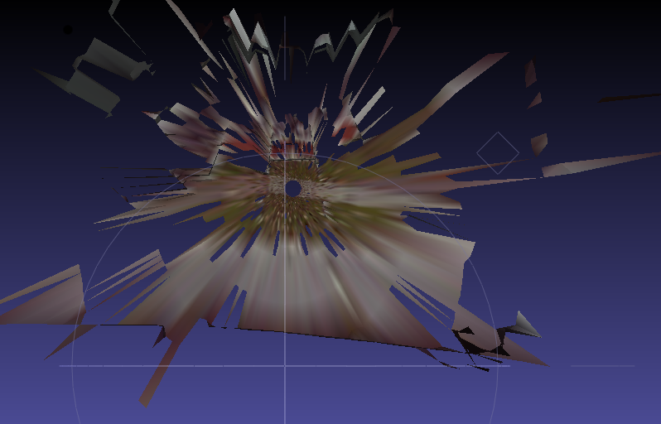
cloud of points - an input for the surface
reconstruction

Slide 14
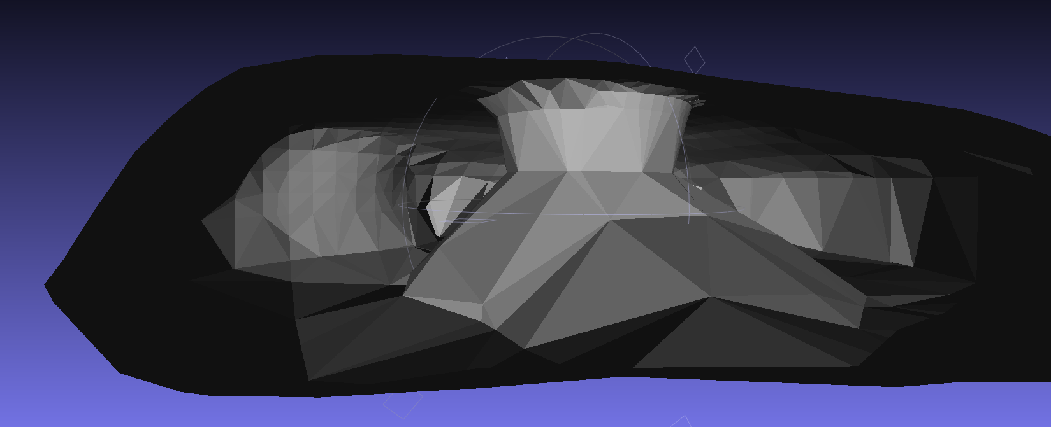
The output of surface reconstruction in Meslab when a command:
meshlabserver -i domica_10x10.ptxDomica001.ptx -o domica001.ply -s poisson.mlx
to perform a surface reconstruction.

Slide 15
Thinking where to go
We have identified two areas which could be interested for us:
Linguistic, applying methods used at studies of natural language to solve advanced information search tasks
Flexibility, re-programmability of systems, increase of the intelligence of computational systems by applying principles of AI

Slide 16
Conclusions
Knowledge of grid computing principles were very useful for my scientific work.
I got in hands a very powerful tool which speeded up data processing
New possibilities occurred for data analyses

Slide 17
Image processing (tracking position of many
microparticles in thin fluid layers)
Phys. Rev. E 70, 031504 (2004)
Phys. Rev. E 78, 061401 (2008)
Computer simulations of avalanche
phenomena
Phys. Rev. E 82, 061116 (2010)
Phys. Rev. E 73, 066125 (2006)

