Slide 1
Prominent ProdSys features
Very high load;
Changing structure;
Size too large to feasibly simulate;
Some simulation frameworks (SimGrid) may be of use to simulate (small) parts of ProdSys, but simulating it entirely is currently not feasible.

Slide 2
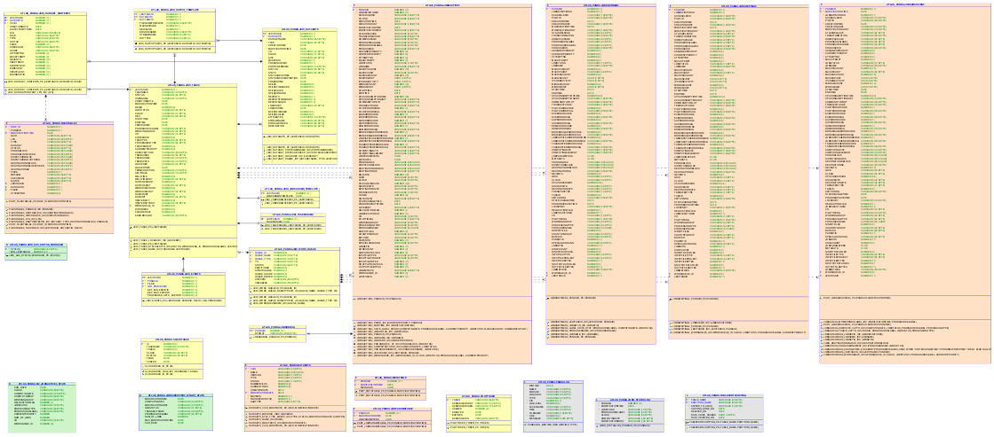
ProdSys logs Other sources
Oracle:
Production requests;
Dataset access logs;
Tasks;
Jobs.
Hadoop:
Tasks;
Jobs;
ElasticSearch:
Network Weather;
Jobs;
Current ProdSys state according to monitoring;
Date trends;
Physic conference schedules;
User input.

Slide 3
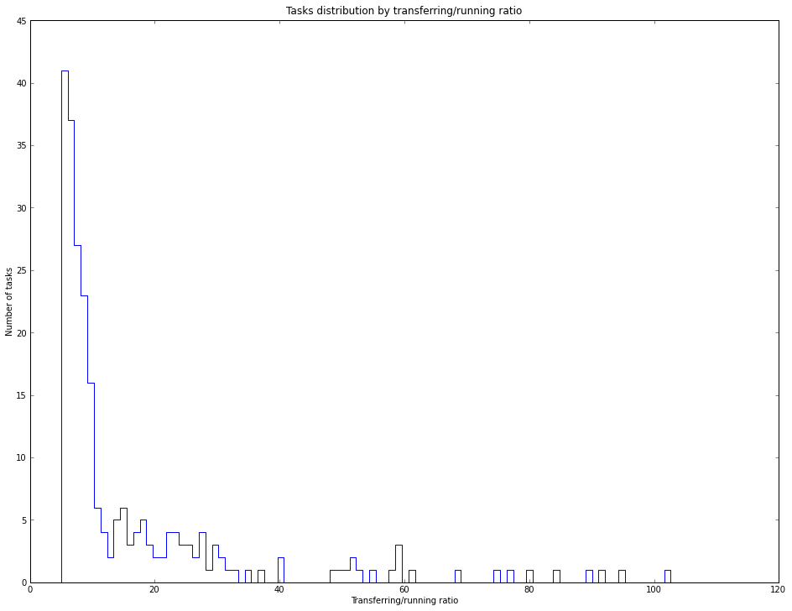
Anomaly detection proposal
ProdSys is too big to simulate directly;
ProdSys behavior is extensively logged;
ProdSys often exhibits anomalies:
Unusual task completion times;
Balancing issues;
Connectivity issues;
It should be possible to model ProdSys behavior using Machine Learning-based models in conjunction with ProdSys logs and external data sources.

Slide 4
First step: “cold” prediction
Based purely on ProdSys task execution logs;
Does not make use of external data sources or ProdSys load;
Based on historical averages.
Considers all tasks of the same category (Project+Type+step) to have same duration.
Implemented.

Slide 5
Using ML for “hot” prediction
“Hot” prediction will use current ProdSys state and external data sources as well as historical data;
Data for “hot” predictions can be viewed as input vectors for ML-based models;
There is enough historical data to teach ML models for prediction of ProdSys;
The data is very diverse; preliminary data analysis (strong predictor detection) is underway.
Predicting ProdSys using ML-based models taught using historical data seems feasible, if data is prepared and pre-selected beforehand.

