Slide 1
ARC101 Technical Meeting, Kosice 2016
Balázs Kónya, Lund University
NorduGrid Technical Coordinator

Slide 2
What is this thing called Advanced Resource Connector (ARC)?

Slide 3
”you might already recognize him .... that early ... memory”

Slide 4
”A master piece of kinetic energy, dynamics and mechanics, sprung from the hands of engineering wizzards of a bygone era
A master piece
job management via gridftp and WS-EMIES
ARC SDK
integrated inteligent data staging
dynamic LDAP-based information system
engineering wizzards
NorduGrid binarians, coders
a bygone era:
batch processing via job description
X509 certificates
pull-mode information discovery

Slide 5
”forged ... in different sources”
ARC is open source
distributed under Apache licence
Modular source, e.g. the latest release 15.03u7 consists of:
NorduGrid ARC, version 5.1.1 (main components)
NorduGrid ARC Documents v. 2.0.7
metapackages for client tools, computing element and information index, version 1.0.7
Nagios probes for ARC CE, v. 1.8.4
common authentication library caNl++, version 1.1.0
gangliaarc, v. 1.0.0

Slide 6
”Equipped with both an inside and an outside”
The ”inside” of the ARC CE:
abstraction layer on top of cluster
Batch system (LRMS) interaction
Resource information collection
Job environment preparation
data provisioning for the job
global – local unix user mapping
Minimal intrusion on the nodes
Accounting data collection
„controldir, sessiondir”
The art of interior design:find the right ballance of hiding details and managing heterogeneity

Slide 7
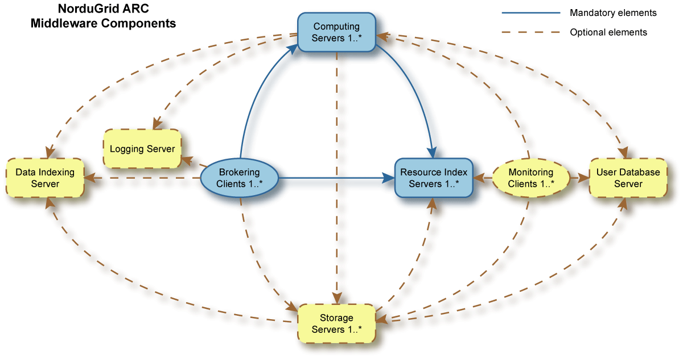
”Equipped with both an inside and an outside”
The ”outside” of the ARC middleware
Exposed external interfaces (of ARC CE):
job management, job desciption, information discovery, data channels, secure connections
Underlying technologies: WS-SOAP, LDAP, gridftp, X509
A pioneer in standardization
APIs, CLIs and GUIs:
SDK: C++, Python, JAVA
Arc* command line client tools
GUI attempts

Slide 8
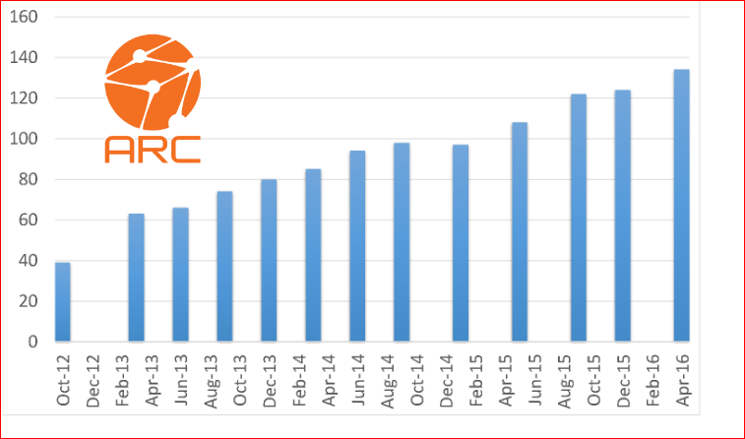
”Equipped with both an inside and an outside”
The ”outside” of the ARC middleware
Integration with the EGI infrastructures:
Accounting: JURA, SGAS, APEL
Information: BDII, GOCDB
Monitoring: Nagios
USER mngmt: VOMS, ARGUS,..
ARC is fully compatible with EGI operations!
Integration with High Energy Physics production frameworks:
”Nordic Cloud”, ARC Control Tower for ATLAS
Condor-based solution for CMS

Slide 9
“Spinsie winsies on both sides … and four door handles”
Core functionality:
An enabling technology within distributed computing that
Provides computing cycles and related data access mechanisms
via special authentication (X509) and authorization layer (VOMS ACCs)
With other words:
You can execute a batch of computational tasks remotely on a cluster ☺
ARC is mostly a Computing Element
WARNING: things do get broken!

Slide 10
”Pop that pony’s face: a real ladies magnet”
Shared file system
Head Node
Session
directory
Control directory
CA certificates
Cache
infoproviders
DTR
SLURM controller
A-REX
gridftp/http
Runtime env.
ARIS
JURA
users
registration process
user mapping
Worker Node
Legend (ARC components in orange):
SLURM daemon
files
Worker Node
processes
SLURM daemon

Slide 11
”... and hepatitis b”
Security aspects:
Job payload is ”well isolated”
User separation, pool accounts
Fine-grained access control
Both external and local authorization points supported
ARGUS, VOMS interoperability
Most of the services do not require root priviliges
Though some functionality loss may occur
X509 framework, openssl
“Several ARC services relying on openssl (A-REX with both GridFTP and WS interfaces, ACIX) are affected by the Heartbleed vulnearibility

Slide 12
”A recipe holder”
ARC comes with extensive documentation, e.g.:
Server side:
ARC Computing Element System Administrator Guide, NORDUGRID-MANUAL-20
arc.conf.reference
Client side:
The libarcclient - A Client Library for ARC, NORDUGRID-TECH-20
ARC Clients User Manual, NORDUGRID-MANUAL-13
See also the Nordugrid wiki full of recipes

Slide 13
”Hmmmmm ART”
Editing configuration file
Mostly authorization part
Interpreting error messages
Mostly on the client side

Slide 14
Prepared for big data
The ARC CE comes with advanced integrated data features
Data Cache with ACIX cache index
DTR supports all major storages systems and protocols:
Dcache, StoRM, DPM, so on
Gridftp, SRM, https, webdaw
Handles data download and/or data stage out
User specifies where to store results and the CE automagically uploads the data

Slide 15
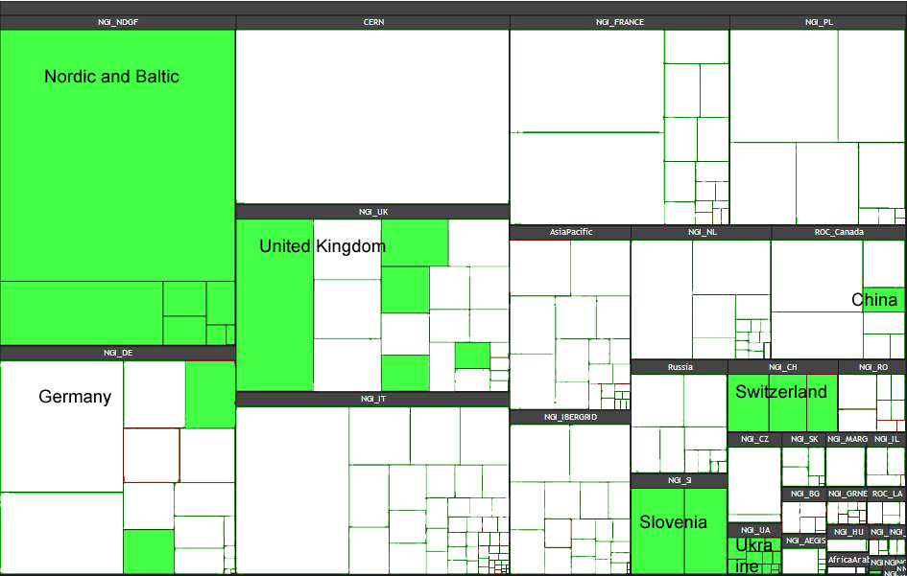
”340 000 circular bends”
Heavy usage by ”big science”: WLCG monitoring board:
Missing out on the ”long tail scientists”

Slide 16
ARC is there and looking forward to the 21st century...

Slide 17
Final remark
The video is a masterpiece from Castor,
„some sort of mgfx artist / creative in Malmö” (theworkofcastor.com),
who tried to sell his car this way on blocket.

Slide 19
a scandinavian CAR
Take a drive with the ARC ............................... CAR!

