Slide 1

NorduGrid 2016
The way forward in distributed computing: evolution or revolution?
https://indico.lucas.lu.se/conferenceDisplay.py?confId=279
F. Ould-Saada, Kosice, Slovakia, 2 June 2016
The NorduGrid Collaboration http://www.nordugrid.org/about.html

Slide 2

Data Intensive Science with ARC on HTC, HPC and more
http://indico.hep.lu.se//conferenceDisplay.py?confId=1578
F. Ould-Saada, Bern, CH, 2-5 June 2015
The NorduGrid Collaboration http://www.nordugrid.org/about.html

Slide 3
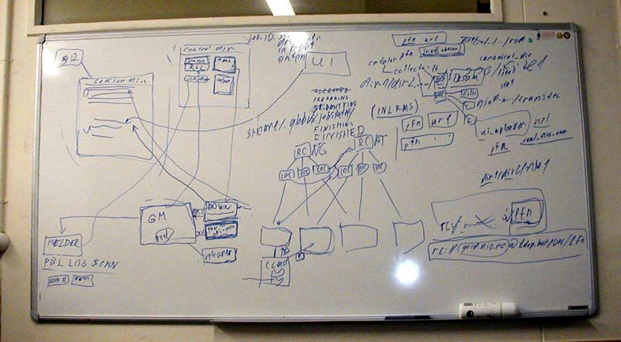
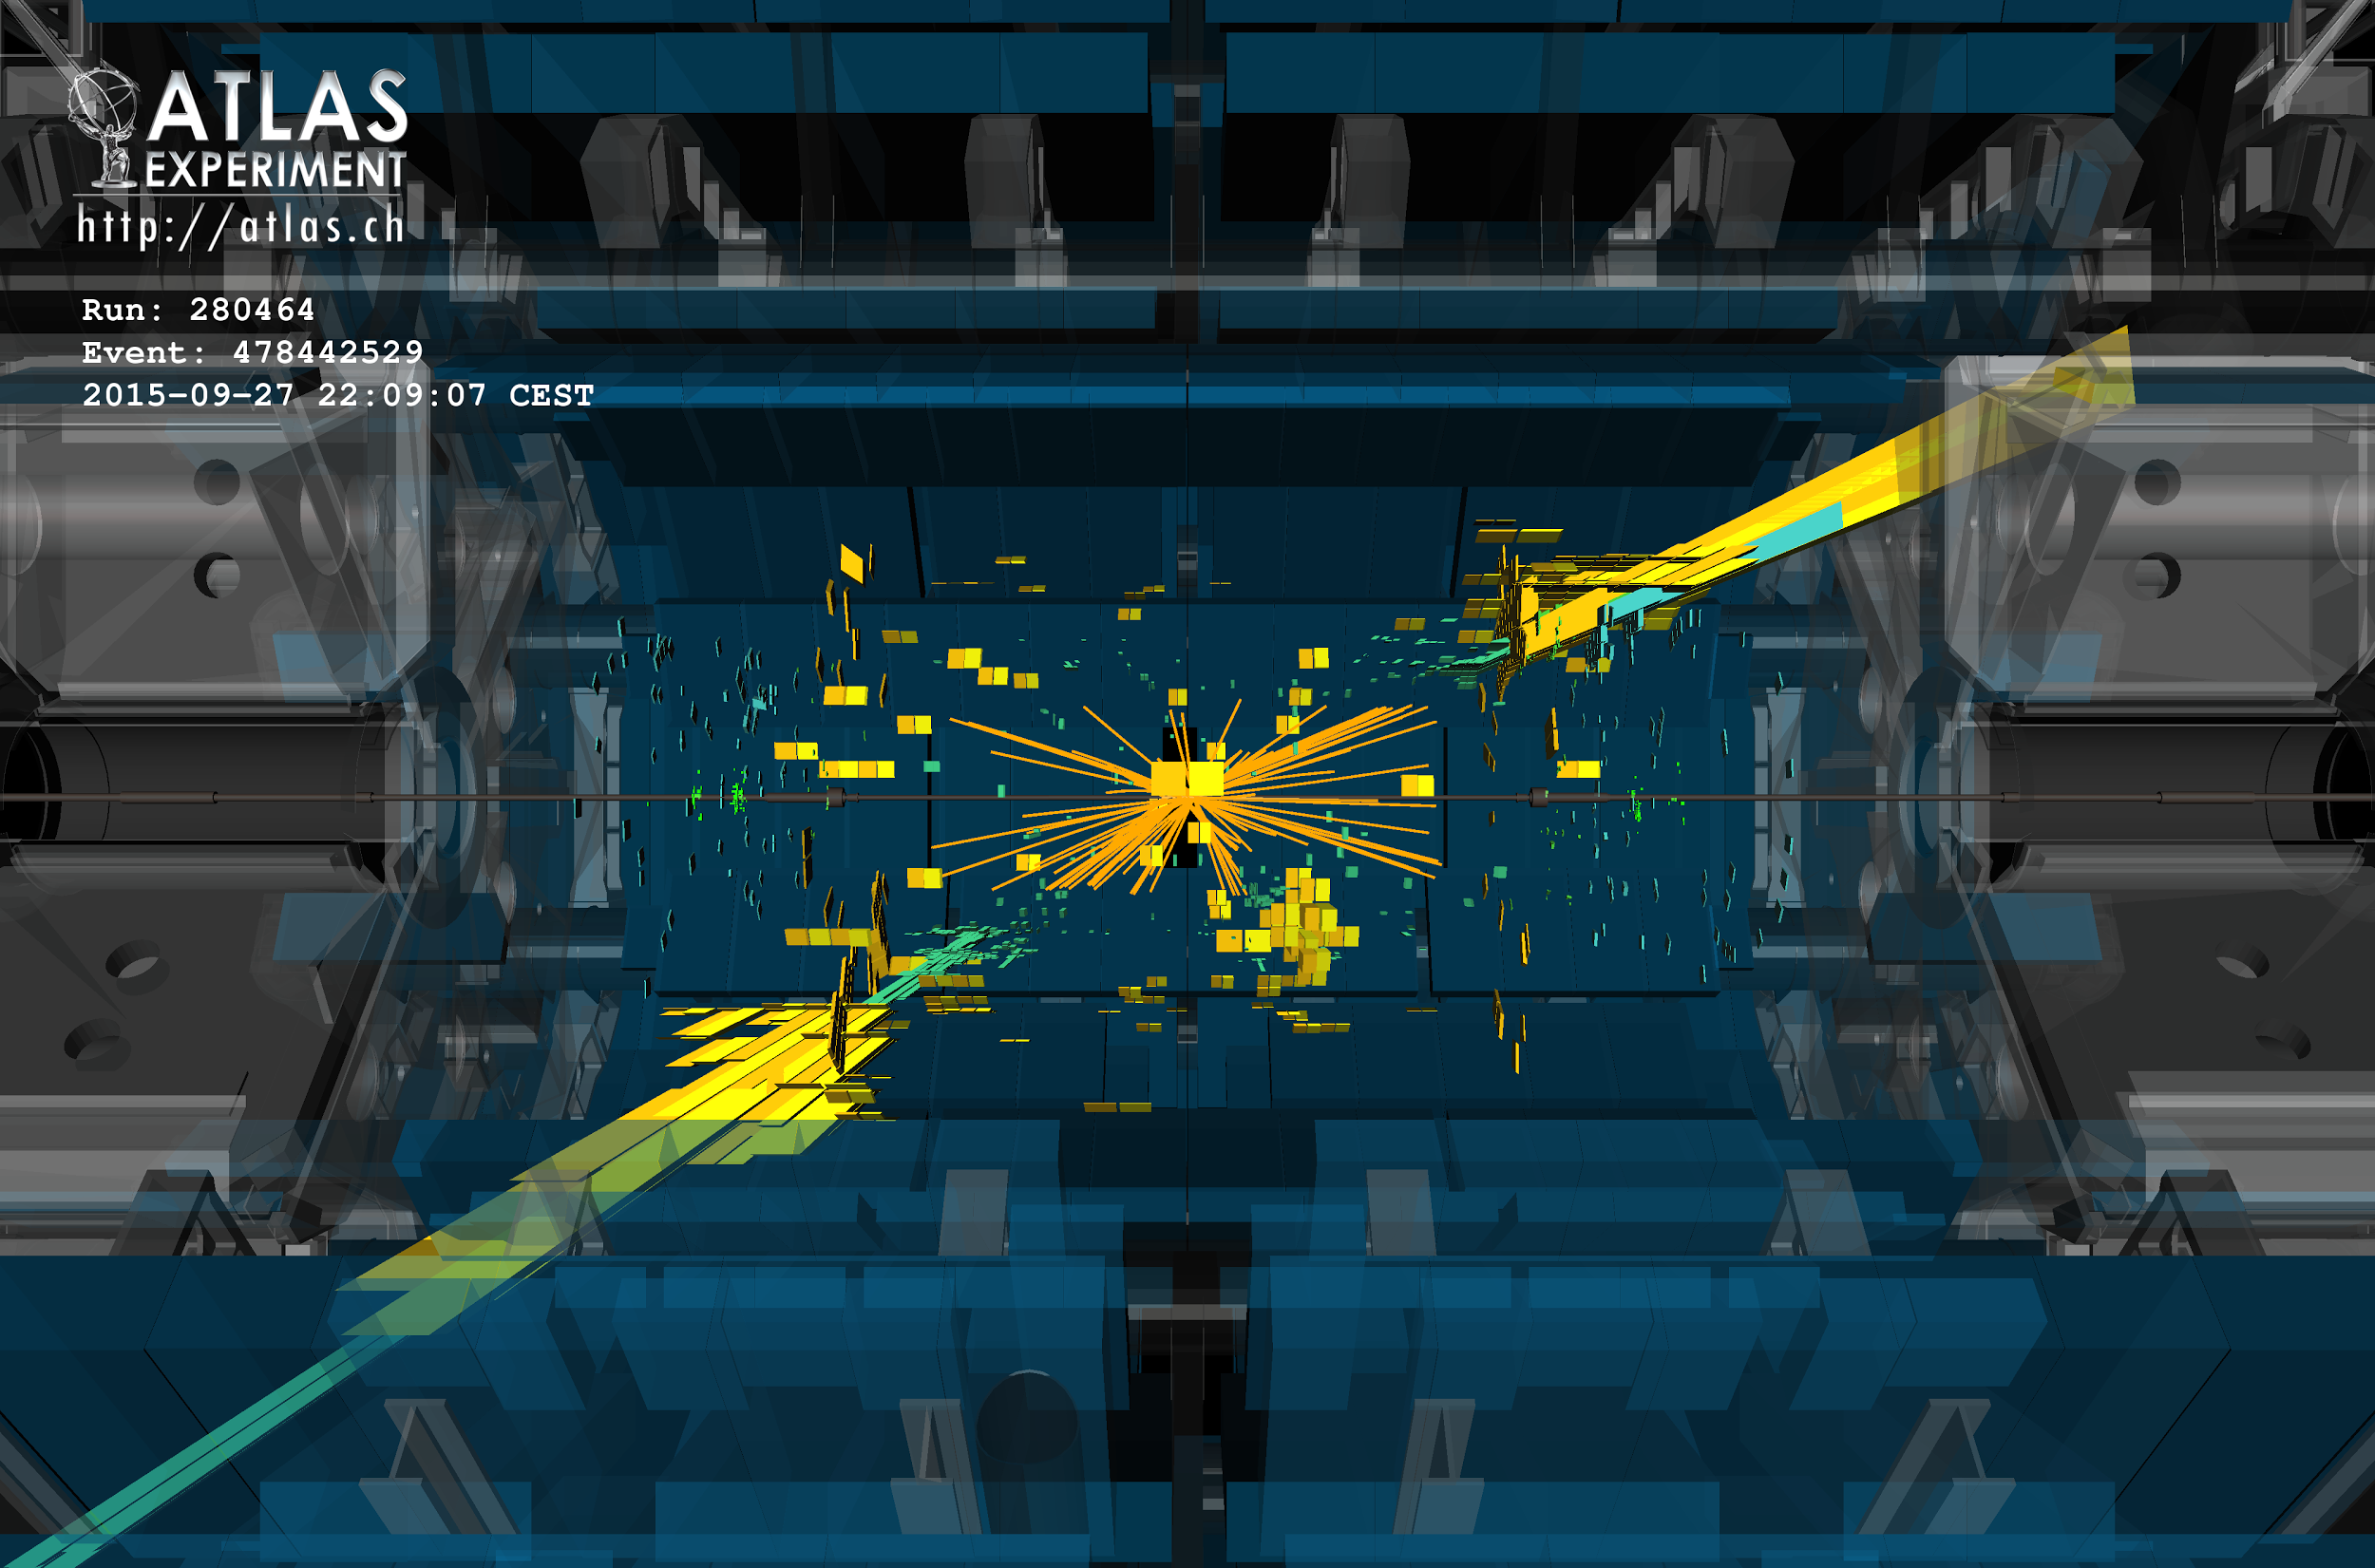
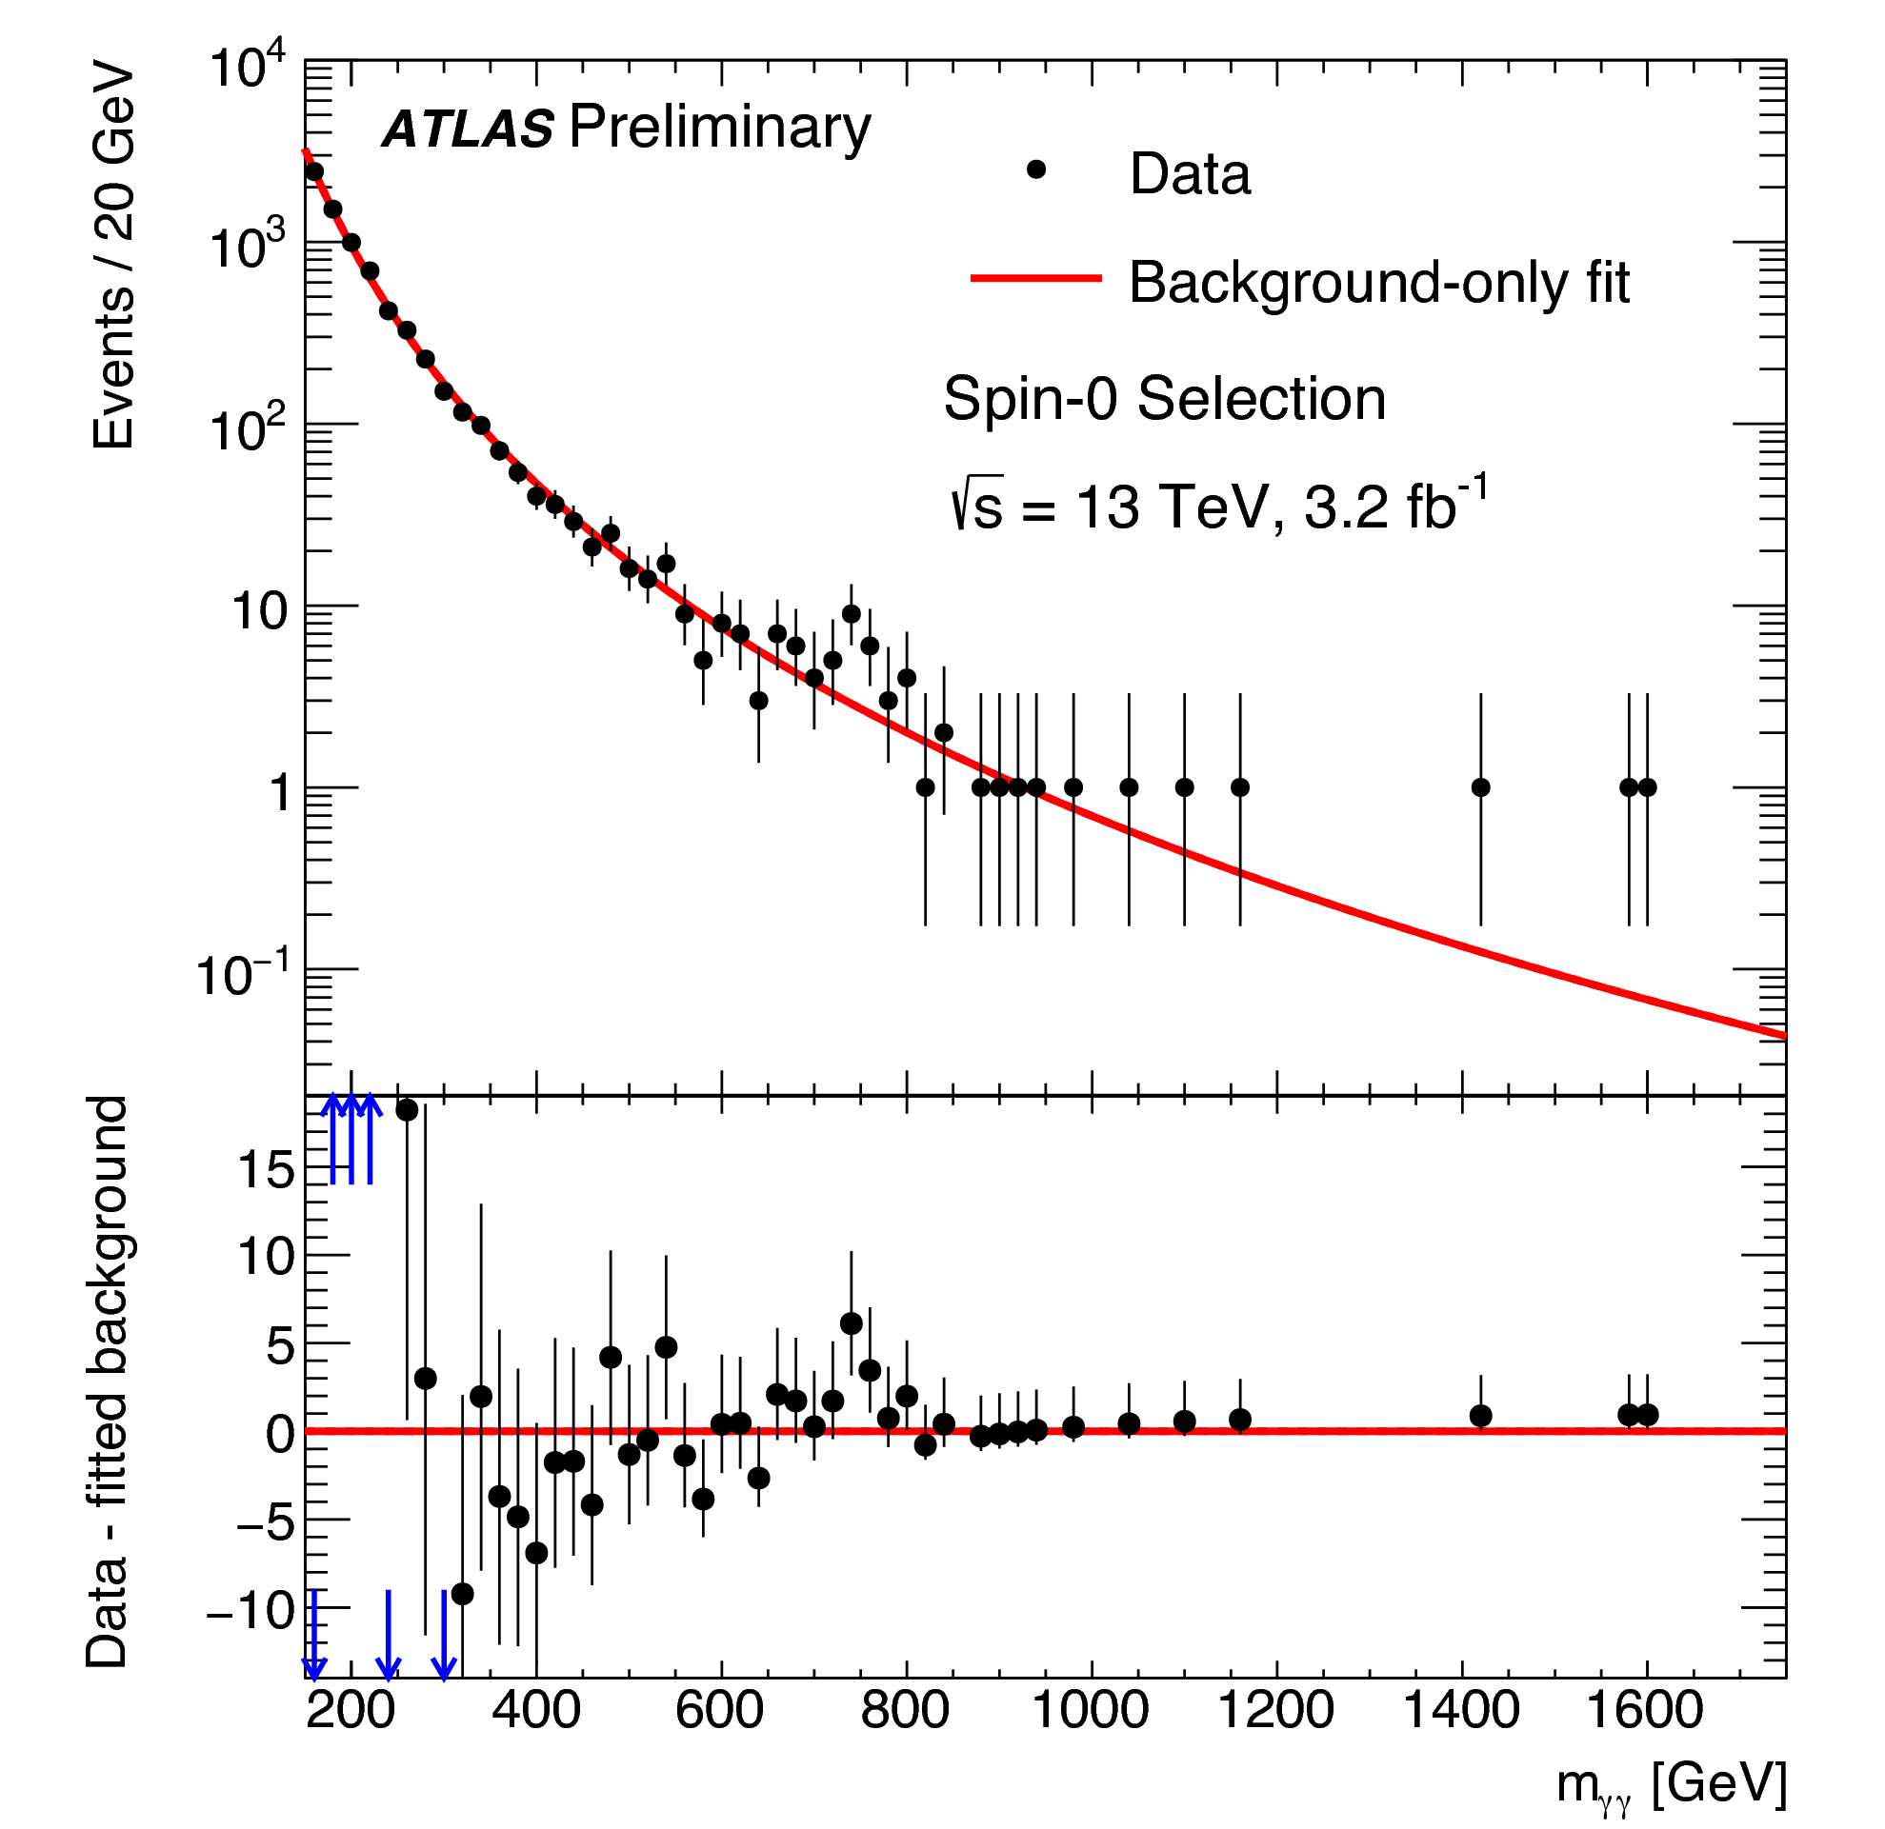
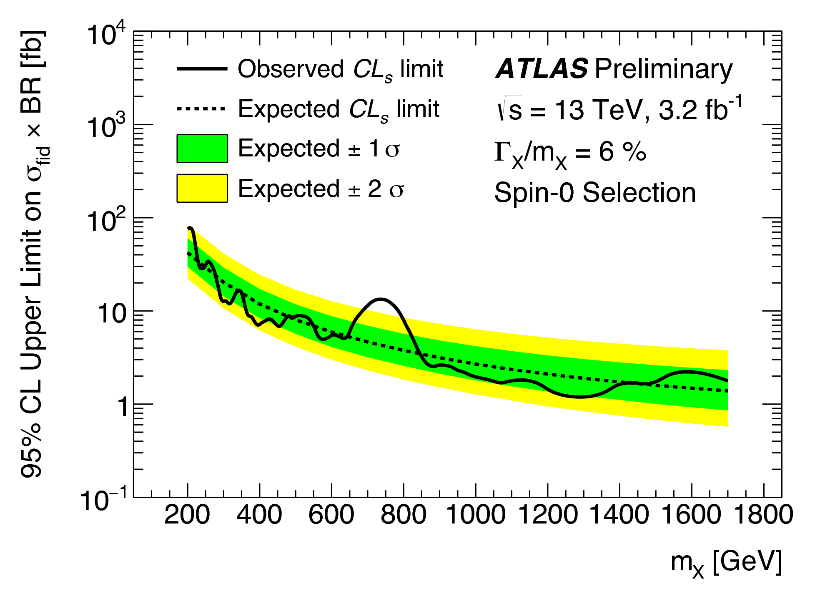
ARC Achievements and Highlights
2001- 2002
  “Transverse momentum distribution” of pre-LHC data simulated on HPC resources
2012 - 2013
  Higgs discovery, Nobel prize
2015 - …
  13 TeV collisions
  Theoretical tsunami

Slide 4
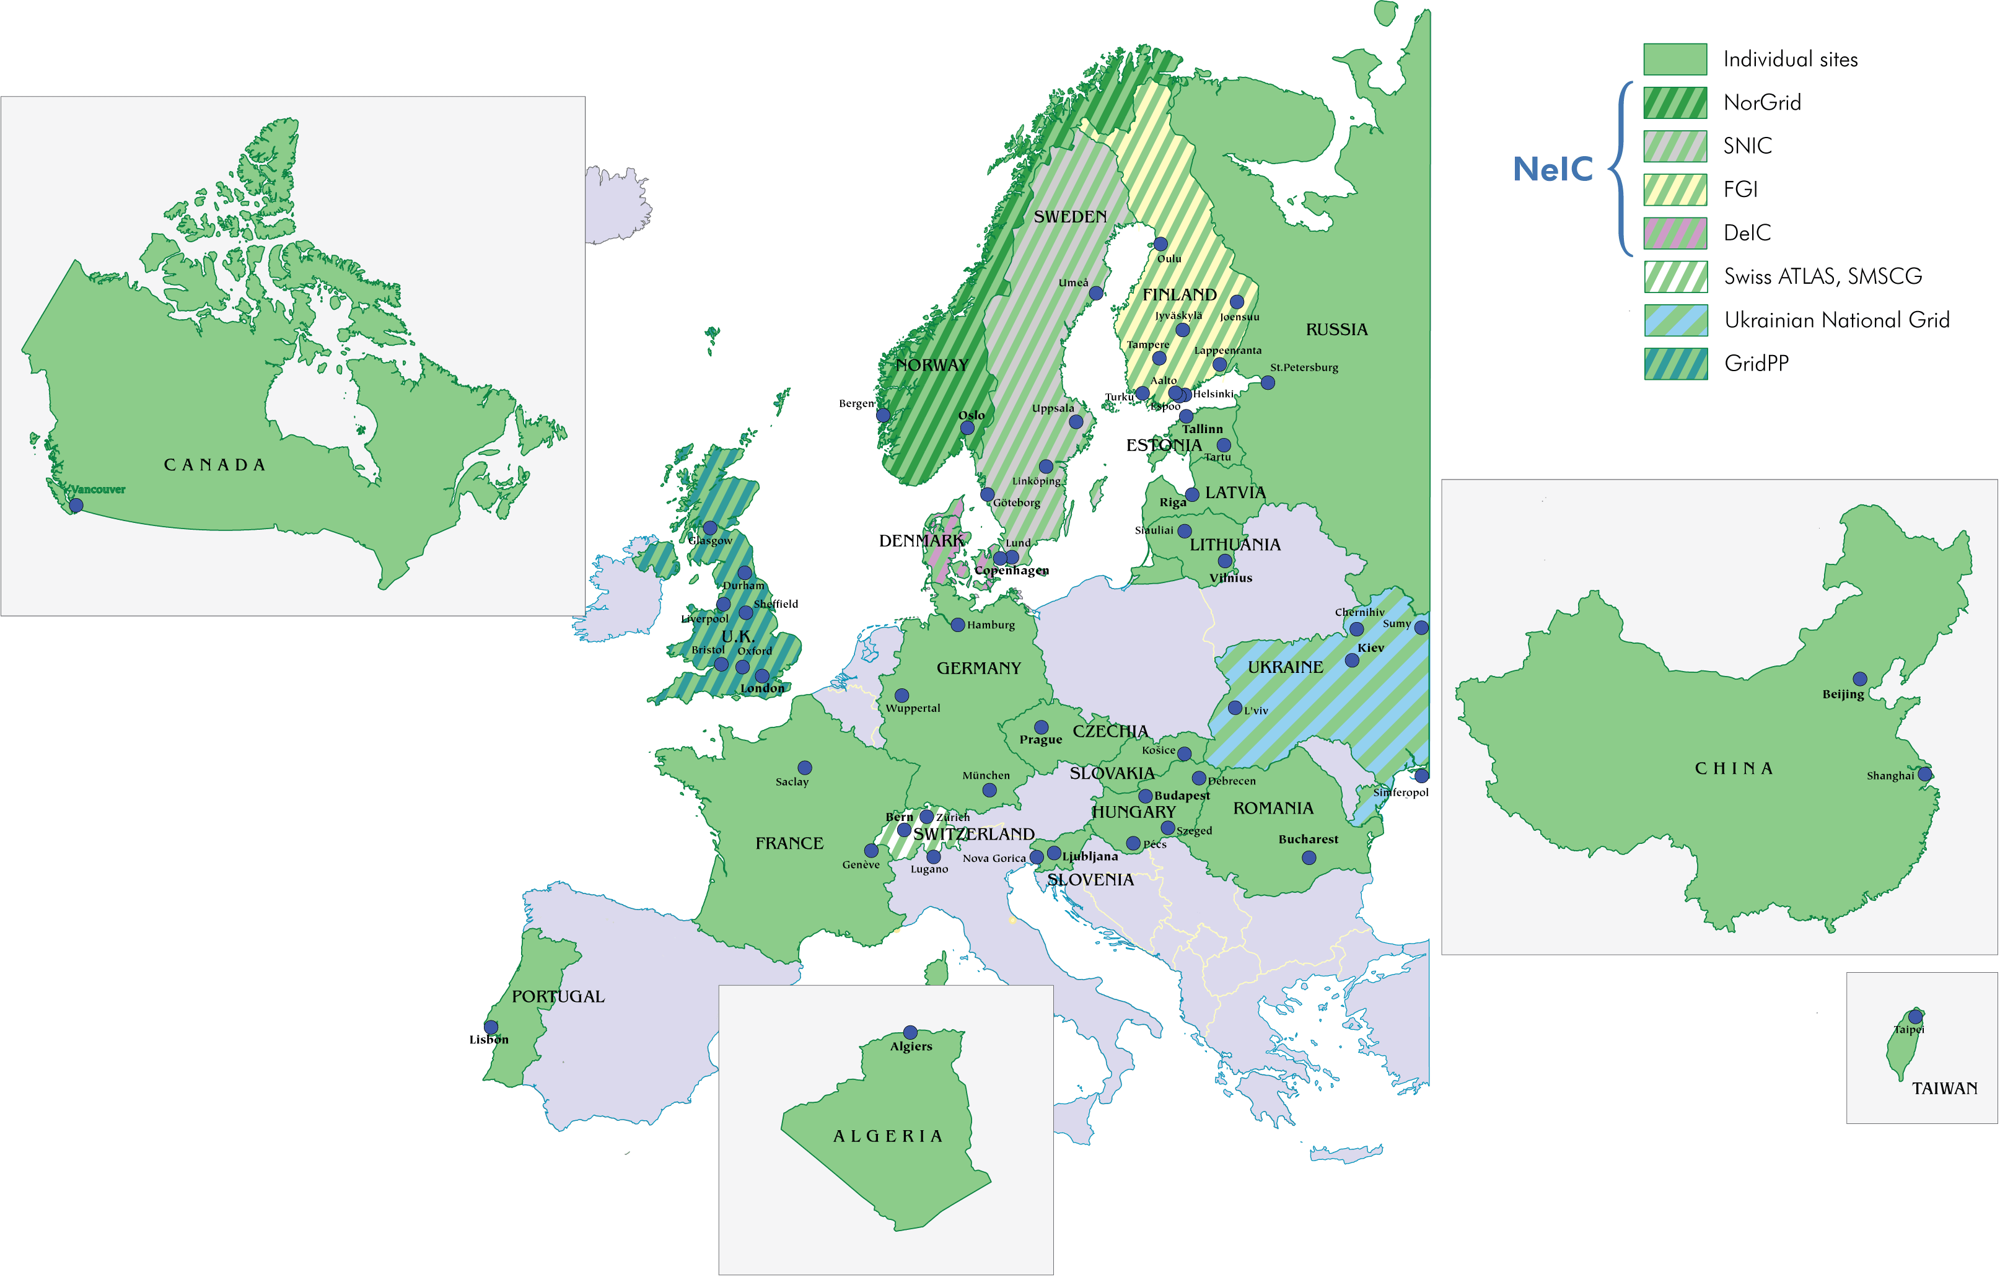
ARC deployment map

Slide 5
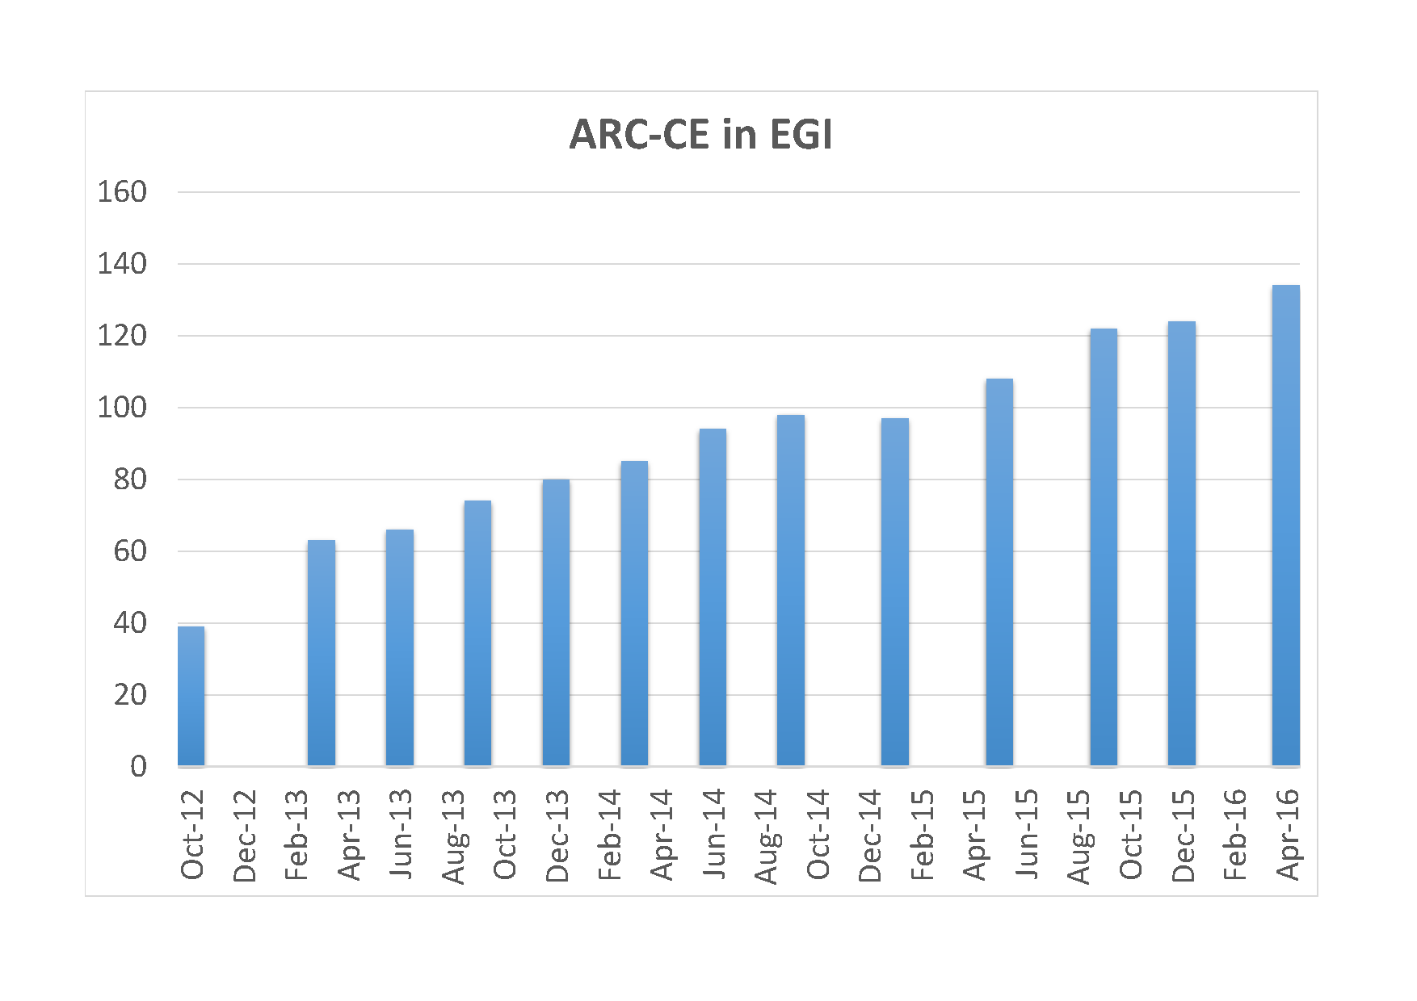
ARC CE in EGI
Trend continues…
  # ARC CE services in EGI database – GOCDB

Slide 6
ARC and Volunteer resources
ATLAS@home
ARC and ARC Control Tower (aCT) as gateway between ATLAS job management system and BOINC – software used to distribute jobs to volunteers

Slide 7
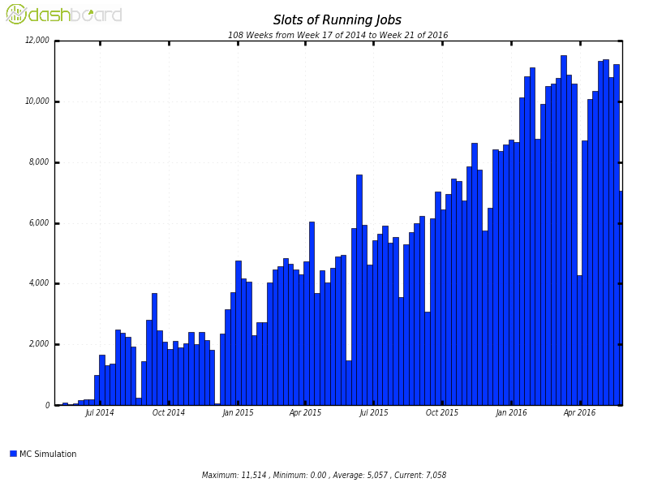
ATLAS@home
Steady increase in the last 2 years
now produces 2.5% of all ATLAS simulation events
Equivalent to a large Tier-2 centre
100k volunteers signed up and around 3000 active at any given time
What about “somethingelse”@home

Slide 8
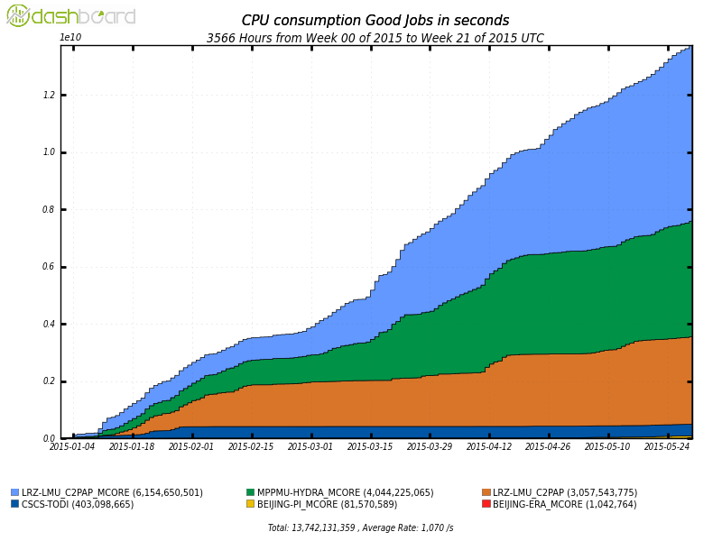
ARC back to HPCs
LRZ-LMU-C2PAP MC, DE
MPPMU-HYDRA MC, DE
LRZ-LMU-C2PAP MC, DE
CSCS-TODI, CH
BEIJING-PI, Shanghai China
BEIJING-ERA, Chinese HPC “grid”

Slide 9
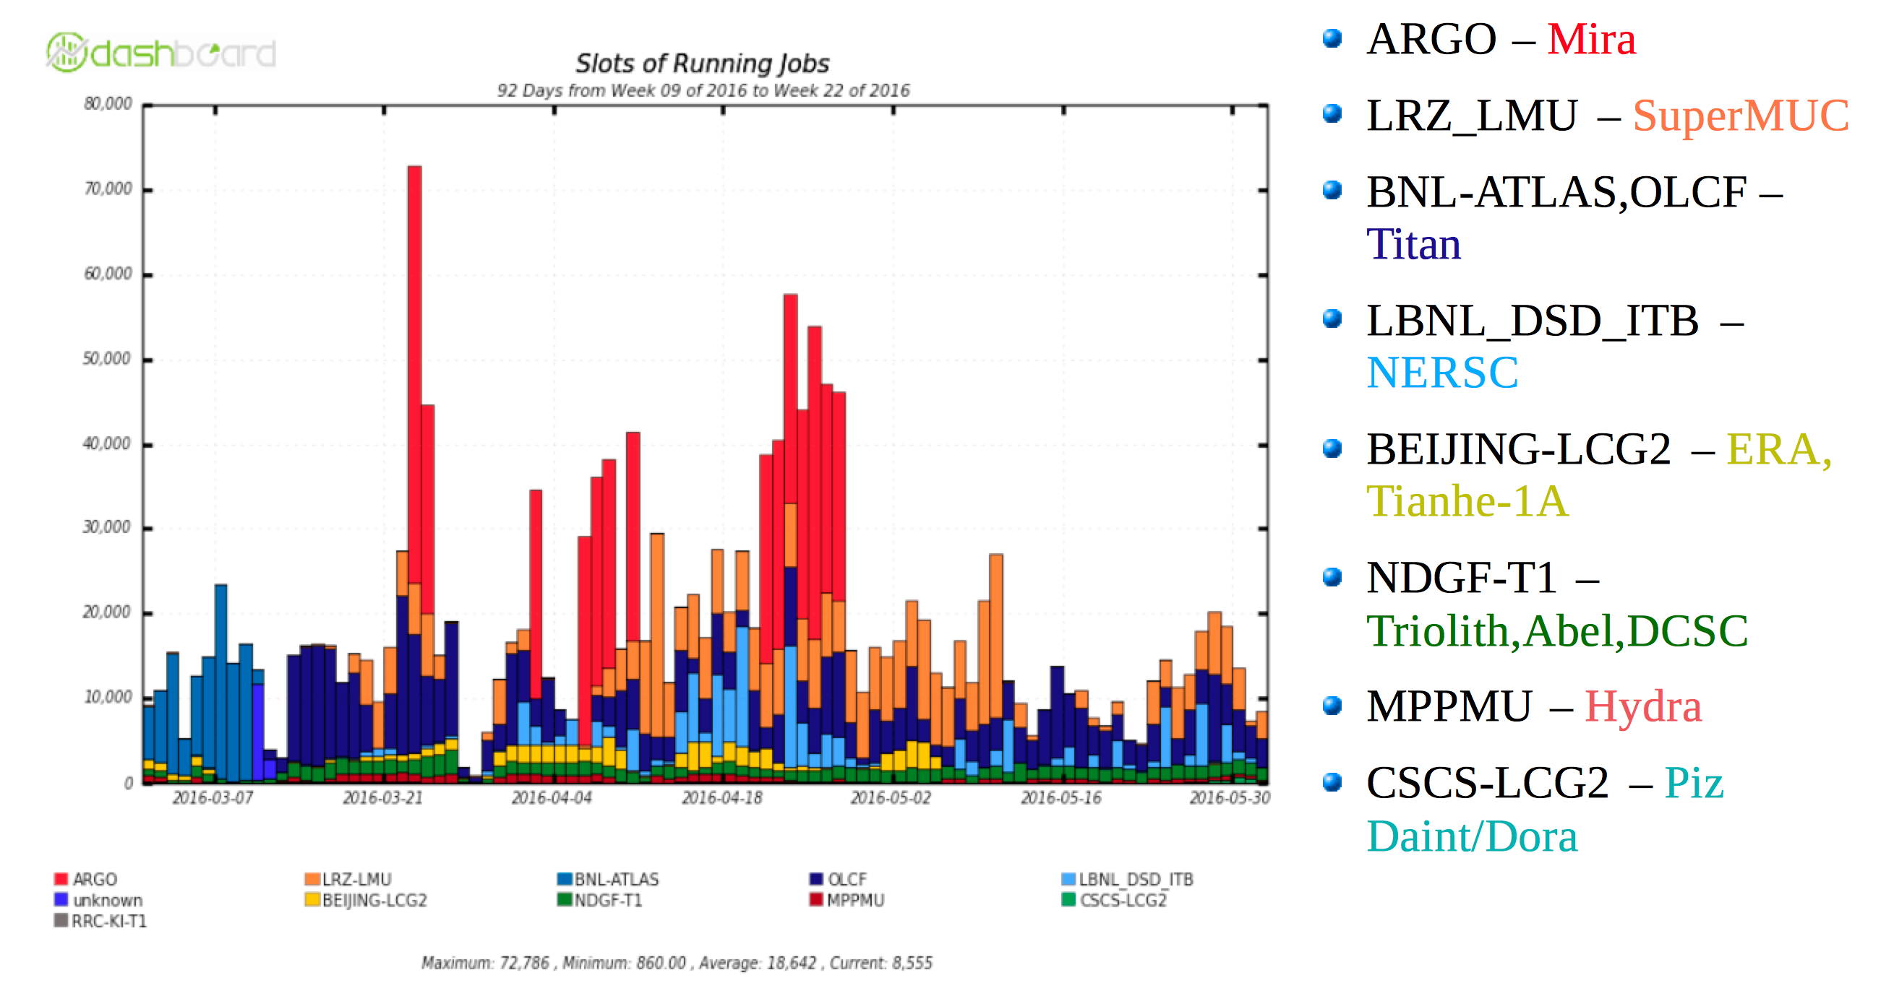
ATLAS HPC resources in production

Slide 10
ARC Control Tower
ARC Control Tower – aCT
Now serving ~20% of all ATLAS jobs
  Soon also cloud resources

Slide 11

ARC, HTCondor, Google, and all that
an opportunity for novice and experienced users to learn, get help and exchange experience with ARC and HTCondor and developers and experts
Workshop consists of presentations, tutorials and "office hours" for consultancy.
  https://indico.cern.ch/event/467075/
More to come

Slide 12
ARC4eInfrastructures – NordForsk sustaining ARC
NorduGrid’s maintenance of the Advanced Resource Connector (ARC) software over a period of three (3) years.
  2015-2017
  Renewable?
Overall goal
  Provide sustainable support for the ARC technology platform that enables NeIC infrastructure and thus provides a gateway to international e-infrastructures

Slide 13

We tried (and must try) to exercise
A proposal submitted to Horizon 2020 – Future Emerging Technologies
  Extreme Resource Connector for Data Intensive Science at Exascale
  Failed … for lack of IMPACT (only physics)!
A proposal submitted to the Norwegian Research Council
  ARChestrate – Advanced Resource Connector for Secure Data-Services Everywhere
  With huge IMPACT & beyond physics
  Failed for lack of enough planned research publications
Collaborations: with Tomsk, … based on R&D
  With enough impact? Beyond physics?

Slide 14
Example of new collaboration outcome
The next generation of front-end technology and data handling software for compute-intensive science and exascale data processing
  Lightweight sites – LARC
  Data delivery service and caching
  Evolving storage technologies
  Machine learning and deep learning technologies for (cached) data popularity prediction and anomaly detection

Slide 15
Continue
Connecting Resources to help Science Advance!

Slide 16
Conference program 2016
May 31- June 1 : Technical workshop
June 1 : Collaboration Board meeting
June 2-3 : Conference
The way forward in distributed computing: evolution or revolution?"
  addresses the challenge faced by many scientific communities: how to survive the data tsunami in the shade of the clouds?
Cover different aspects and directions of future distributed computing systems:
  Virtualised infrastructures for data and computng
  Cluster resource management
  Exploiting supercomputers and distributed infrastructures
  New approaches to networked computing

Slide 17
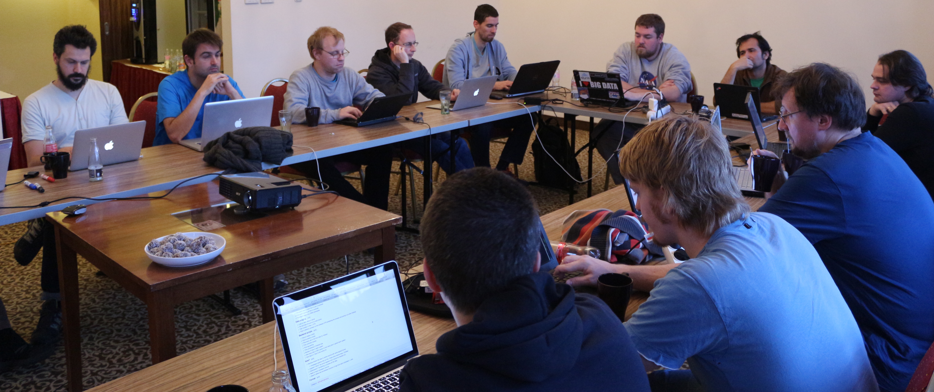
Time again to take part in R&D Challenges
From / in addition to succesful ARC coding camps
  Time for brainstorming camps to meet the future

